Slide 1
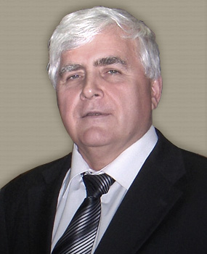
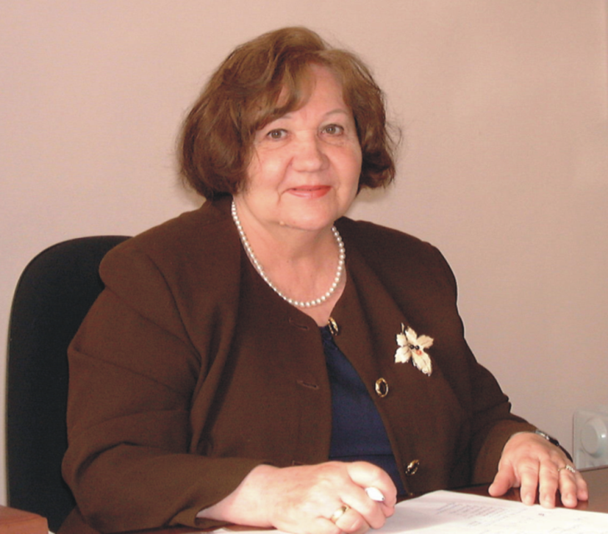
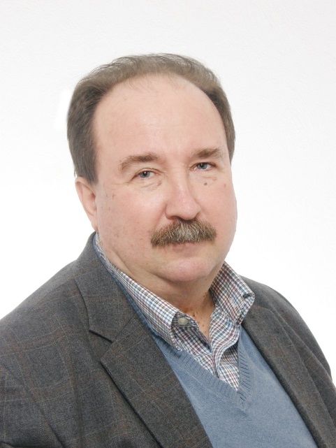
CARRYING ON MEZHANOV'S TRADITIONS: NEW ACHIEVEMENTS ON SHS IN ISMAN
M.I.Alymov, I.P.Borovinskaya, A.S. Rogachev

Slide 2
Plan of the lecture
Development of combustion science
Macroscopic theory and experiments
Microscopic models
Macro- micro- and nano-structured SHS systems
Product structure formation and design
Applications and commercialization

Slide 3
Tradition #1: Don’t miss theory
Theory
Experiment
Trial-and-error
http://z-walls.ru/oboi/siluet_alpinist_chelovek_gory_sneg

Slide 4
SHS and Combustion Theory
“Up to now, structure-macro-kinetic theory of SHS that consider the combustion process together with structure-formation … has not been created”
“Possibility for development of generalized theory of flame propagation in heterogeneous media, that is important not only for SHS, has appeared”
(A.G.Merzhanov, I.P.Borovinskaya, “Concept of SHS development”, Chernogolovka, 2003)

Slide 5
New phenomena in filtration combustion
Reaction spots and fingering (Ti – Air)
Laboratory of Prof. Petr M.Krishenik
Kostin, S.V., Krishenik, P.M., and Shkadinsky, K.G.,Experimental study of the heterogeneous filtration combustion mode, Combust. Explos. Shock Waves, 2012, vol. 48, no. 1, pp. 1–9.
Kostin, S.V. and Krishenik, P.M., Unsteady infiltration mediated combustion in conditions of regulated quasiisobaric flow of gaseous reagent, Int. J. Self. Propag. HighTemp. Synth., 2013, vol. 22, no. 2, pp. 88–92.

Slide 6
New phenomena in filtration combustion
Computer modeling
Laboratory of Prof. Petr M.Krishenik
Ozerkovskaya, N.I., Firsov, A.N., and Shkadinsky, K.G., Emergence of spatial structures during filtration combustion, Combust. Explos. Shock Waves, 2010, vol. 46, no. 5, pp. 515–522.
Kostin, S.V., Krishenik, P.M., Ozerkovskaya, N.I., Firsov, A.N., and Shkadinsky, K.G., Cellular filtration combustion of porous layers, Combust.Explos. Shock Waves, 2012, vol. 48, no. 1, pp. 1–9.

Slide 7
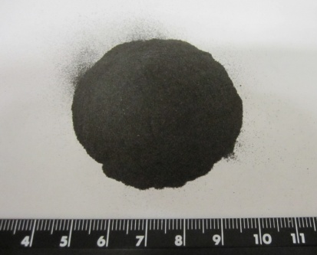
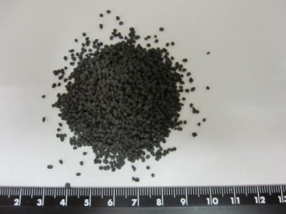
Combustion of powder and granulated Ti+0.5C
Laboratory of Dr. Boris S. Seplyarskii
3 mm/s
9 mm/s

Slide 8
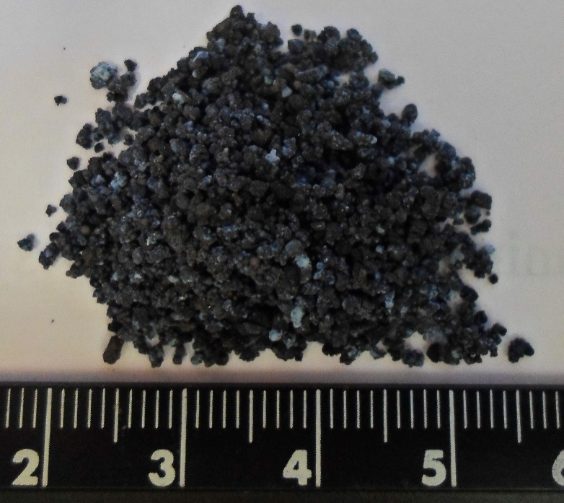
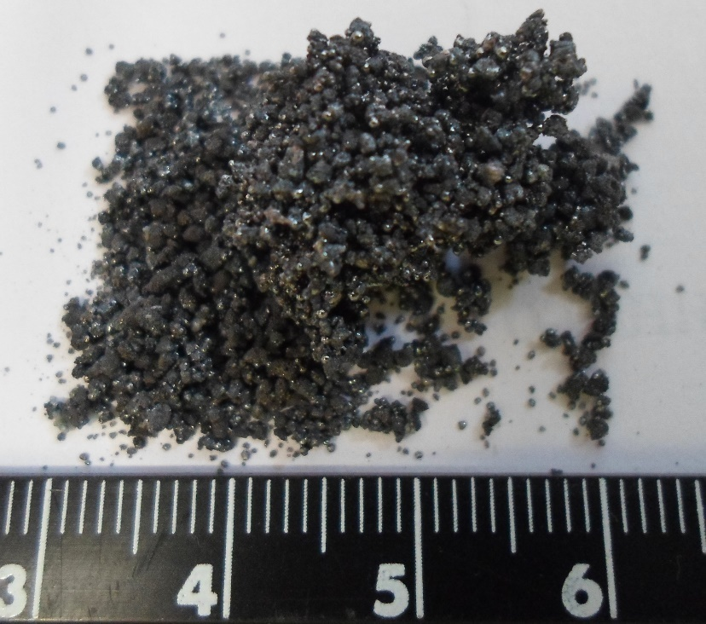
Combustion of granulated Ti+0,5C: yield
Laboratory of Dr. Boris S. Seplyarskii
New SHS products
New SHS products
Contribution to combustion science
Combustion in Ar: carbide
Combustion in N₂: carbonitride

Slide 9
High speed Macro- and Micro- video: influence of the medium microstructure
Ni+Al Mechanically structured System
Ti+B System

Slide 10
Dynamics of the local combustion front movement

Slide 11
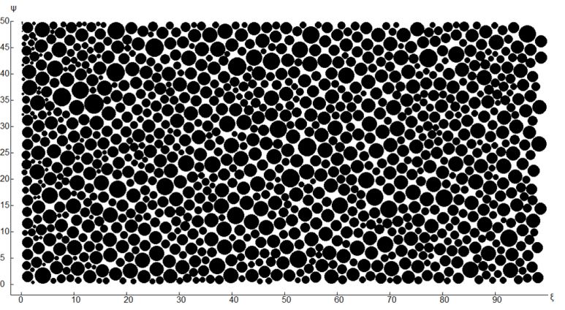
2D model of the microheterogeneous combustion and experimental verification
Laboratory of Prof. Petr M.Krishenik
P.M.Krishenik, K.G.Shkadinskii, S.A.Rogachev, 2013

Slide 12
mutual contributions of shs and combustion science (made recently)
New regimes of combustion wave propagation, fingering
Microstructure and particles contacts as governing parameters for propagating velocity, discrete model of combustion
Correlations between combustion mechanisms and microstructure of solid products

Slide 13
Merzhavov’s traditions
Tradition #2: Develop new methods of experimental diagnostics
Tradition #3: Study structure formation processes
Tradition #4: Create new materials and structures
Tradition #5: Cover the whole way from fundamental idea to applications

Slide 14
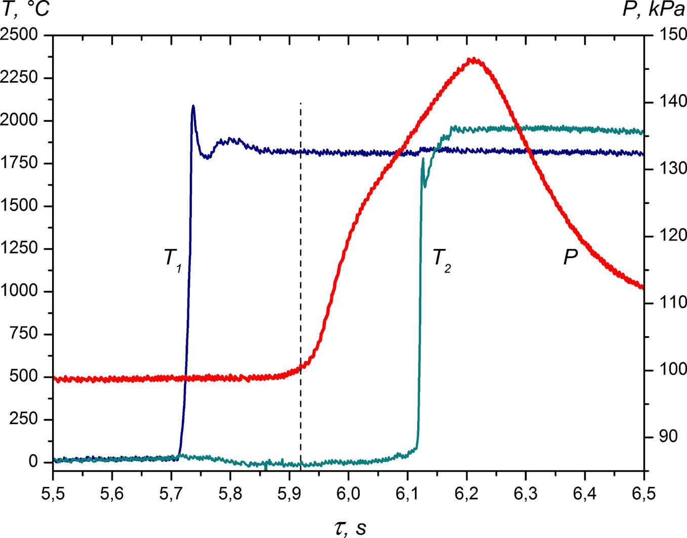
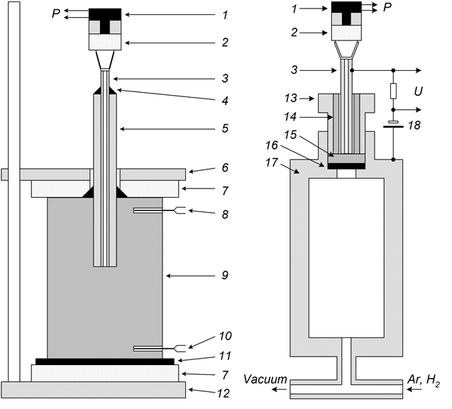
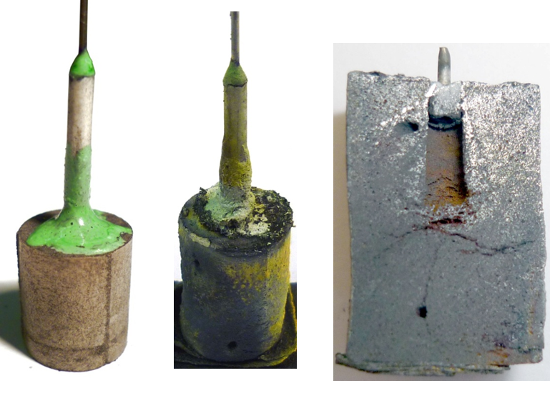
Probing local gas pressure during SHS
Dr. Sergey G. Vadchenko, Alexander S. Schukin
Ti-C system

Slide 15
Voltage generated by shs under pressure
Prof. Vladimir A. Scherbakov, Dr. Valeryi N. Barinov
P
(1) Ti + B sample, (2) WR5/20 thermocouples,
(3) igniting tablet, (4) igniting coil, (5) punch,
(6) heat insulator (sand), (7) mold,
(8) amplifier, (9) AD converter, and (10) PC.
Electromotive force (EMF) curves recorded during combustion of Ti-B mixture with ratio B/Ti = 0,75

Slide 16
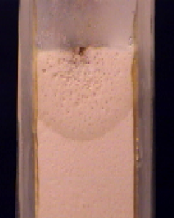
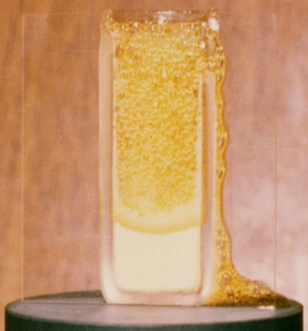
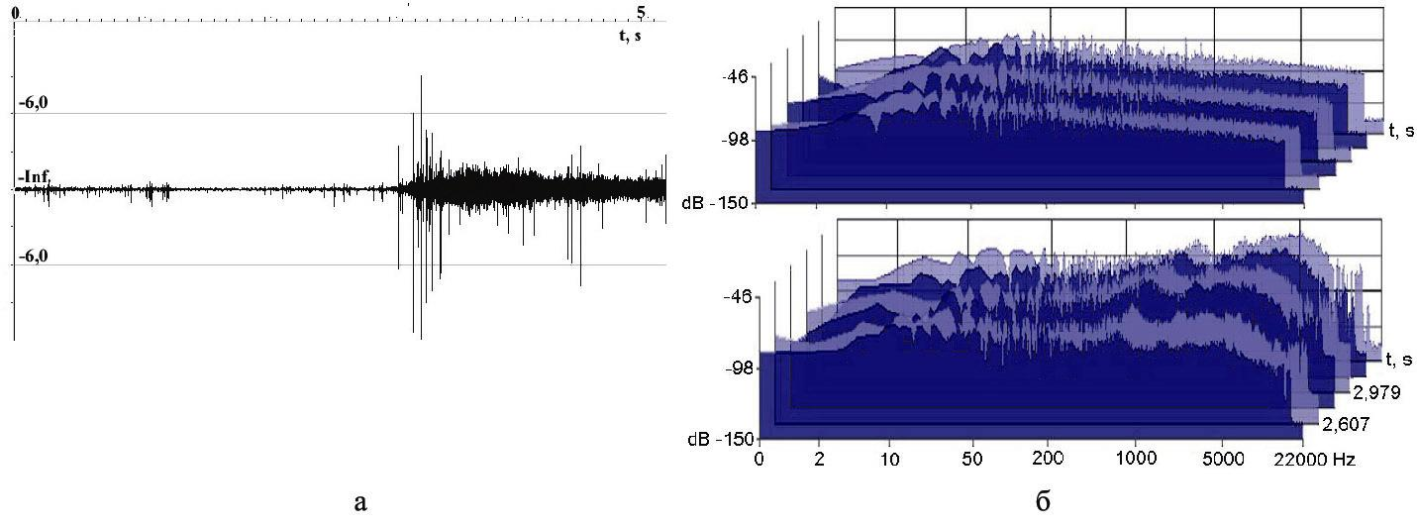
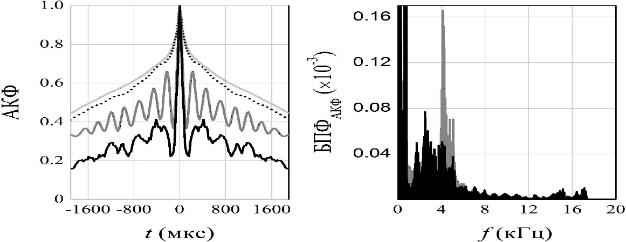
ACOUSTIC DIAGNOSTICS OF ORGANIC SHS
C₄H₁₀N₂ + R(COOH)_{2n} → C₄H₁₀N₂ · R(COOH)_{2n} + Q
Dr. Evgenii G. Klimchyk
acoustic emission
ACF
ACF
FS_{ACF}(x10⁻³)
f, (kHz)
t, (μs)
acoustic signal
autocorrelation function (ACF)
Fourier-spectra of ACF
spectrums

Slide 17
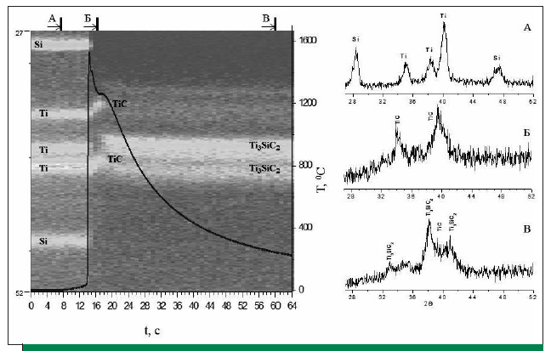
Hunting for MAX-phases: I
TR-XRD of combustion 3Ti−Si−2C mixture
Initial mixture
Ti₃SiC₂
Ti₃SiC₂
Product
Ti₃SiC₂
Laboratories of Dr. Alexander E. Sytschev and Dr. Dmitry Yu. Kovalev

Slide 18
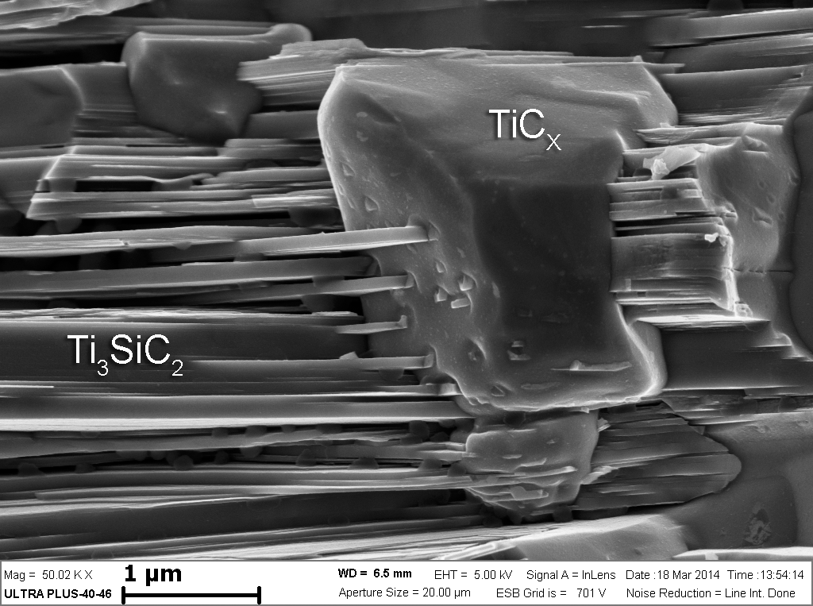
Hunting for MAX-phases: II
Laboratoriy of Dr. Alexander E. Sytschev

Slide 19
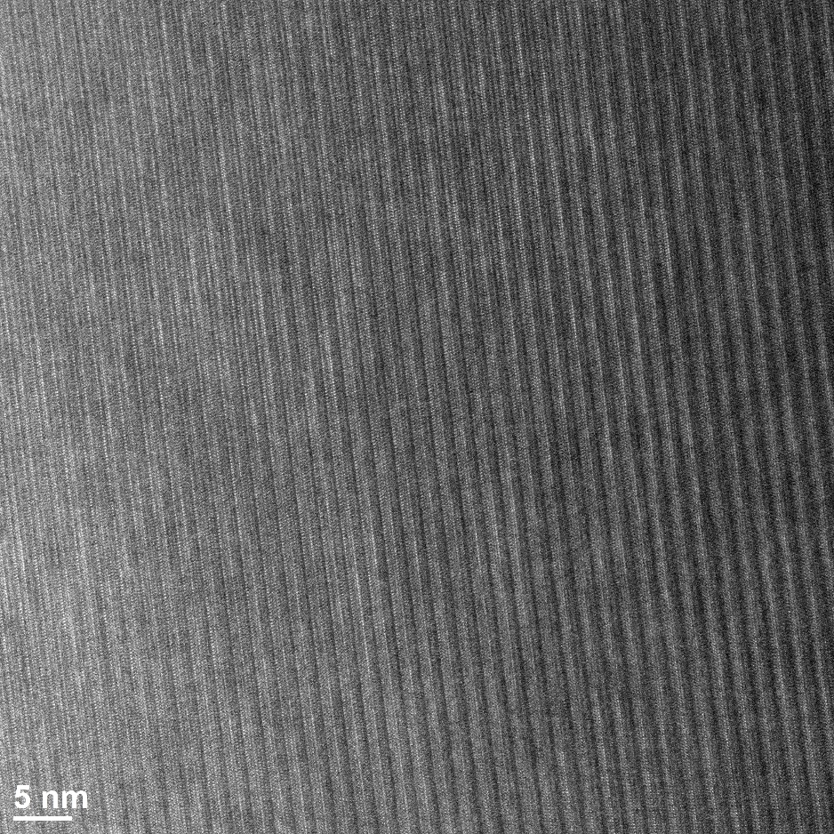
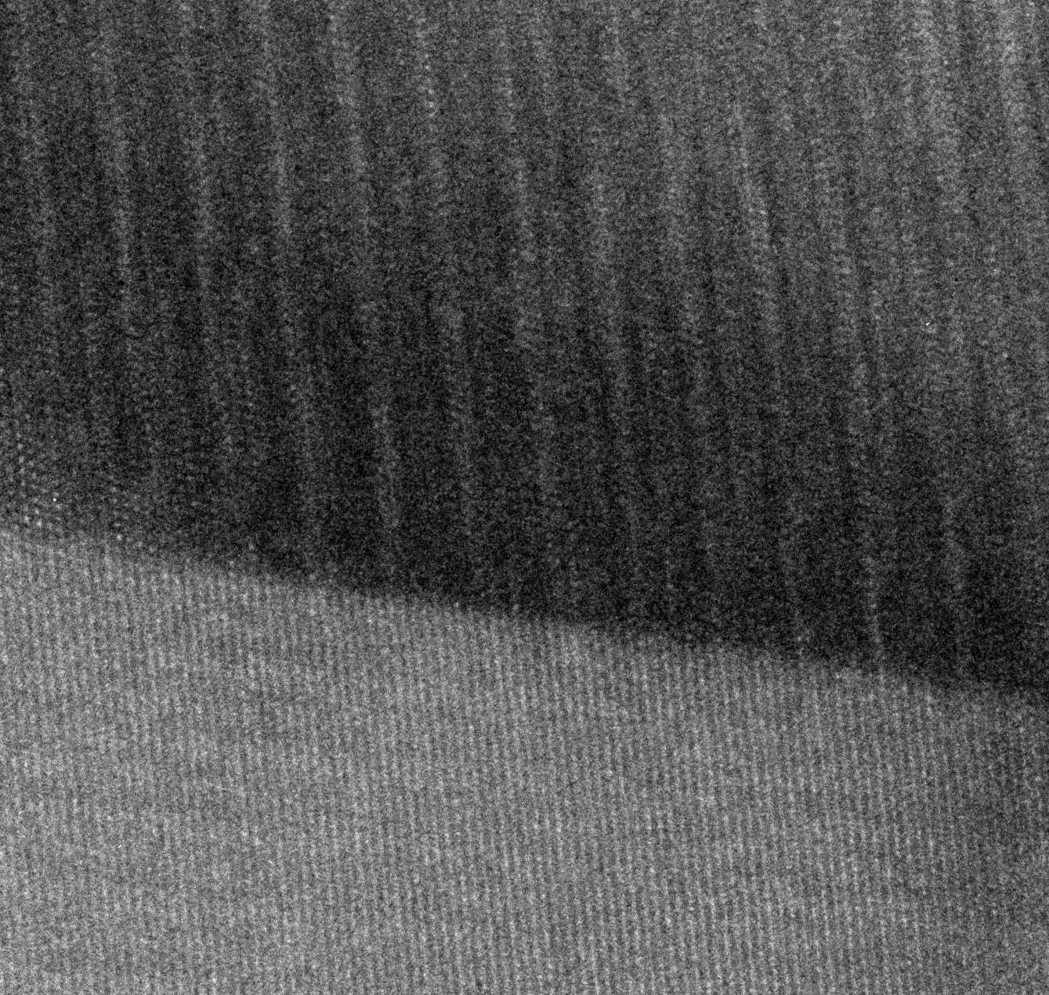
Hunting for MAX-phases: III
TEM HR
Ti₃SiC₂
In collaboration with Notre Dame University
TiC

Slide 20
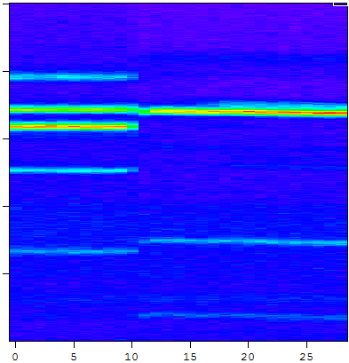
Combustion of the Ti-Al-C mixture in the helium: TRXRD picture and thermogram of process
A
B
C
Ti
Ti, Al
A
28
TiAl
Ti
Al
Ti
35
Ti
Ti, Al
Ti2AlC
TiAl
Ti
B
Ti2AlC
42
Al
TiAl
2θ, deg.
Ti2AlC
Ti2AlC
Т, ⁰С
49
Ti2AlC
Ti
Ti2AlC
C
56
TiAl
Ti2AlC
Ti2AlC
Ti2AlC
TiAl
TiAl
TiAl
63
Time, s
2θ, deg.
Laboratoriy of Dr. Dmitry Yu. Kovalev

Slide 21
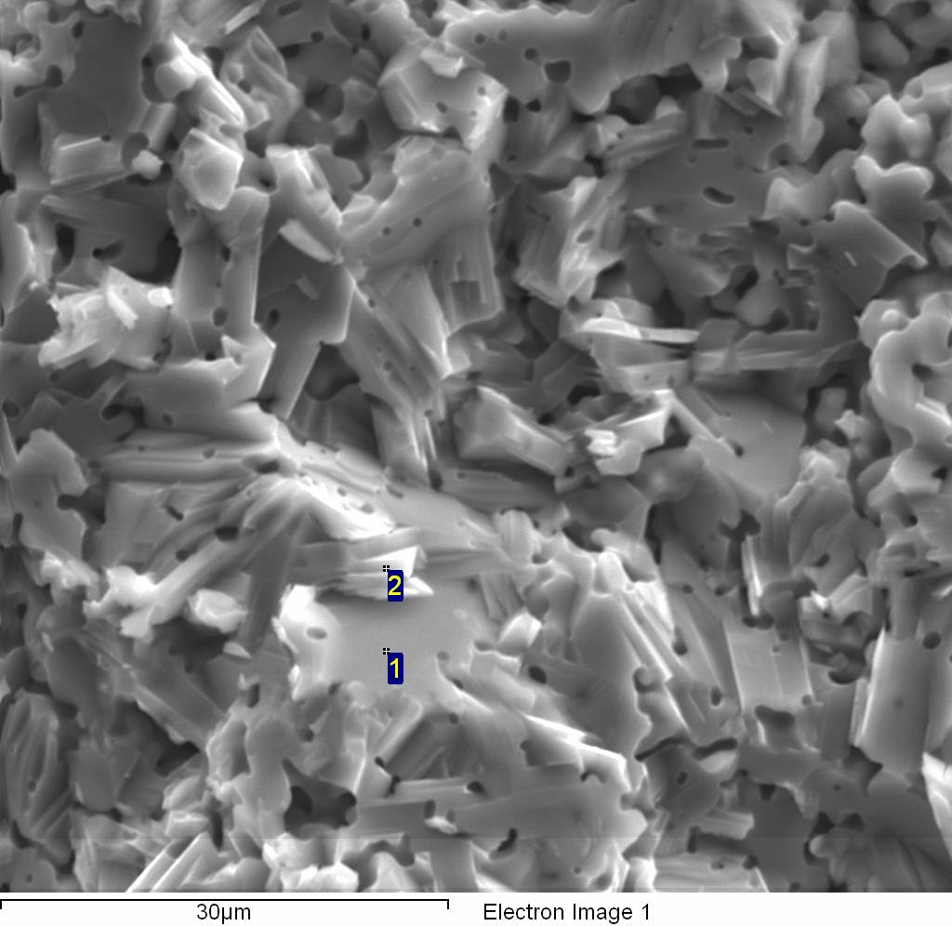
Hunting for MAX-phases: IV
Preparation of Ti₂AlN by Reactive Sintering
Point | Ti | Al | N
1 | 67.43 | 23.30 | 9.27
2 | 68.24 | 21.57 | 10.19
Way, which provides output target product Ti2AlN not less than 99% - isothermal annealing in argon (0.3 MPa) at temperatures 1300⁰C during 2 hour.
Laboratories of Dr. Alexander E. Sytschev and Dr. Dmitry Yu. Kovalev

Slide 22
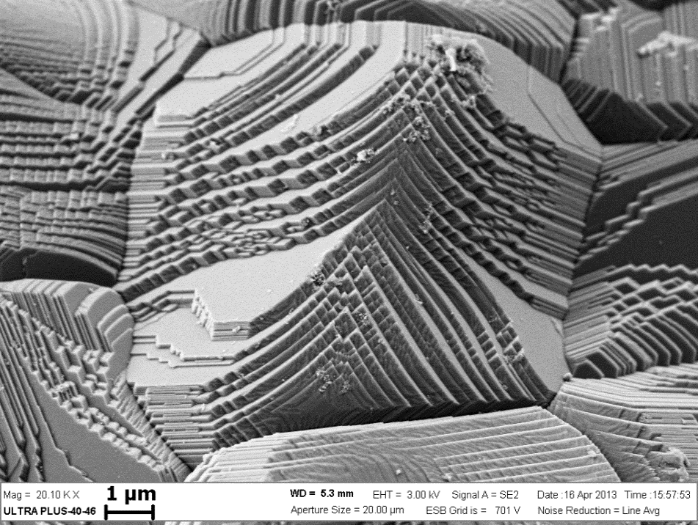
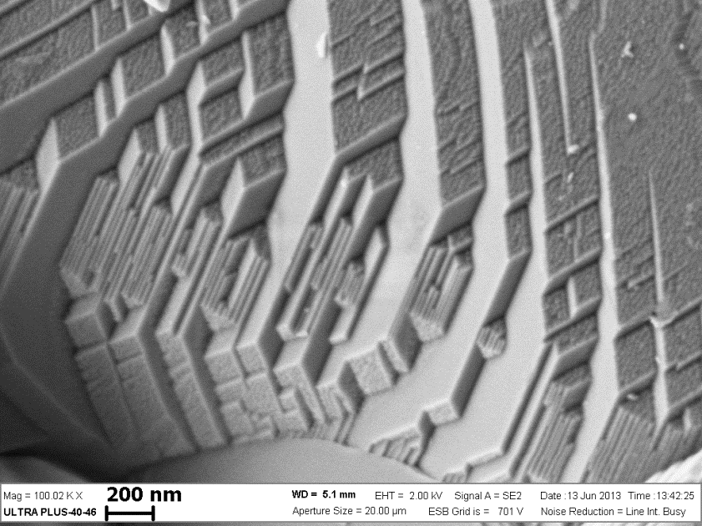
New materials: alon
Conjugated reactions (chemical oven)
2B + N₂ = 2BN - heat source and secondary product
Al + 2Al₂O₃ + N₂ = 2Al₅O₆N – primary product
Borovinskaya I.P., Ignat’eva T.I., Semenova V.N., and Chemagina E.A. SHS of Aluminum Oxynitride in Chemical Furnace. Int. J. SHS, 2015, Vol. 24, No. 4.

Slide 23
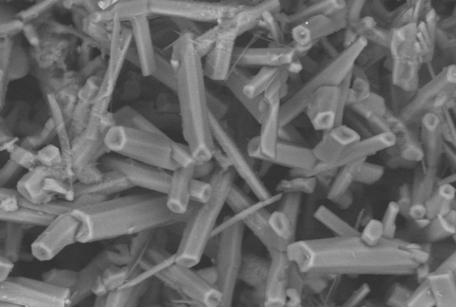
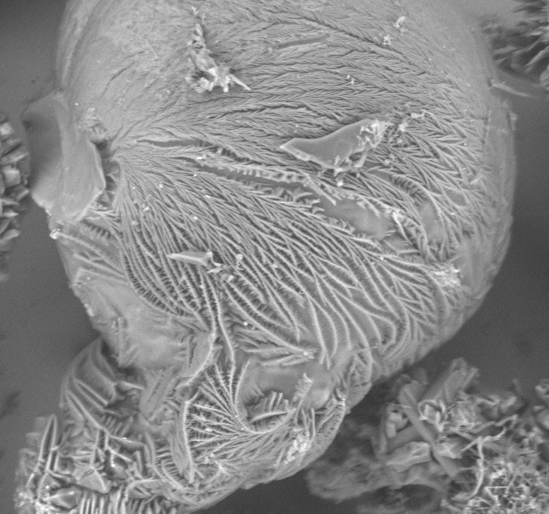
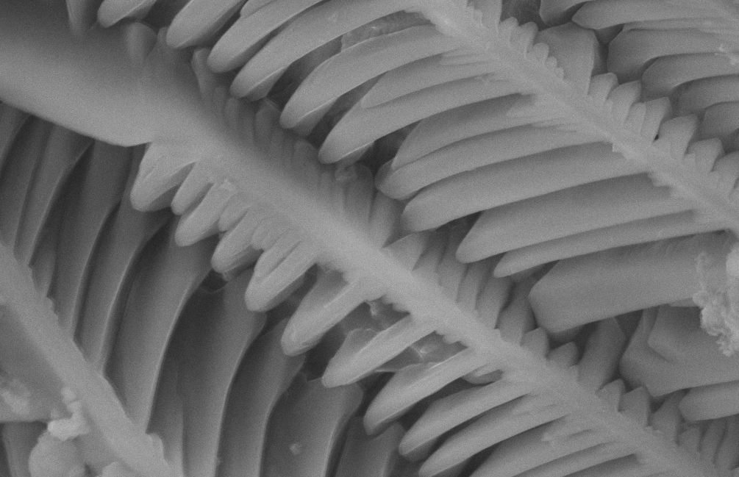
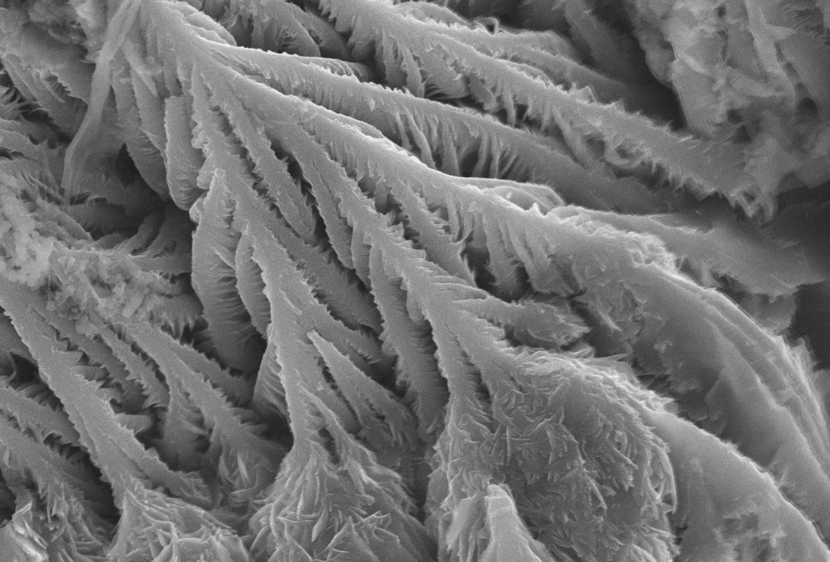
New morphologies: si3n4
β – Si₃N₄
Modified morpholody with fusing agent
Borovinskaya I.P., Loryan V.E., and Zakorzhevsky V.V. In: Nitride Ceramics: Combustion Synthesis, Properties, and Applications. Wiley-VCH Verlag GmbH, 2014, pp. 1-49.

Slide 24
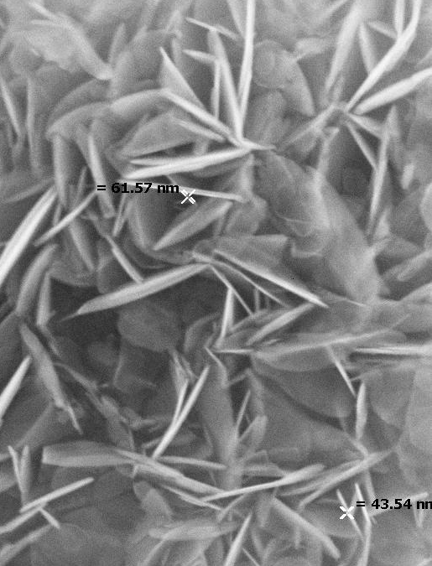
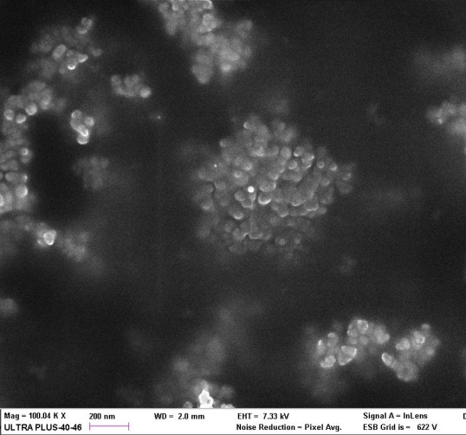
New microstructures: submicron and nano- powders
BN
MoSi₂
WC
Боровинская И.П., Игнатьева Т.И., Вершинников В.И., и др. Технология СВС наноразмерных порошков тугоплавких соединений. Российские нанотехнологии, 2007, т. 2, с.114-119.

Slide 25
New chemical route: B + co2
Reaction mechanism
В + СО₂ → В₂О₃ + СО
В₂О₃ _{(ж)} + 3.44С_{(тв)} = В₄С + газовая фаза (В₂О₂, ВО₂, ВО)
2В₂О₂ _{(г)} + 6СО_{(г)} = В₄С_{(тв)} + 5СО_{2 (г)}
2В₂О₂ _{(г)} + 8СО_{(г)} = В₄С_{(тв)} + 7СО_{2 (г)}
2В₂О₂ _{(г)} + 5СО_{(тв)} = В₄С_{(тв)} + СО

Slide 26
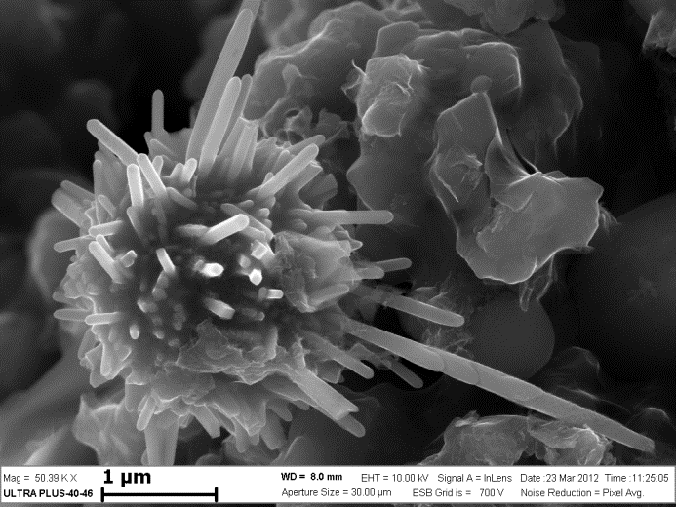
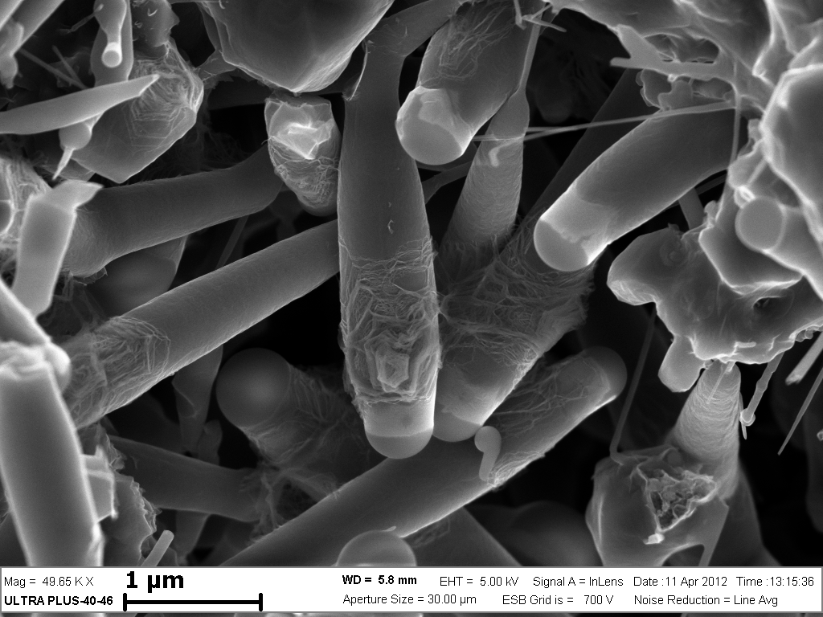
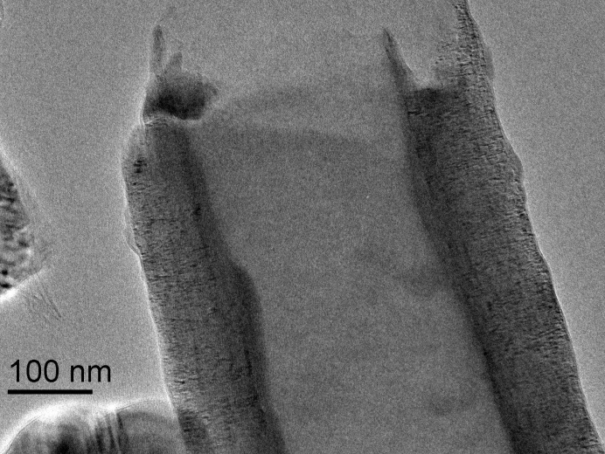
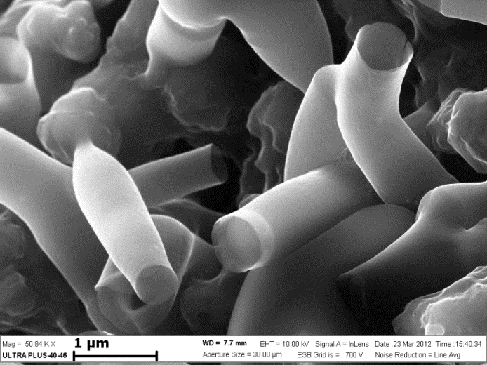
Whiskers and nanotube produced by combustion of B with CO₂
I.P.Borovinskaya, E.A.Chemagina, T.I.Ignatyeva, - work in progress

Slide 27
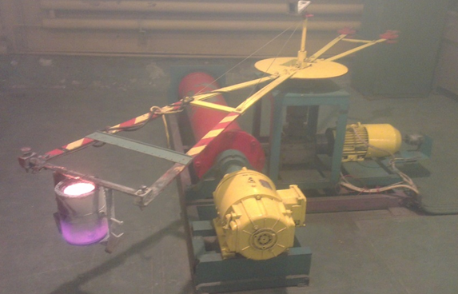
Centrifugal SHS of multicomponent alloys
Laboratory of Prof. Vladimir I. Yukhvid
(M₁ + M₂ + M₃ + ... + M_{n}) + (N₁ + N₂ + ... + N_{n}) + R → [CAs] +Al₂O₃ + Q
where M_{n} stands for oxides of Cr, Ni, Co, Nb, W, Mo, Mn, etc.; N_{n} stands for nonmetals such as C, B, etc.; and R is reducing agent (Al); CAs cast alloys;
Q heat release.
Green
mixture
Combustion
Phase segregation
of melt products
Solidification
and cooling
Centrifugal
acceleration
(n = a/g)
Oxide
(Al₂O₃)
Cast alloy

Slide 28
New materials: high-entropy NiCrCoFeMnAl_{x} alloys by SHS-casting
Vladimir Sanin*, Denis Ikornikov, Dmitry Andreev, Vladimir Yukhvid
X=2
After light etching (SEM)

Slide 29
POLYMETALLIC CATALYSTS ON THE BASE OF SHS-INTERMETALLIDES
Laboratory of Dr. Vyacheslav N. Borsch
Complex multicomponent intermetallides (aluminides) produced in one-stage short-term SHS were the precursors for new class of catalysts.
The catalysts were produced by leaching and stabilizing of intermetallic alloys.
The catalysts composition consisted of iron group metals (Fe, Ni, Co) as main components with addition of other d-metals and rare-earth elements (V, Mn, Cu, Zr, Mo, La, Ce etc.) as promoters. Catalysts demonstrated high activity and selectivity both in oxidative and in reducing processes.
The catalysts are composite materials in fact, with highly disordered nanostructured metal-oxide phases supported by unleached phases of lower intermetallides.
The catalysts surface was covered by two-level nanostructures. Low-level structures observed for all catalysts samples and consisted of almost perfect or slightly distorted plane hexagons of 1-2 μm in diameter and 10 - 100 nm in thickness. Inner structure of these hexagons depended on chemical composition and consists of 10-30 nm granules or fine unresolved substructures.
We suppose the nanostructures noted are main reason of high catalytic properties of these materials.

Slide 30
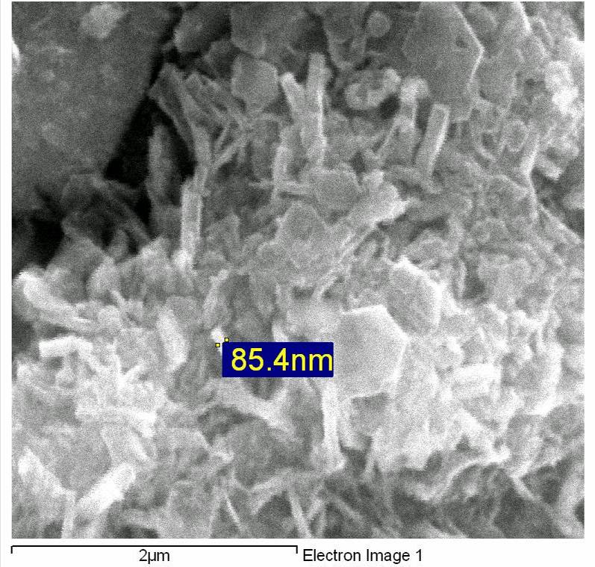
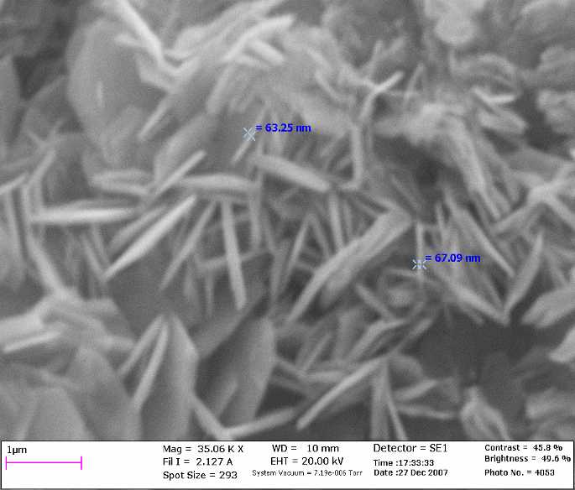
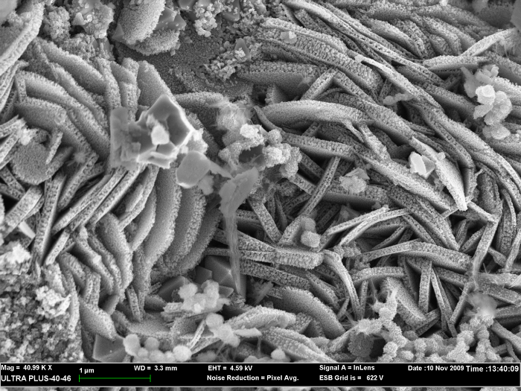
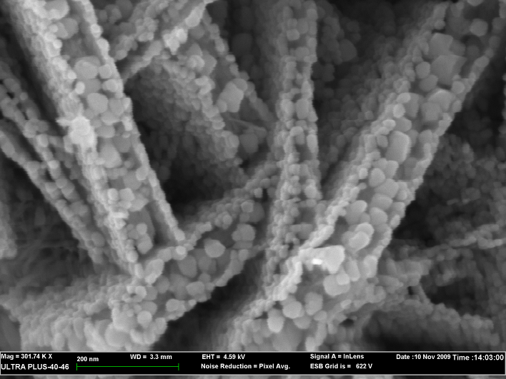
NANOSTRUCTURES OF Ni- AND Fe-BASED CATALYSTS OF DEEP OXIDATION
Laboratory of Dr. Vyacheslav N. Borsch
85Ni-10Co-5Mn
79Fe-15Co-6Mn
2 μm
2 μm
90Fe-5Mn-5Ce
79Fe-15Co-6Mn
2 μm
200 nm

Slide 31
DEEP OXIDATION OF CO AND PROPANE ON Ni-Co-Mn CATALYSTS
Laboratory of Dr. Vyacheslav N. Borsch
Propane conversion, %
CO conversion, %
Temperature, ⁰C
Temperature, ⁰C
V.N.Borshch, E.V.Pugacheva, S.Ya.Zhuk, D.E.Andreev, V.N.Sanin, V.I.Yukhvid / Doklady Physical Chemistry, 2008, Vol.419. Part 2, pp.77-79.
V.N.Sanin, D.E.Andreev, E.V.Pugacheva, S.Ya.Zhuk, V.N.Borshch, V.I.Yukhvid / Inorganic Materials, 2009, Vol.45, No.7, pp.777-784
E.V.Pugacheva, V.N.Borshch, S.Ya.Zhuk, D.E.Andreev, V.N.Sanin, V.I.Yukhvid. / Int. J. SHS, 2010, V.19, No.1, pp. 65–69.

Slide 32
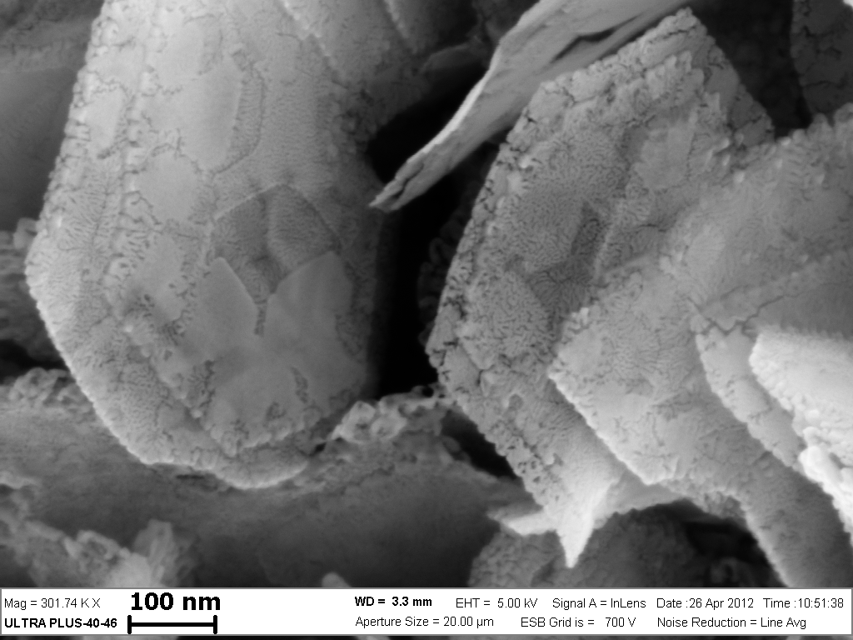
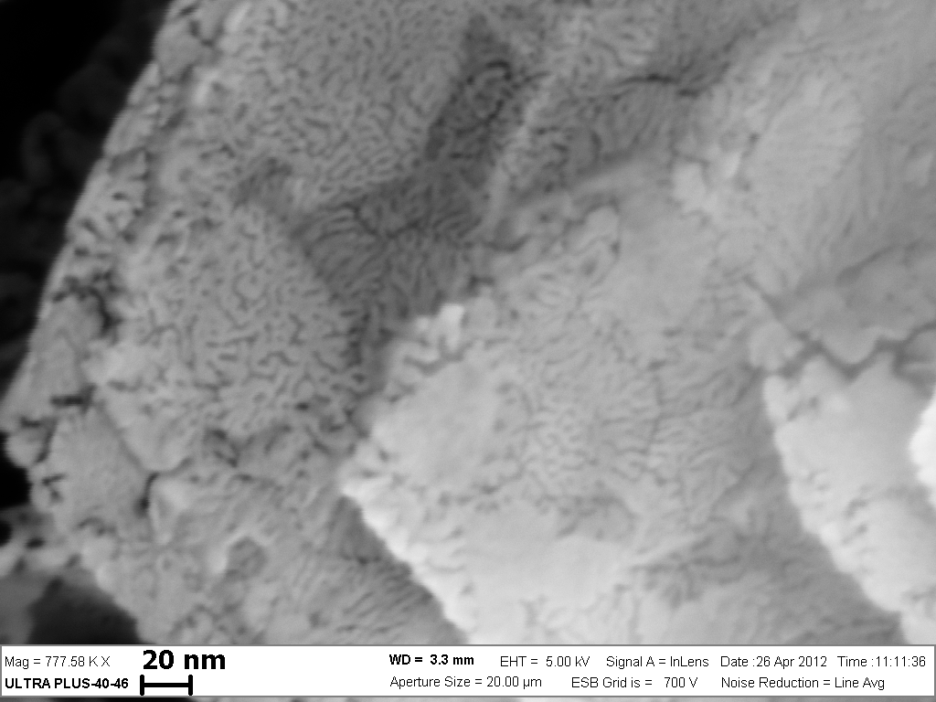
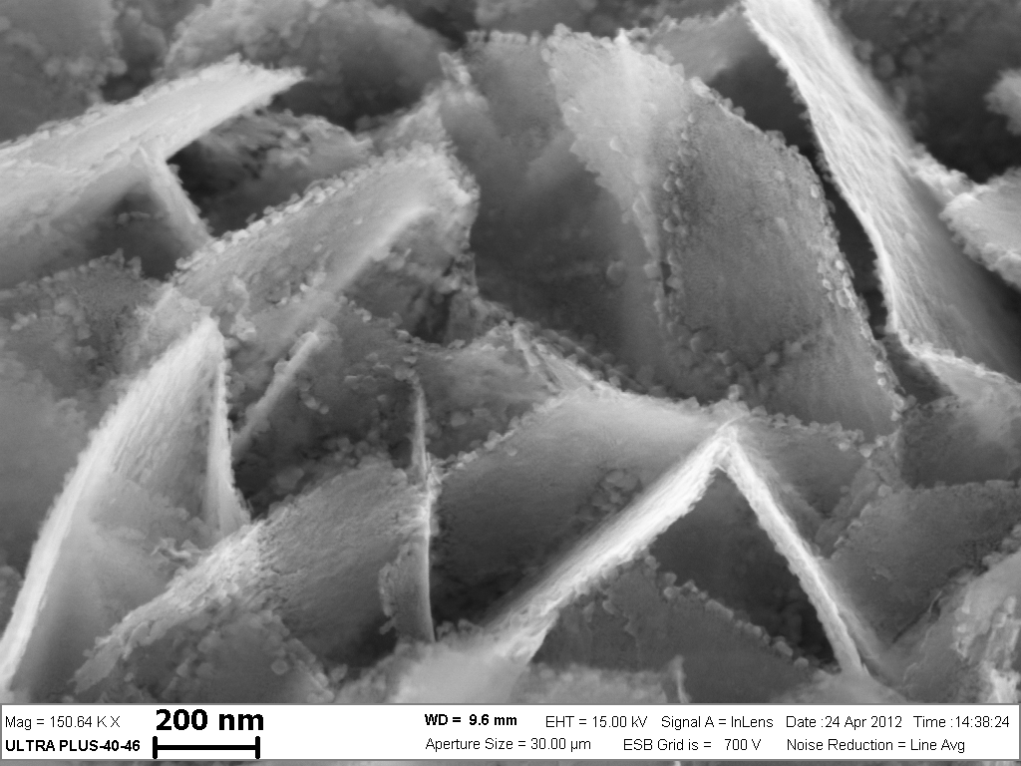
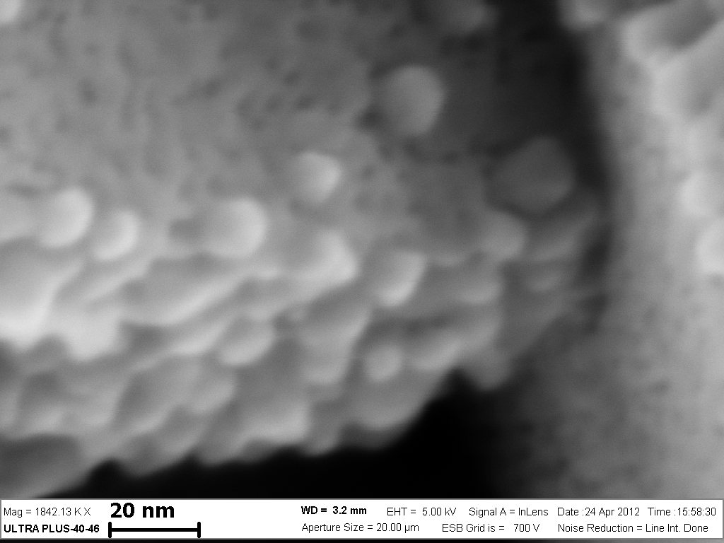
NANOSTRUCTURES ON THE SURFACE OF Co-BASED CATALYSTS FOR FISCHER-TROPSCH PROCESS
95Co-5Ce
100 nm
40 nm
95Co-5Ce-5Zr
95Co-5Ce-5Zr
200 nm
20 nm

Slide 33
ACTIVITY AND SELECTIVITY OF Co-BASED CATALYSTS IN FISCHER-TROPSCH PROCESS P=2.0 MPa, t=200⁰C, H₂:CO = 2:1, V=2.5 l(NTP)Ч(sЧg)⁻¹
Catalyst | Activity, (μmol CO)Ч (sЧg)⁻¹ | Selectivity, %mol |  |  | Compound of C₅₊ products
 |  | CH₄ | C₅₊ | CO₂ | ASF α | iso- / n-
Co | 1.29 | 7.2 | 92.8 | 0.0 | 0.90 | 0.18
50Co-50Ni | 2.11 | 6.7 | 92.6 | 0.5 | 0.91 | 0.15
95Co-5V | 1.27 | 7.1 | 92.9 | 0.0 | 0.92 | 0.16
95Co-5Zr | 0.97 | 7.5 | 91.8 | 0.0 | 0.91 | 0.17
95Co-5Ce | 4.64 | 12.7 | 73.7 | 1.1 | 0.82 | 0.15
95Co-5La | 3.37 | 4.0 | 93.8 | 1.1 | 0.94 | 0.13
90Co-5Ce-5Zr | 2.63 | 12.3 | 82.0 | 2.0 | 0.85 | 0.14
90Co-5La-5Zr | 3.24 | 8.0 | 87.6 | 1.4 | 0.88 | 0.16
20Co-0.5Re/Al₂O₃ | 3.95 | 7.0 | 88.0 | 1.5 | 0.83 | 0.25
Laboratory of Dr. Vyacheslav N. Borsch
V.N.Borshch, O.L.Eliseev, S.Ya.Zhuk, R.V.Kazantsev, D.E.Andreev, V.N.Sanin, V.I.Yukhvid and A.L.Lapidus / Doklady Physical Chemistry, 2013, Vol.451. Part 2, pp.167-171.
V.N.Borshch, E.V.Pugacheva, S.Ya.Zhuk, D.E.Andreev, V.N.Sanin, V.I.Yukhvid O.L.Eliseev, R.V.Kazantsev, S.I.Kolesnikov, I.M.Kolesnikov,and A.L.Lapidus / Kinetics and Catalysis, 2015, Vol.56, No.5, pp.681-688.

Slide 34
Mo-Ni-CATALYSTS OF HYDRODESULPHURIZATION PROCESS (hydropurification of diesel fraction)
Catalyst | Initial concentration of total sulphur in diesel fraction, ppm | Residual sulphur concentration, ppm
 |  | 250⁰С | 350⁰С | 400⁰С
АNМ-1 | 9900 | 7200 | 33 | 288
АNМ-2 | 9900 | 7230 | 37 | 312
АNМ-3 | 9900 | 7410 | 45 | 335
АNМ-4 | 9900 | 7490 | 52 | 358
V.N.Borshch, E.V.Pugacheva, S.Ya.Zhuk, D.E.Andreev, V.N.Sanin, V.I.Yukhvid O.L.Eliseev, R.V.Kazantsev, S.I.Kolesnikov, I.M.Kolesnikov,and A.L.Lapidus / Kinetics and Catalysis, 2015, Vol.56, No.5, pp.681-688.

Slide 35
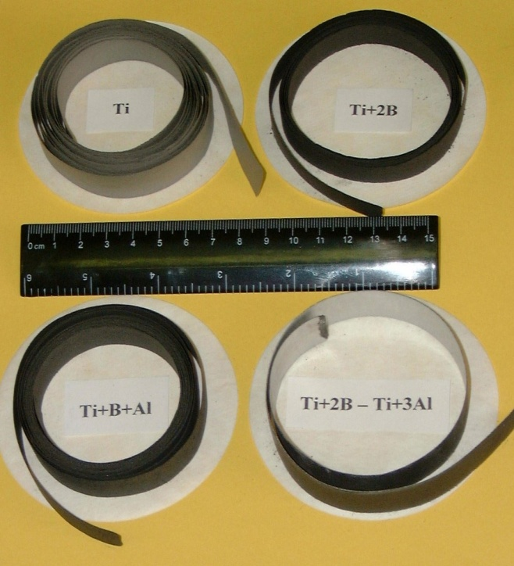
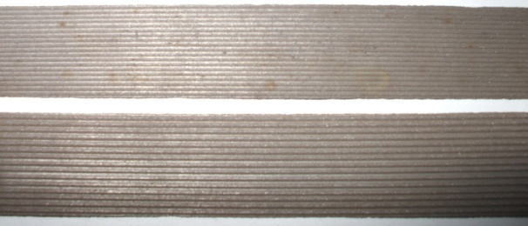
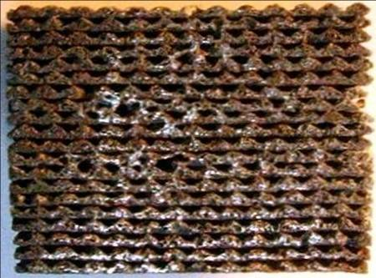
Cold rolling of Reactive films with corrugated (profiled) surface
Dr. Sergey G, Vadchenko
20 mm
Q ~ 1200 – 1300 J/g
dQ/dt ~ 1 MJ/g s
TiB₂

Slide 36
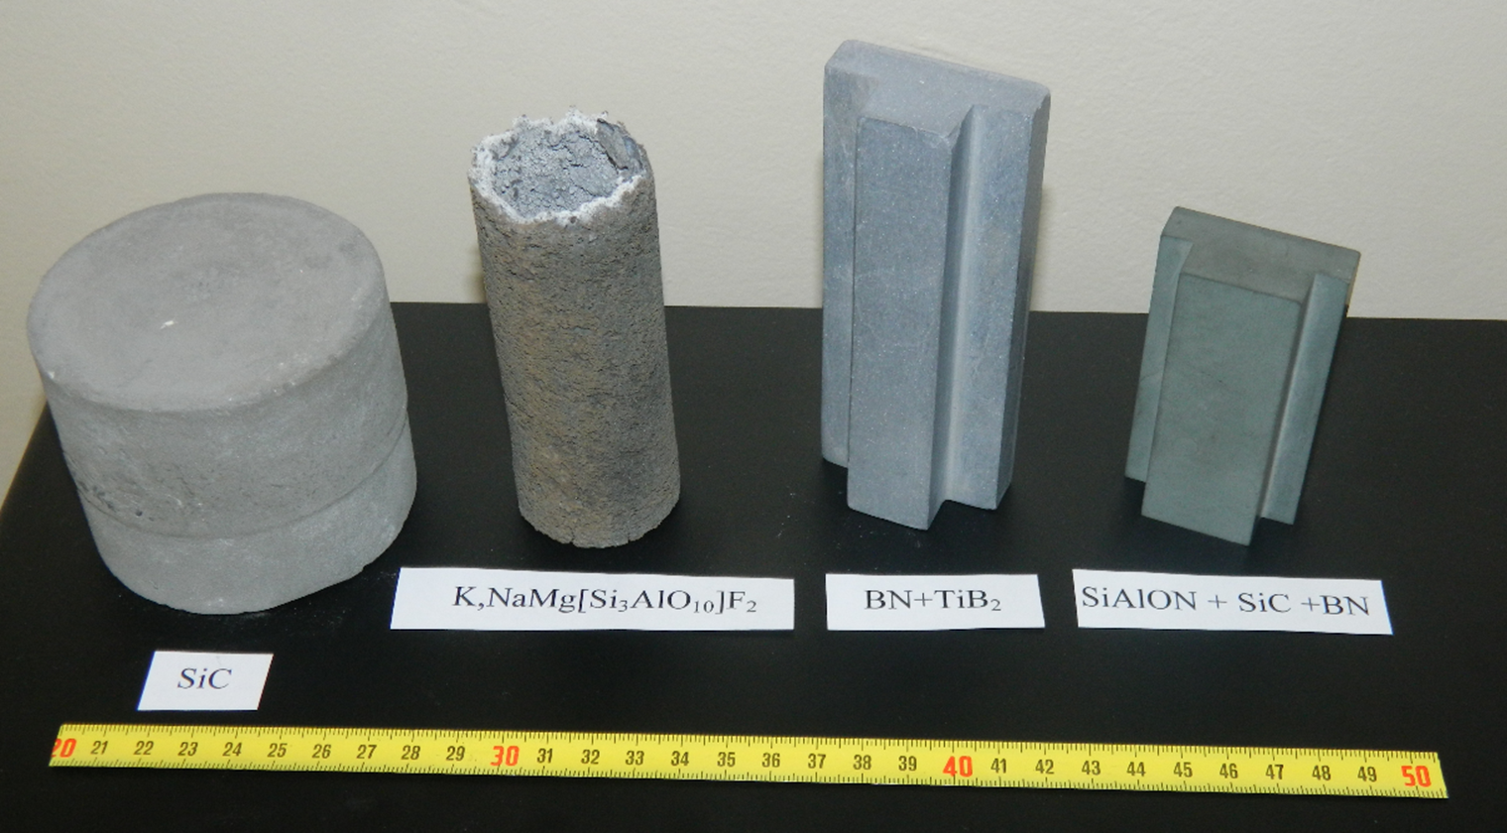
Ceramic items produced by SHS
Prof. I.P.Borovinskaya with co-workers

Slide 37
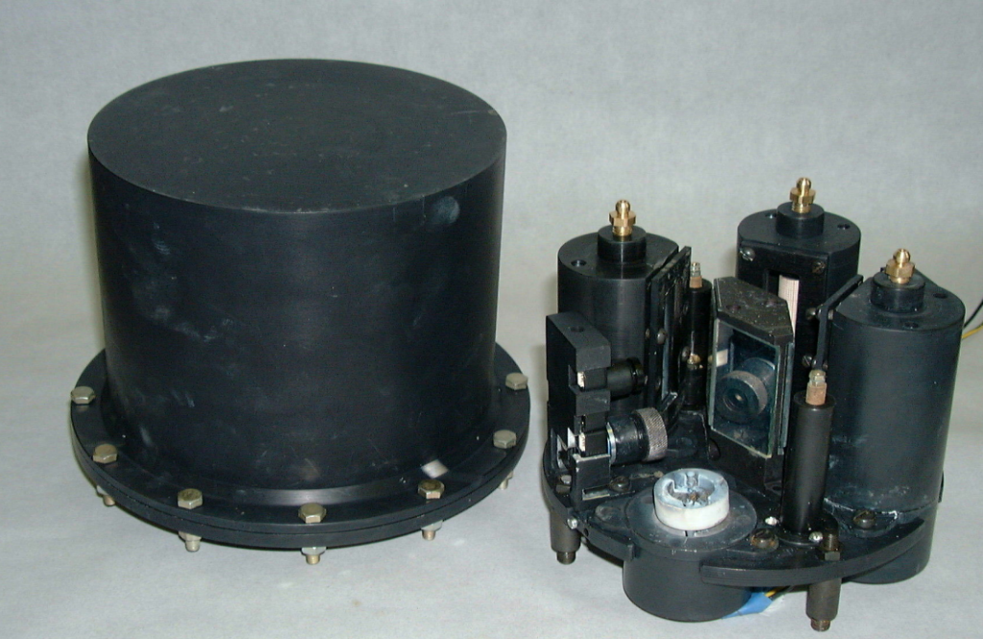
SHS in space: ISS

Slide 38
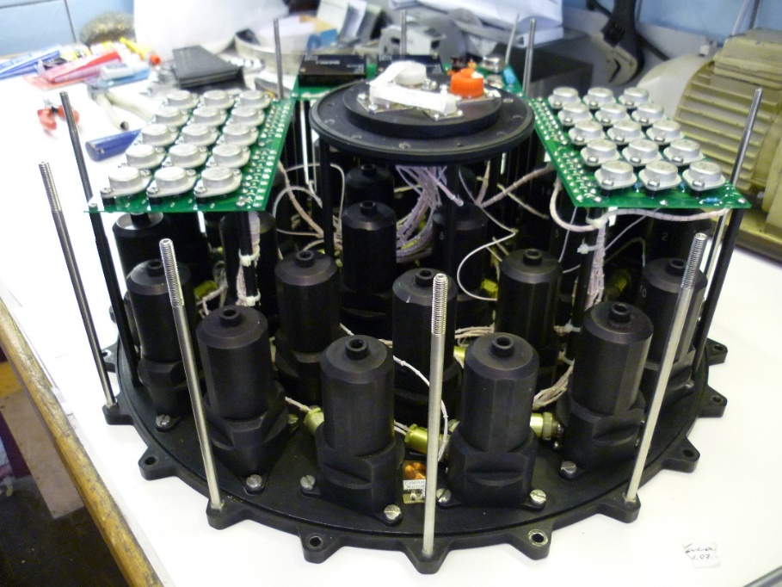
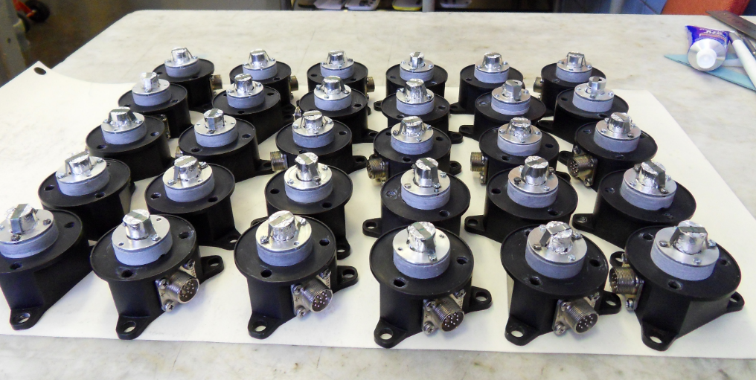
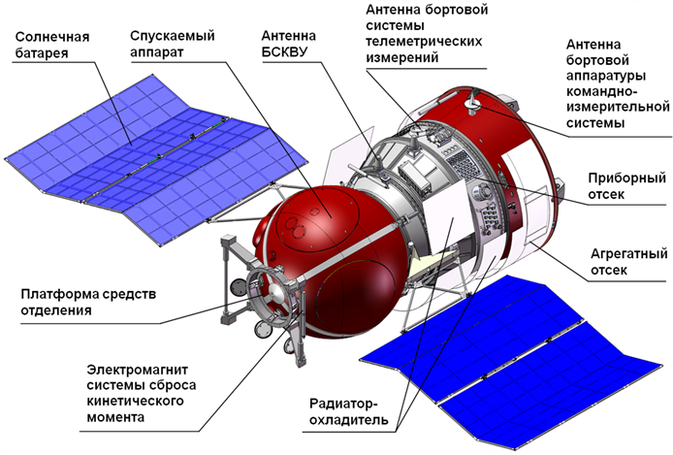
SHS in space: unmanned spacecraft
Dr. A.E.Sytschev, S.G.Vadchenko, et al.

Slide 39
Wave of CuTi(amorph) to CuTi (cryst) transformation
CuTi(amorphous) CuTi (crystalline intermetallic)
Intensity of
XRD peak, counts
CuTi
2 θ
CuTi
- Distance, mm
Distance, mm

Slide 40
Some other achievements:
Production of ultrafine Ti through SHS hydrogenation-milling-furnace dehydrogenation route
New modification of boron carbide B₂₅C₄Mg_{1.42}
Electric insulating ceramics BN-SiO₂
Filters and membranes of TiC with catalytic activity
And others…

Slide 41
Thank you for your attention!
Carrying on Merzhanov’s traditions…

