Slide 1


Recent Advances in Combustion Synthesis of Materials (Overview)
Alexander S. Mukasyan
Department of Chemical and Biomolecular Engineering, University of Notre Dame, Notre Dame, USA
also with National University of Science and Technology,
MISiS, Moscow, Russia
XIII-th International Symposium on Self-Propagating High-Temperature Synthesis, October 12th, 2015 , Antalya, Turkey

Slide 2
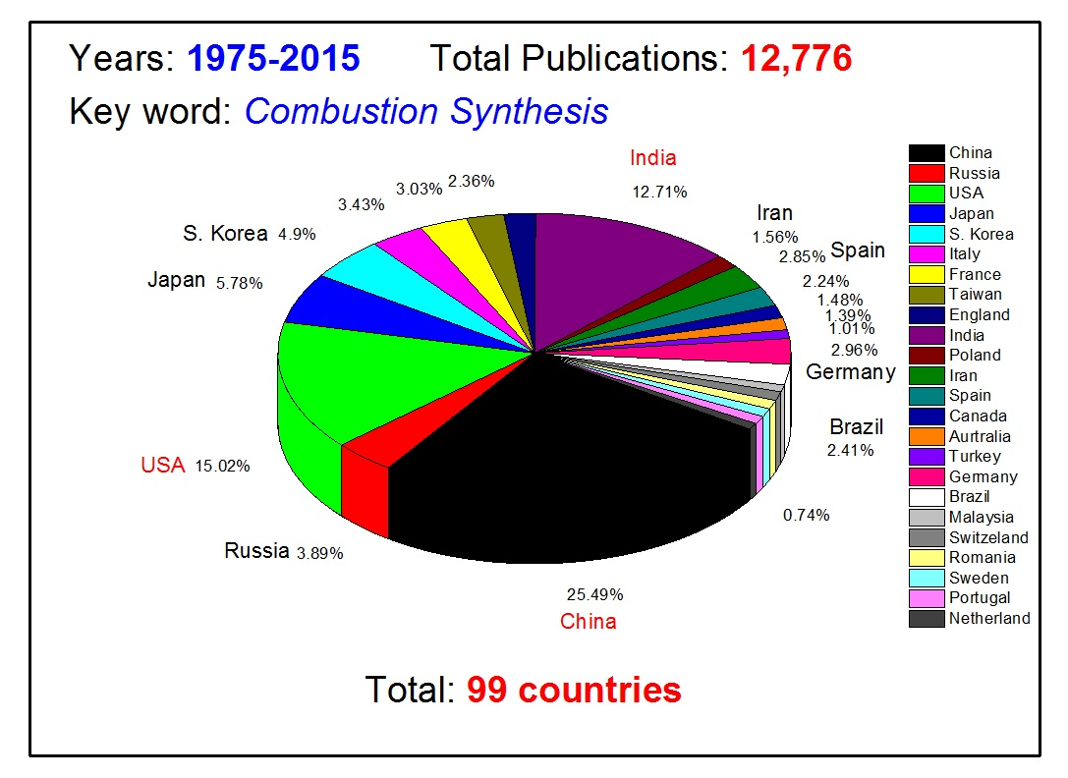
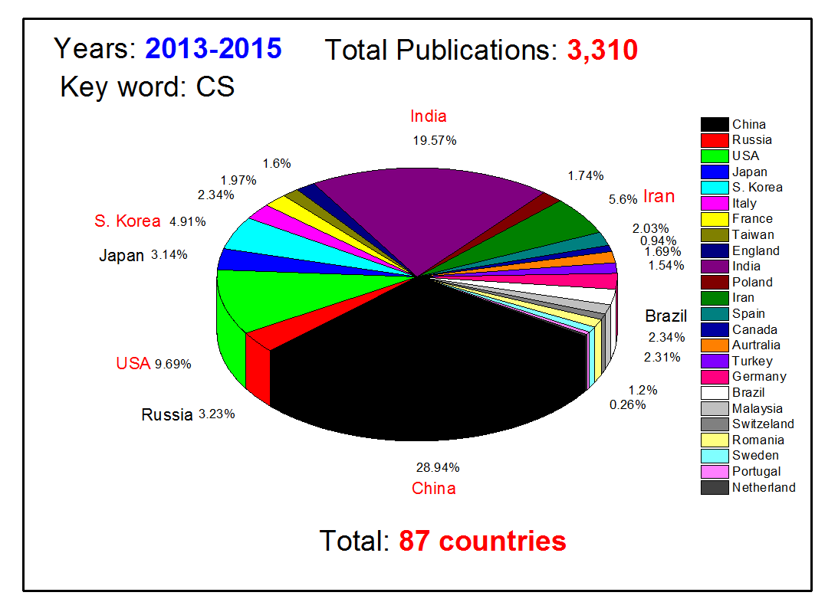
Statistics On Publications: CS
More than 1000 publications per year
CS is on all continents except of Antarctica
XIII-th International Symposium on Self-Propagating High-Temperature Synthesis, October 12th, 2015 , Antalya, Turkey

Slide 3
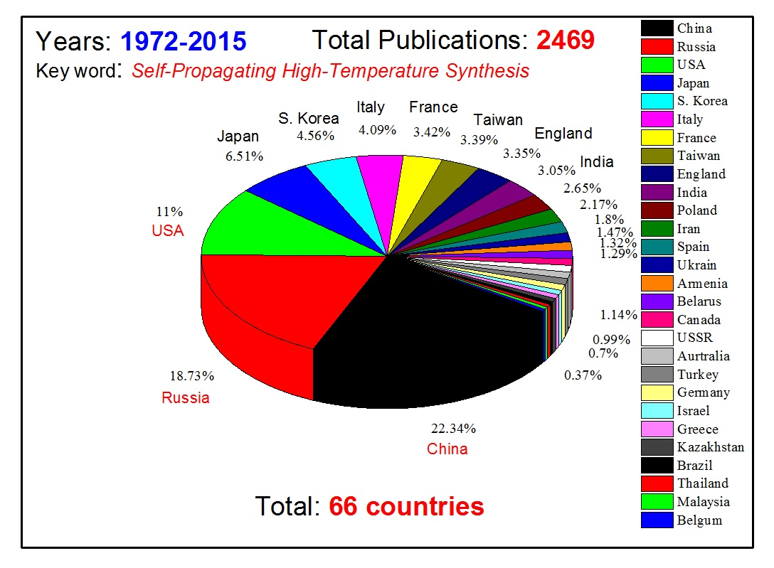
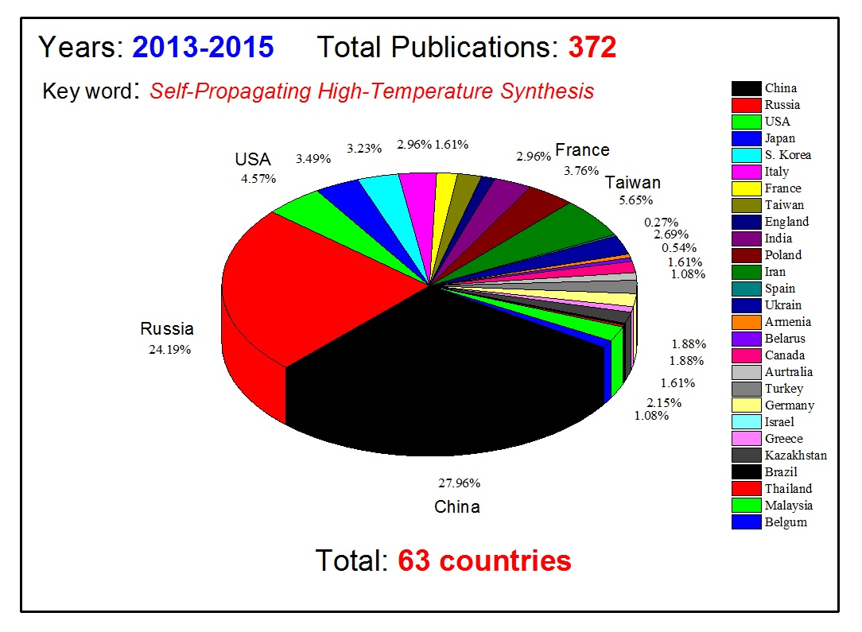
Statistics On Publications: SHS
XIII-th International Symposium on Self-Propagating High-Temperature Synthesis, October 12th, 2015 , Antalya, Turkey

Slide 4
Statistics On Publications: SHS + CS
Growth rate: exponential function
Three points of “acceleration”
XIII-th International Symposium on Self-Propagating High-Temperature Synthesis, October 12th, 2015 , Antalya, Turkey

Slide 5



International Journal of
Self-Propagating High-Temperature Synthesis
Publisher: Springer Science
Publication type: Journals.
ISSN: 1934788X, 10613862
Coverage: 2012-2014
Indicators | 2012 | 2013 | 2014
SJR | 0,160 | 0,209 | 0,349
Total Documents | 36 | 44 | 43
Total Docs. (3years) | 49 | 85 | 129
Total References | 760 | 641 | 698
Total Cites (3years) | 14 | 32 | 69
Self Cites (3years) | 3 | 10 | 25
Citable Docs. (3years) | 48 | 84 | 128
Cites / Doc. (4years) | 0,29 | 0,38 | 0,54
Cites / Doc. (3years) | 0,29 | 0,38 | 0,54
Cites / Doc. (2years) | 0,29 | 0,38 | 0,53
References / Doc. | 21,11 | 14,57 | 16,23
Cited Docs. | 11 | 20 | 47
Uncited Docs. | 38 | 65 | 82
% International Collaboration | 19,44 | 25,00 | 11,63
156/263 Material Science Journals
68/115 Engineering Journals
http://www.scimagojr.com/journalrank.php?category=0&area=2500&year=2014&country=US&order=sjr&min=0&min_type=cd&page=3

Slide 6

International Journal of Self-Propagating High-Temperature Synthesis
The journal has been accepted for a new edition of Web of Science launching this fall. The new edition, called the Emerging Sources Citation Index, will make the content discoverable and citable in Web of Science.
Emerging Sources Citation Index: A New Edition of Web of Science
More high quality publications should be submitted to the Journal

Slide 7
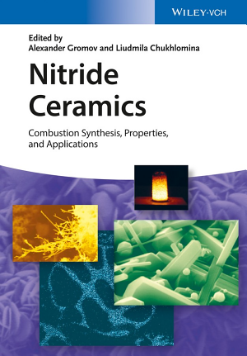
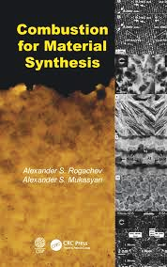
Books: 2014-2015
A comprehensive overview of recent developments in the field of non-oxide ceramics with special emphasis placed on the combustion synthesis of group I-VI nitrides.
To ensure the widest possible perspective, the authors are experts in academia, industry, or government research, and each chapter discusses different synthetic methods and process parameters, as well as material properties & applications
Summarizes both the classical works and the recent breakthroughs in the field of combustion synthesis of materials, including reactions in different nano-systems
Reviews modern theoretical approaches and advanced in situ experimental methods for and applications of combustion synthesis materials
Analyzes mechanisms of the structural transformations
in the unique conditions of the combustion process for
a variety of solid–solid and gas–solid systems

Slide 8
Reviews: 2013-2015
Microwave-Assisted Synthesis of Calcium Phosphate Nanostructured Materials in Liquid Phase
By: Chen Feng; Zhu Yingjie; PROGRESS IN CHEMISTRY Volume: 27 Issue: 5 Pages: 459-471, MAY 2015
Combustion synthesis in nanostructured reactive systems
By: Mukasyan, Alexander S.; Rogachev, Alexander S.; Aruna, Singanahally ThippaReddy
ADVANCED POWDER TECHNOLOGY Volume: 26 Issue: 3 Special Issue: SI Pages: 954-976, MAY 2015
Combustion/micropyretic synthesis of atomically thin two-dimensional materials for energy applications
By: Mukasyan, Alexander S.; Manukyan, Khachatur V. CURRENT OPINION IN CHEMICAL ENGINEERING Volume: 7 Pages: 16-22, FEB 2015
Sol-gel synthesis and characterization of iron doped mullite
By: Ilic, S.; Zec, S.; Miljkovic, M.; et al. JOURNAL OF ALLOYS AND COMPOUNDS Volume: 612 Pages: 259-264, NOV 5 2014
Advances in synthesis of calcium phosphate crystals with controlled size and shape
By: Lin, Kaili; Wu, Chengtie; Chang, Jiang, ACTA BIOMATERIALIA Volume: 10 Issue: 10 Pages: 4071-4102, OCT 2014
A review on combustion synthesis intensification by means of microwave energy
By: Rosa, Roberto; Veronesi, Paolo; Leonelli, Cristina, CHEMICAL ENGINEERING AND PROCESSING Volume: 71 Pages: 2-18 , SEP 2013
Lithium manganese spinel materials for high-rate electrochemical applications
By: Potapenko, Anna V.; Kirillov, Sviatoslav A. JOURNAL OF ENERGY CHEMISTRY Volume: 23 Issue: 5 Pages: 543-558 , SEP 2014
Magnetic polymer nanocomposites for environmental and biomedical applications
By: Kalia, Susheel; Kango, Sarita; Kumar, Amit; et al. COLLOID AND POLYMER SCIENCE Volume: 292 (9) Pages: 2025-2052. SEP 2014
Comparison of Reactive and Non-Reactive Spark Plasma Sintering Routes for the Fabrication of Monolithic and
Composite Ultra High Temperature Ceramics (UHTC) Materials
By: Orru, Roberto; Cao, Giacomo MATERIALS Volume: 6 Issue: 5 Pages: 1566-1583 , MAY 2013
Recent progress in the field of multicomponent bioactive nanostructured films
By: Shtansky, Dmitry V.; Levashov, Evgeny A.; Batenina, Irina V.; et al. RSC ADVANCES Volume: 3 Issue: 28 Pages: 11107-11115, 2013
Preparation of ceramic nanoparticles via cellulose-assisted glycine nitrate process
By: Birol, Hansu; Rambo, Carlos Renato; Guiotoku, Marcela; et al. RSC ADVANCES Volume: 3 Issue: 9 Pages: 2873-2884, 2013
TOTAL: 46

Slide 9
Upcoming PROJECTS: 2015-2016
Book: Energetic Nanomaterials
ISBN: 9780128027103
Edited by V. Zarko
Elsevier
Book: CONCISE ENCYCLOPEDIA OF COMBUSTION SYNTHESIS:
HISTORY, THEORY, TECHNOLOGY, AND PRODUCTS
Edited by I.Borovinskaya, A. Gromov, Y. Maksimov,
Rogachev, E. Levashov, and A. Mukasyan
Elsevier
Invited Review to Chemical Reviews:
Solution Combustion Synthesis of Nanoscale Materials
by A.Varma, A. Mukasyan, A.Rogachev and K. Manukyan
ACS Publication

Slide 10
Recent Advances in CS: Scientific directions
Topics to be discussed:
Reactive Nano Systems
  Mechanically – induced composite nanostructured particles and CS/SHS
  Solution Combustion Synthesis
    Thin layers
    Catalysis
    2D – crystals by SHS
    Spark Plasma Sintering and Combustion Synthesis
    Dynamic Molecular Simulation for CS
    Industrial Applications
    Concluding Remarks

Slide 11
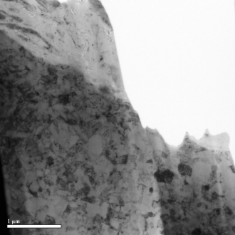
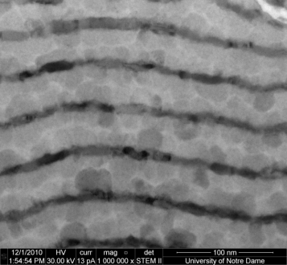
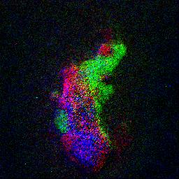
Reactive Nano-Systems
Composite Reactive Particles by High Energy Ball Milling
Examples: Ni/Al; Ti/B; Zr/C
Application: tunable HEDM, Novel Advanced Materials
Reactive Nano-foils
Examples: Ni/Al; Ti/Ni; Cu/TiO₂
Application: joining of materials
Sol-Gel or Solution Combustion
Examples: Cu(NO₃)₃/ glycine;
Fe(NO₃)₃/ hydrazine
Application: synthesis of metal
and oxide nanopowders; catalysis
Super Thermites
Examples: MoO₃/Al; Bi₂O₃/Al and I₂O₅/Al
Application: gas generator, igniter
Ni
Al
Ni
Al
Cu
Ni
Fe
50 nm
Notes:
11
11

Slide 12
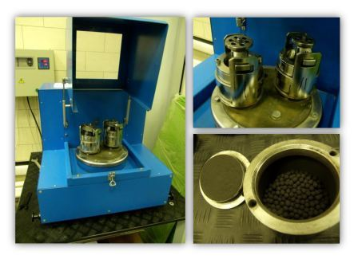
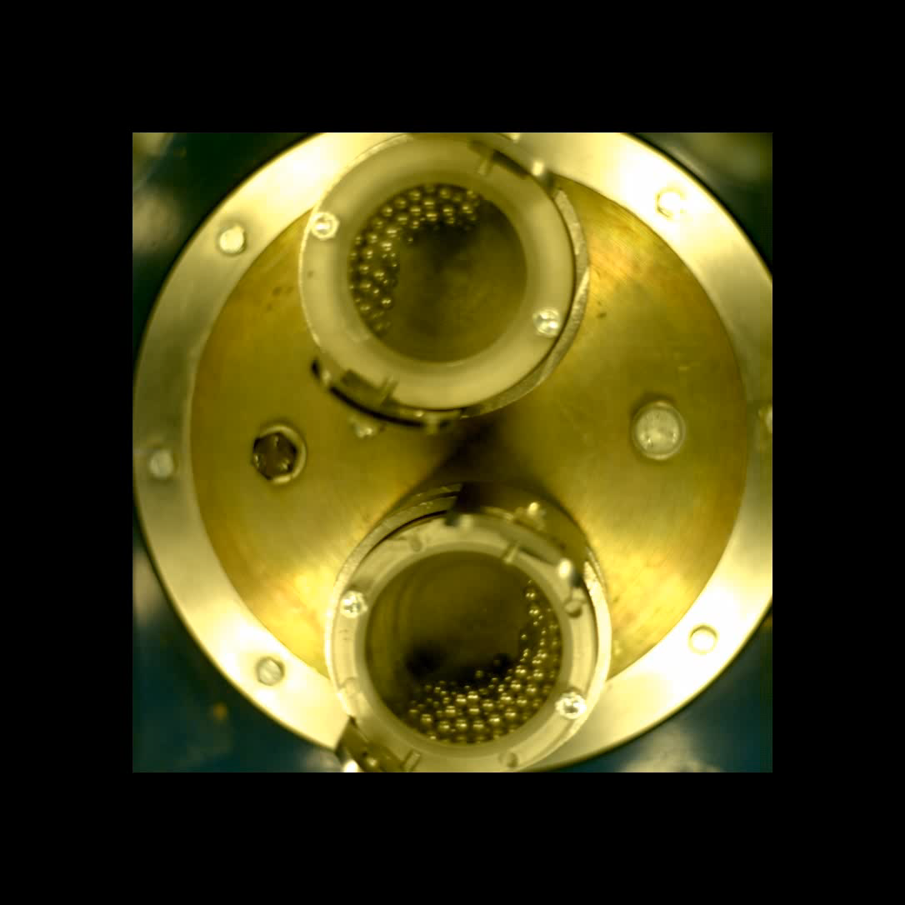
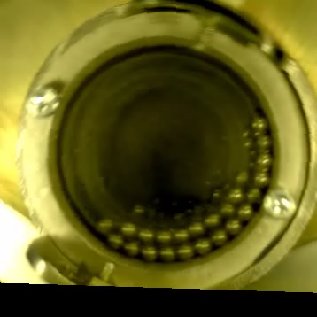
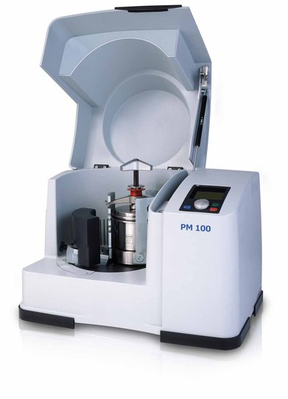




High Energy Ball Milling or Mechanical activation
WOS: 158/365
HEBM
Oxide-Free
Oxide
layers
  Composite particles contain both reactants
The surface contact area between reactants is high
Typically no oxide layers between reactants
Decrease the crystal size
Decrease the diffusive layer thickness
Pore free media

Slide 13
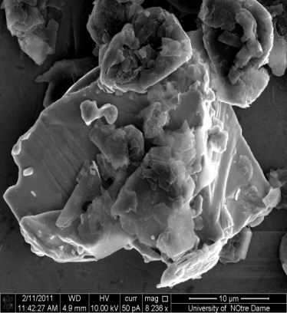
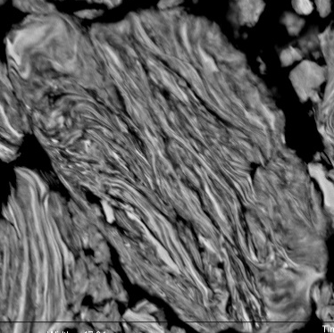
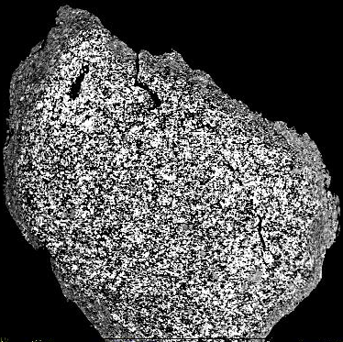
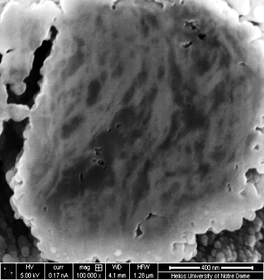
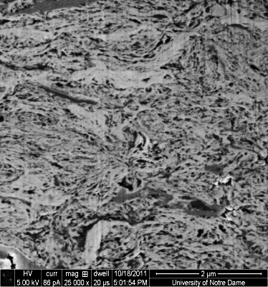
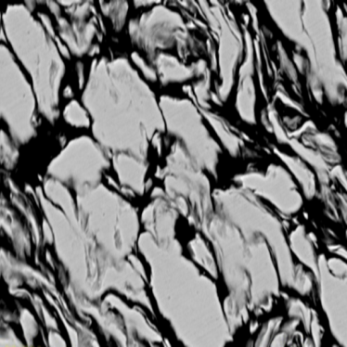
Modification of Microstructure: HEBM
Conventional media
Composite particles
Short-term
High energy
Ball Milling
(HEBM)
Titanium
Ti/C
Graphite
The microstructure of composite particles depends on
Mechanical properties of reactants
Milling conditions
Ni-Al
Hf-C
Ti-C
Ta-C
Ni-Al

Slide 14
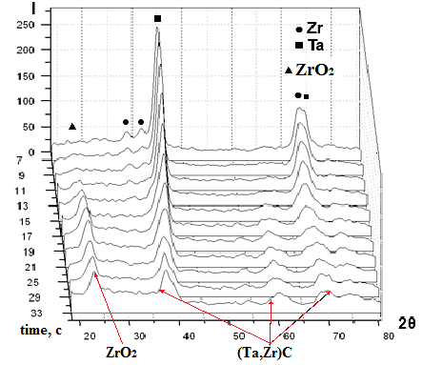
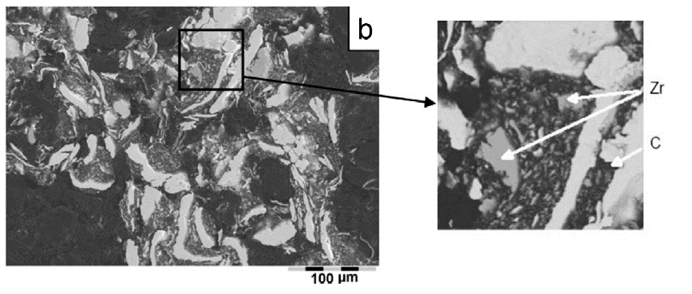
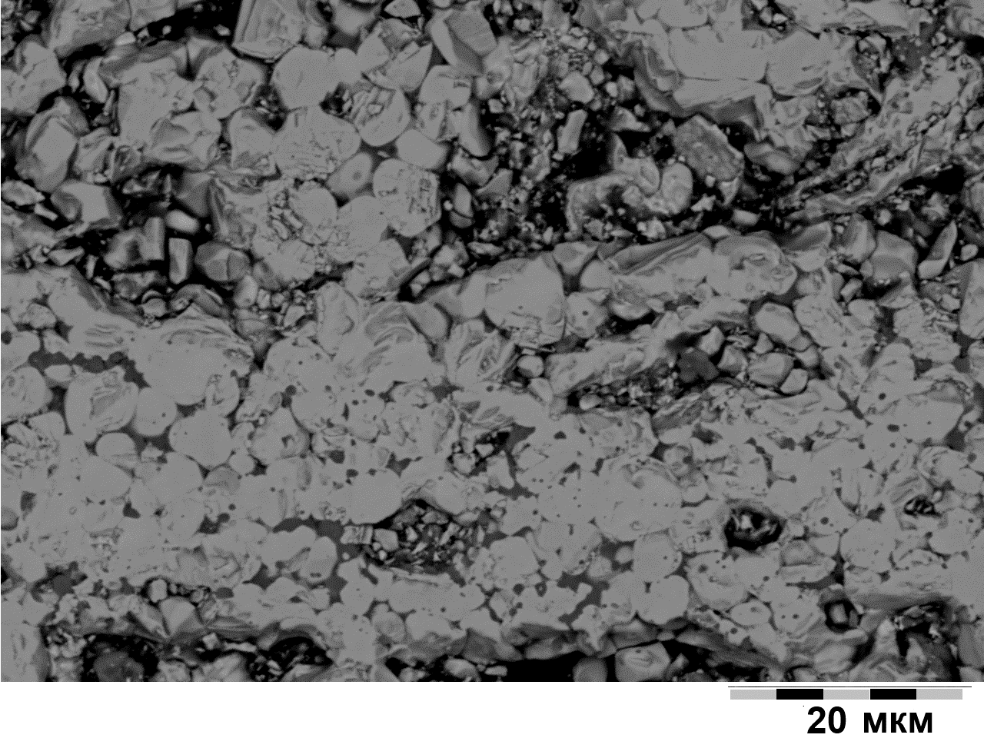
Ultra-high temperature (Ta,Zr)C carbide by HEBM + SHS
The melting points of binary (Ta,Zr)C carbides are extremely high: up to 4160 K. The adiabatic combustion temperature T_{ad} for of composition: 82.71% Ta+10.43% Zr+6.86%С is 2914K. Question: Can one produces single-phase complex carbide?
The particles deformed during HEBM to form flake shape composite agglomerates: smaller C and Zr particles are embedded into the tantalum flakes, resulting in formation of agglomerates ~ 200–300 mm in size
Ta
Microstructure of composite particles after HEBM
The dynamics of structural transformations in the combustion wave were studied. It was shown that Zr partially transformed into oxide is in the combustion zone at the initial stage of chemical interaction and remainder of Zr subsequently reacted with C to form zirconium carbide. Tantalum carbide also formed in the combustion zone, while the binary tantalum–zirconium carbide (Ta,Zr)C appeared in the post-combustion zone.
The XRD analysis demonstrates that the products synthesized by forced SHS compaction in a sand mold are the single-phase (Ta,Zr)C solution with the lattice parameter of tantalum-zirconium carbide of 0.4479 nm, which corresponds to 10–11% of zirconium in complex carbide.
Microstructure of single (Ta,Zr)C phase
E.I. Patsera, E.A. Levashov, V.V. Kurbatkina, D.Yu. Kovalev. Production of Ultra-High Temperature Carbide (Ta,Zr)C by Self-Propagating High-Temperature Synthesis of Mechanically Activated Mixtures// Ceramics International, Vol 41, 7 (2015) 8885-8893.

Slide 15
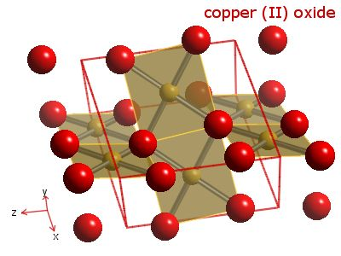
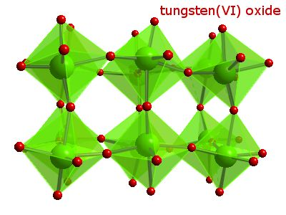
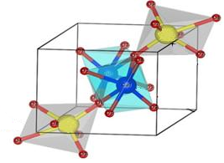
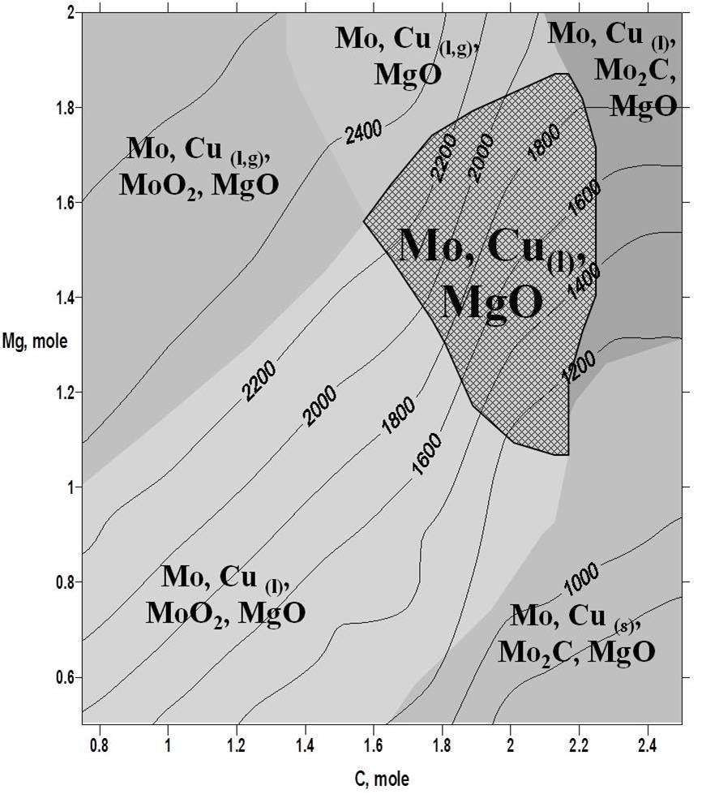
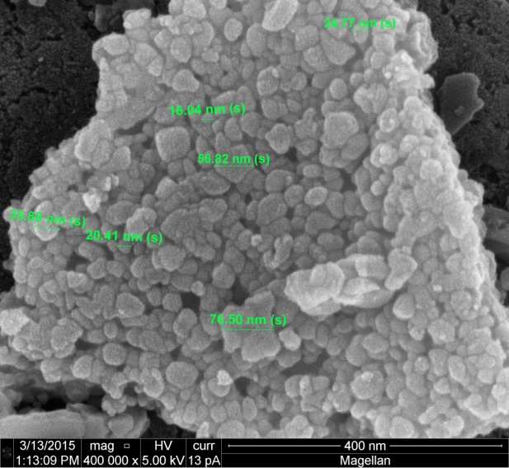
Cu-Mo(W) pseudo-alloys by combustion-coreduction approach
To perform joint reduction of oxides/salts in controlled combustion mode using the coupling of low exothermic reduction reactions (MeO+C) with a high-energetic one (MeO+Mg).
MoO₃ + 3Mg, T= 3500 K
Precursors preparation
Explosive reactions
CuO + Mg, T=3100 K
Mixing of MoO₃, CuO
Making a salt from co-precipitation or calcination
MoO₃ + 3 C, T= 650 K
CuO + C, T= 850 K
Mechanoactivation (planetary milling)
No combustion
Thermodynamic consideration
CuO - MoO₃ - Mg – C
T = 1000 - 2500 K
CuMoO₄ - Mg - C
CuO-MoO₃-Mg
CuO-MoO₃-C
SHS co-reduction by (Mg+C) mixture
Combustion laws and XRD/SEM analyses of pseudoalloys
S.V. Aydinyan, H.V. Kirakosyan, S.L. Kharatyan, Cu-Mo composite powders obtained by combustion-reduction process,
Int. J. Ref. Met. Hard Mater,2015, doi:10.1016/ j.ijrmhm. 2015.09.002.

Slide 16

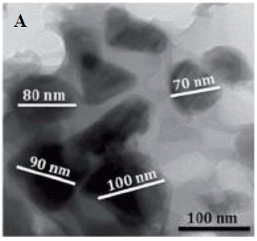
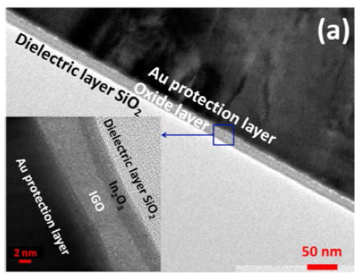
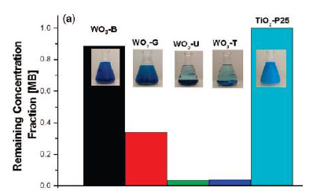
Solution Combustion Synthesis
WOS: 809/2057
Oxidizer,
typically nitrate
Fuel,
e.g. glycine
Solid
oxide or metal
Gas phase
products
Me^{v}(NO₃)₂ + 2n NH₂CH₂COOH
MeO_{v/2} + 5nH₂O+(n+v/2)N₂+4nCO₂
Applications
Energy
Catalyst
Semiconductors
Thin Films
Ceramics
Electrode
materials
for Li-on
batteries
Emission
control
Catalysts
Oxide semi-
conductors for
photocatalytic,
solar cells and
light emitting
applications
Crystalline
thin-film
transistors
Electro
-Ceramics
Catalytic
combustion of
natural gas
Magnetic
-Ceramics
Super
capacitors
Amorphous
thin-film
transistors
TiO₂, ZnO, WO₃
LaFeO₃, ZrV₂O₇,
ZrMo₂O₈, Cd₂SnO₄
Bi₂WO₄, Ag₂WO₄,
CuWO₄, ZnWO₄,
BiAgW₂O₈
Bio
-Ceramics
SOFC
electrolyte
Hydrocarbon
conversion
reactions
to fuel
In₂O₃
Zn-Sn-O
In-Zn-O
Structural
-Ceramics
TEM image of
Li₂FeP₂O₇
material
Ni-SiO₂
Supported catslyst
HRTEM image
of In₂O₃/InGaO_{x}
bilayer

Slide 17

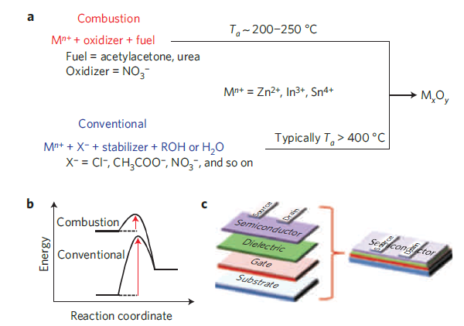
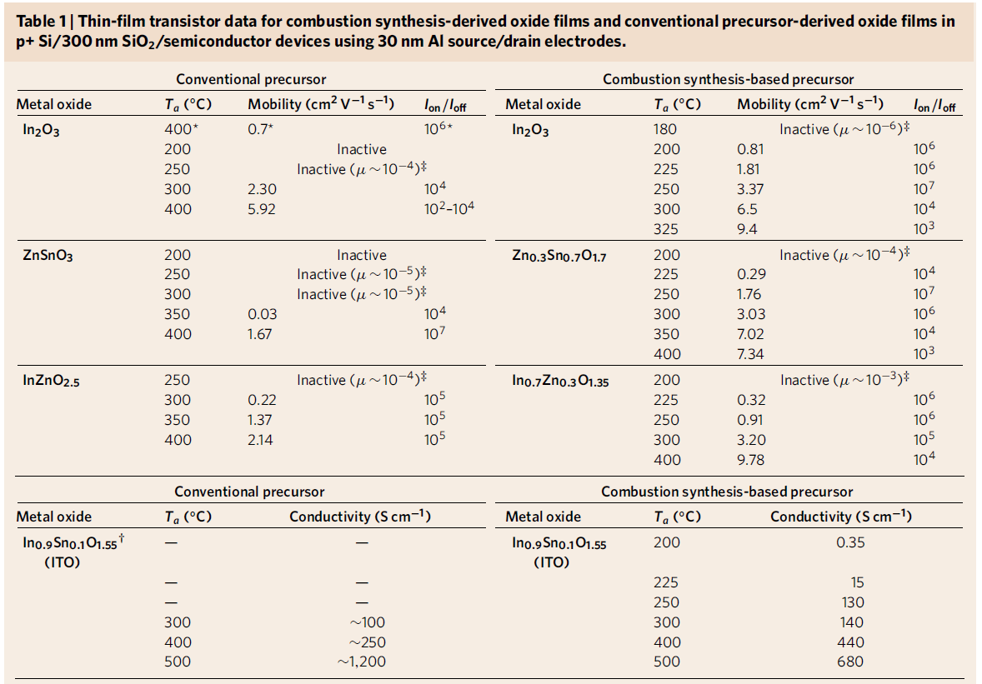
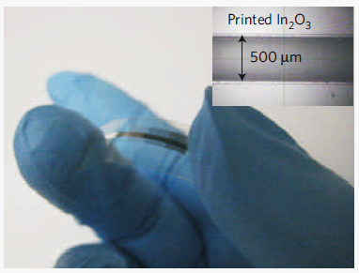
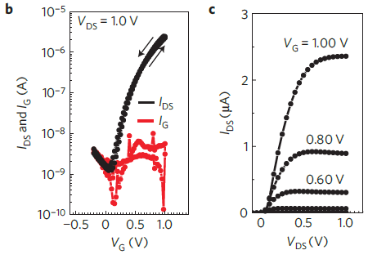
Low-temperature fabrication of high-performance metal oxide thin-film electronics via Combustion Processing
Optical image of a flexible combustion-processed In₂O₃ device on AryLite (30nm Al gate electrode/
41nm a-alumina dielectric, with 30nm Al source and drain electrodes) and Transfer characteristics (b)
and output characteristics (c) of flexible In2O3 thin-film transistors (TFTs ).
Source: Kim, M.-G.; Hennek, J. W.; Kim, H. S.; Kanatzidis, M. G.; Facchetti, A.; Marks,NATURE MATERIALS VOL 10 MAY 2011

Slide 18
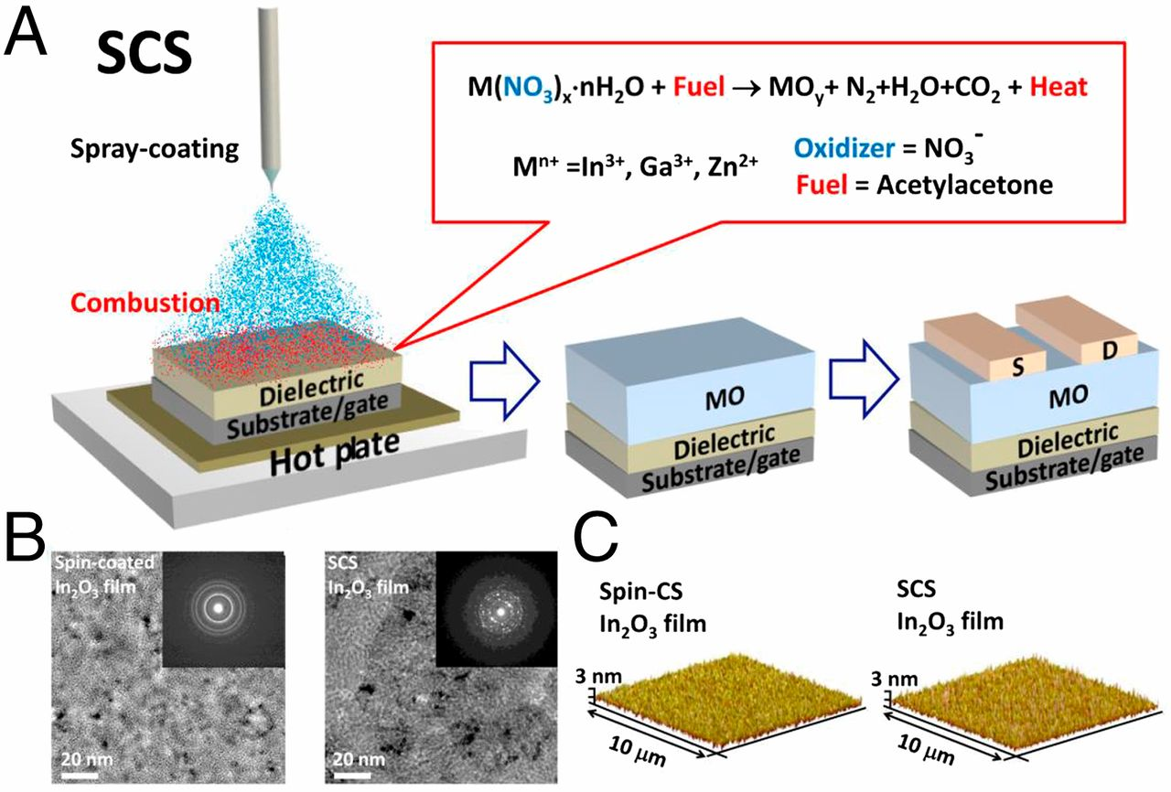
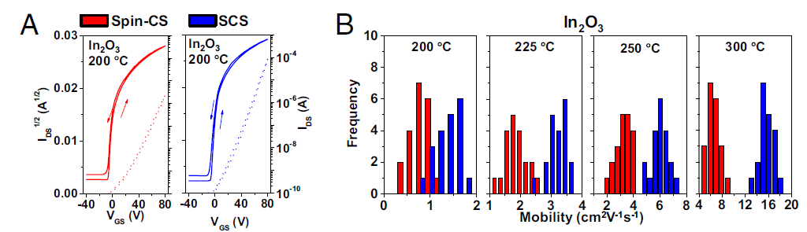
Spray-combustion synthesis: Efficient solution route to high-performance oxide transistors
Proc. Natl. Acad. Sci.
SCS of MO films and corresponding morphological characterization.
(A) Schematic of the SCS process used for growing MO films under
ambient conditions and the corresponding bottom gate top contact
TFT structure used in this study. (Inset) Combustion reaction for a
generic metal nitrate acting as the oxidizer and acetylacetone as the
fuel.
(B) High-resolution, bright-field transmission electron microscopy
(TEM) images and (Insets) selected area energy-filtered electron
diffraction patterns of In₂O₃ films deposited by spin coating and SCS.
(C) Atomic force microscopy images of 20-nm In₂O₃ films.
Transistor transfer characteristics and mobility distribution statistics for 20-nm-thick MO TFTs fabricated on SiO2/Si substrates by spin-CS (four MO layers that are 5-nm thick)
and SCS (single 20-nm MO layer).
Representative transfer plots (VD = 80 V) for In2O3 devices annealed at 200 °C.
(B) Corresponding saturation mobility distribution for In2O3 at the indicated temperatures.
Source: Yu, X.; Smith, J.; Zhou, N.; Zeng, L.; Guo, P.; Xia, Y.; Alvarez, A.; Aghion, S.; Lin, H.; Yu, J.; et al.
Spray-Combustion Synthesis: Efficient Solution Route to High-Performance Oxide Transistors. Proc. Natl. Acad. Sci. 2015, 112 (11), 3217–3222.

Slide 19
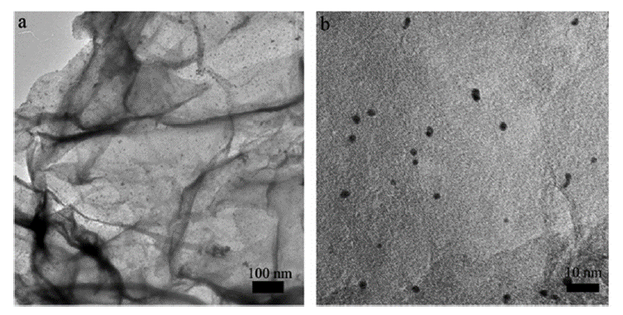
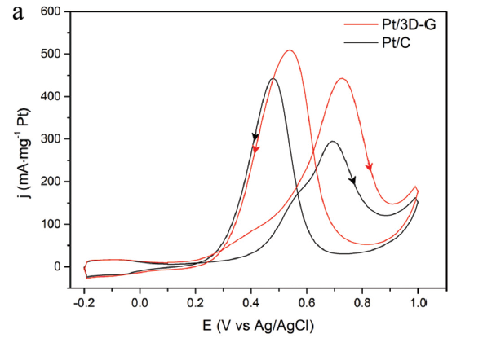
Catalyst by SCS
WOS: 101/274
Synthesis of 3D structured graphene as a highperformance catalyst support for methanol electro-oxidation
Direct-methanol fuel cells (DMFCs) have been regarded as an emerging green technology owing to the low cost, industrialscale availability, and high energy density of liquid methanol
A simple process for preparing 3D structured graphene (3D-G)
by a solution combustion method is reported.
The product was deposited with platinum and used for
Methanol electro-oxidation.
Characterization reveals that the Pt/3D-G catalyst has a more
negative onset potential as well asa higher electrochemically
active specific surface area than a commercial Pt/C catalyst.
Moreover, the catalyst exhibits higher tolerance to corrosion
than carbon black.
Low magnification TEM image of Pt/3D-G.
High magnification TEM image of Pt/3D-G.
Combustion Reaction:
GO + Glycine = 3D-G+N2+CO₂+H₂O
Electrocatalytic activities of the catalysts normalized to mass
Yecheng Li, Lei Zhang, Zhuofeng Hu and Jimmy C. Yu, Nanoscale, 2015, 7, 10896

Slide 20
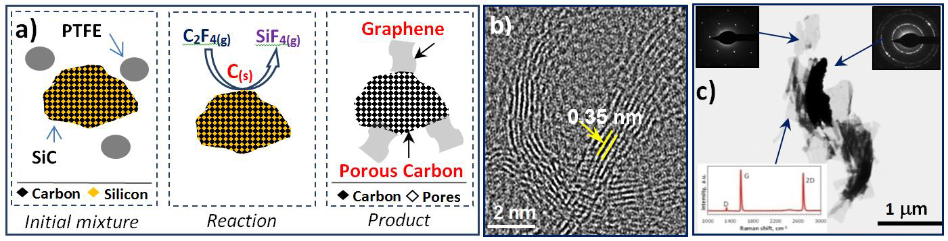
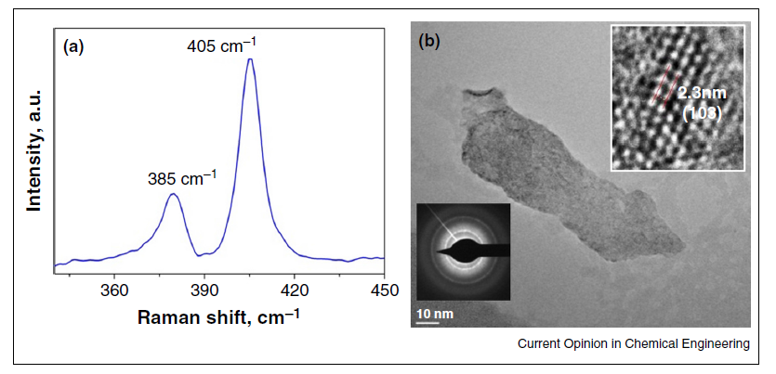
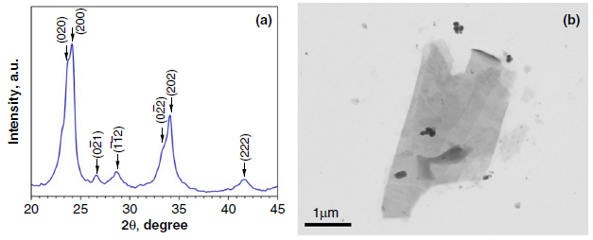


Combustion Synthesis of 2D-Structures
The reaction route in SiC + PTFE combustion wave to produce graphene (a),
folded graphene layers on the surface of porous particles (b)
and characteristic graphene flakes with selected area diffraction pattern (c)
Raman spectrum (a) and TEM image of single atomic layer MoS₂
sheet with selected area diffraction pattern and HRTEM image (b)
XRD pattern (a) and SEM image (b) of WO₃ thin crystals
Source: K. Manukyan and AS. Mukasyan, Current Opinion in Chemical Engineering, 7, 2015, 16–22

Slide 21


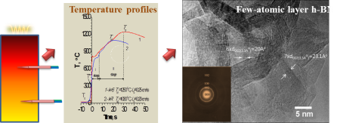
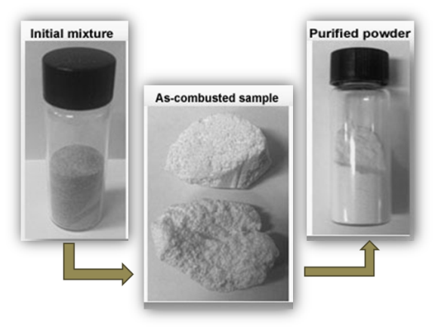
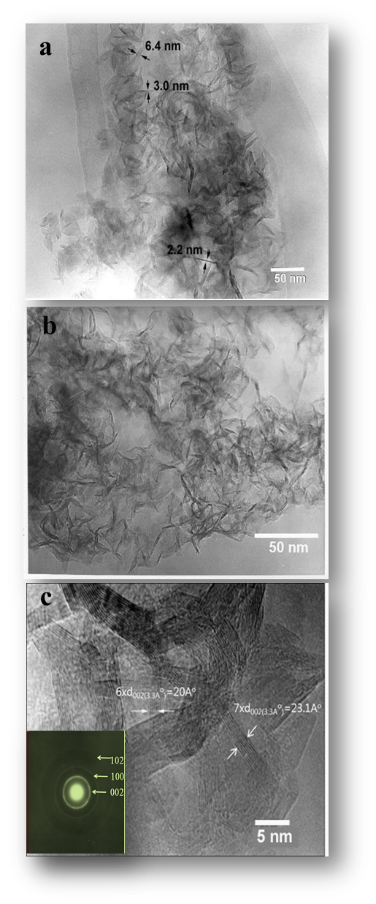
2D Crystals by SHS
Images of reaction species: a - initial mixture; b – large pieces of as-combusted sample; c - acid leached powder.
XRD patterns of purified h-BN samples
Time, s
Temperature-time profiles in the combustion wave of B₂O₃+Mg+kNH₄Cl system
Raman spectrum of h-BN nanosheets
TEM and HR-TEM images and SAD patterns
of purified BN samples
Chungnam National University,
Republic of Korea
Source: H. Nersisyan, T.-Hyuk Lee, Ka-Ho Lee, Y.-So An, Jin-Seok Lee, J.-Hyeon Lee,
RSC Advances, 5(12), 2015, 8579-8584

Slide 22
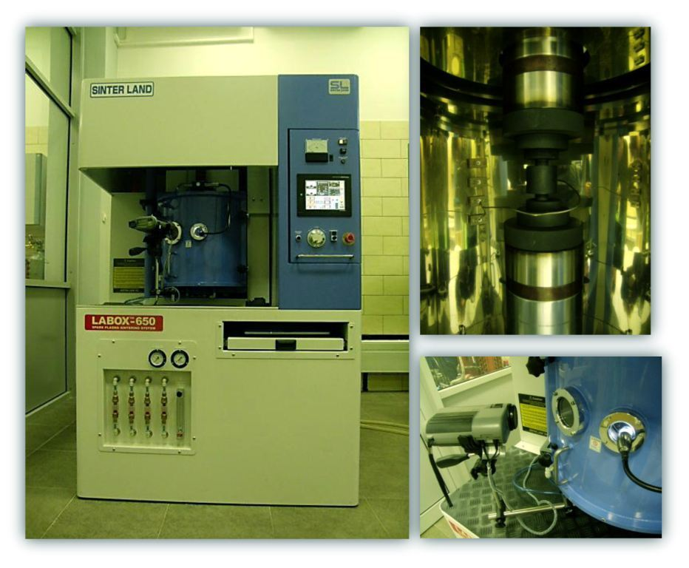
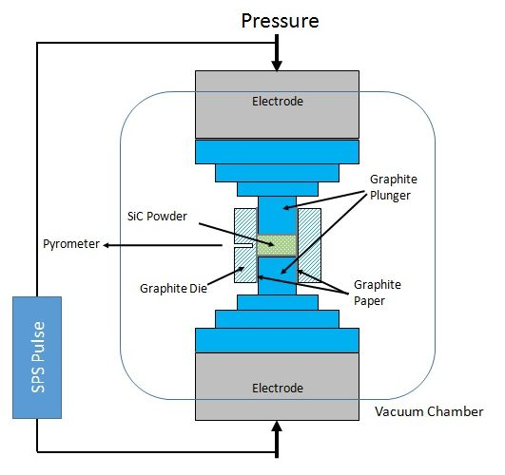
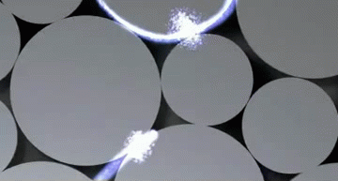
WOS: 27/107
Spark Plasma Sintering
(SPS)
# 09
The combination of the SHS and SPS techniques
offers a promising opportunity for the consolidation
in shorter processing times and milder temperature
conditions of difficult-to-sinter ceramic powders:
MB₂, MB₂-SiC, MB₂-MSi₂ and MB₂-MC-SiC (M=Zr, Hf, Ta)
The SHS route is able to rapidly provide highly sinterable UHTC (Ultra-high-temperature) powders
The severe heating and cooling rate conditions ➔
➔ higher defect concentration in SHS product
  A significant role is played by the stronger bonds established at the interfaces between the different phases formed in-situ during SHS
Sintering phenomena are promoted
LABOX-650 (Japan)
Schematic illustration of spark plasma sintering device

Slide 23
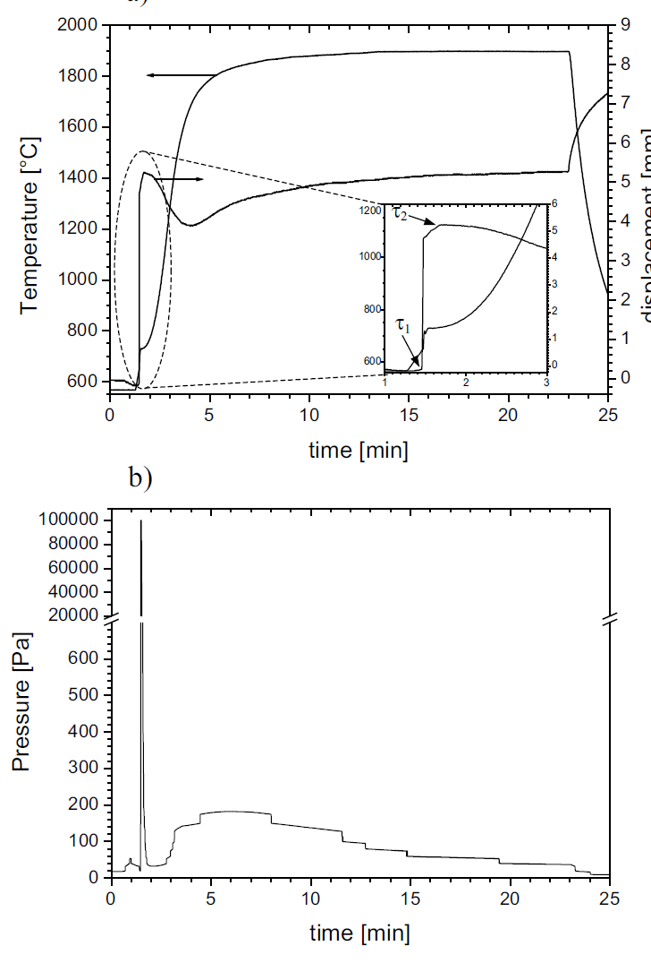
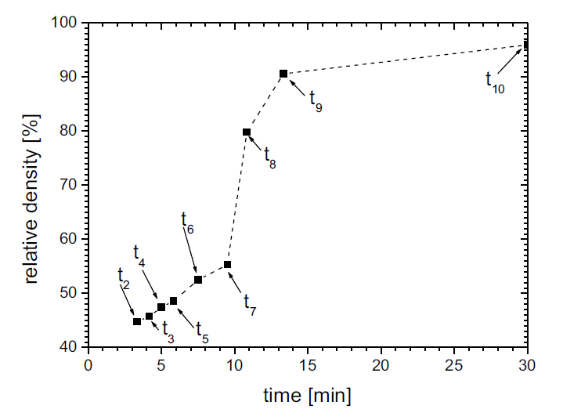
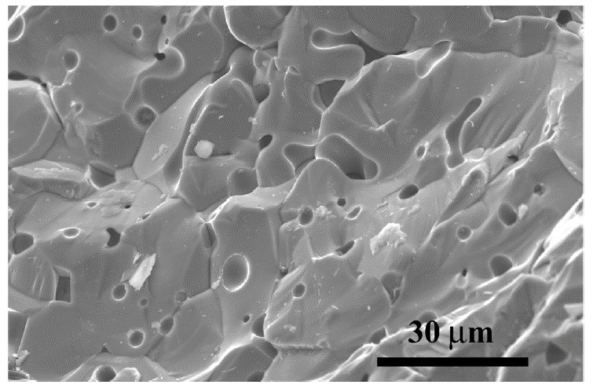
In situ synthesis and consolidation of ZrB₂ by reactive Spark Plasma Sinteringr
The effect of the heating rate during reactive SPS to obtain dense ZrB2 from elemental reactants is investigated. When the temperature is increased at 500◦C/min or faster, the synthesis reaction evolves under combustion regime. Despite of the combustion synthesis route allows to obtain pure dense products at milder temperature conditions, safety problems make its exploitation not convenient.
In particular, the abrupt sample displacement taking place during the
SHS reaction should be avoided, or care-fully controlled, for safety reasons,
as it may lead to die/punches breakage. The latter one certainly represents
a crucial aspect tobe accounted for in view of a possible process
scale-up for the fabrication of ZrB2 by reactive SPS.
Temperature, sample displacement (a)
nd gas pressure (b)during reactive SPS of ZrB2.
Density of final product obtained by
reactive SPS
SEM image of the fracture surfaces
for ZrB2productsobtained by reactive SPS
Licheri, R.; Musa, C.; Orru, R.; et al. JOURNAL OF THE EUROPEAN CERAMIC SOCIETY Volume: 35 Issue: 4 Pages: 1129-1137 Published: APR 2015

Slide 24


Pore-free SiC Ceramics by SHS+SPS
# 13
2000 ºC
200 K/min
60 min
90 MPa
Relative density
99,9 %
Equation for Calculation of K1C Values from Vickers Crack Systems
HV=24 GPa
Equation number | Reference | Equation | K1C, (MPa∙m1/2)
P-1 | Niihara et al. |  | 4.36±0.15
P-2 | Shetty et al. |  | 5.25±0.18
R-1 | Anstis et al. |  | 3.05±0.3
R-2 | Niihara et al. |  | 4.70±0.45
R-3 | Laugier |  | 3.0±0.30
It was demonstrated that 1 hour SPS at 2000ºC allows us to produce essentially pore-free SiC ceramics with market level properties (H_{V}=24.1±1.3 GPa; K_{1C}: 3-5 MPa∙m^{1/2}). It is worth noting all SPS experiments were carried without using of any sintering additives such as boron and carbon powders.
DO. Moskovskikh, Ya-C. Lin, PJ. McGinn, et al., J. Eur. Ceram. Soc., 477–486 (2015).

Slide 25




WOS: 10/10
Molecular Dynamics Simulation (DMS)
Record 2006: 1 million atoms Simulation time : 50 ns
system size : 220 A
S. Hub and Bert L. de Groot. Mechanism of selectivity
in aquaporins and aquaglyceroporins PNAS. 105:1198-1203 (2008)

Slide 26


Molecular Dynamics Simulation (DMS)
of SHS Processes
a
Stationary combustion regime:
combustion velocity is constant (20 m/s)
System involves 1 500 000 atoms
Stationary wave
T_{m}(Al)
fcc atoms (Ni, Al)
bcc atoms (NiAl)
unknown
a
b
c
Ni
Al
SHS in NiAl nanofoils: the microscopic study allows to understand the relation between the exothermic reaction wave and the microstructural transformation of the reactive media
Laboratoire ICB, Dijon - France
Source: O. Politano, and F. Baras, Journal of Alloys and Compounds 652 (2015) 25-29

Slide 27






Molecular dynamics simulations of the reaction mechanism in Ni/Al reactive intermetallics
An atomistic level description of the reaction mechanisms in thermally ignited samples of reactive core/shell Ni/Al wires. The combination of very long simulation times (up to 0.1 ms) and very reactive core/shell nanostructures enables ignition at unprecedentedly low temperatures for molecular dynamics simulations. Samples ignited at low temperatures (900 K or less) follow a multi-stage reaction process involving solid-phase diffusion and the formation of the B2 NiAl phase, while samples ignited at higher temperatures, follow a direct reaction path with accelerated diffusion of Ni into molten Al, leading to a completely molten final state. Interestingly, NiAl nucleates and grows under a significant concentration gradient, which may explain the absence of other phases like AlNi3. The formation of the B2 intermetallic slows atomic diffusion and consequently the reaction rates.
Al - blue
Ni
15 nm
Temperature vs time for different ignition temperatures,
thin black lines show exponential fits. Diffusion coefficient
as a function of ignition temperature showing two regimes
of Arrhenius behavior for the wires
Microstructure evolution during reaction for samples ignited at 650, 900
and 1000 K. fcc atoms (Ni or Al) are in green, B2 NiAl is in blue, while
amorphous or grain boundary atoms are in translucent orange
Purdue and J. Hopkins Universities, USA
Source: MJ. Cherukara, TP. Weihs, A.Strachan, Acta Materialia, 201596, 2015, 1-8

Slide 28

SHS Ceramic Composite Pipe
Company Profile: Sunny Steel Enterprise Ltd.
Product Brand: Sunny Steel
Region: China
Category: Minerals & Metallurgy - Steel Profiles
Link Tool: China Minerals & Metallurgy - China Steel Profiles
Product Tags: Resistant Ceramic Composite Pipe - SHS Ceramic Composite Pipe SHS Pipe
SHS- self -igniting alumina ceramic composite pipe is the
national 863 program in the field of new materials , and
the successful implementation of the industrialization of
high-tech achievements. The products are of corundum
(a-AL2O3) ceramic intermediate layer , three layers of steel
from the inside to the outside. Alumina ceramic composite
pipe full play to the high strength of corundum ceramics
with high wear resistance, heat resistance and steel has
excellent toughness and weldability , toughness ceramic
overcome poor and low carbon steel pipe hardness ,
poor wear resistance . Thus , the product has wear, heat ,
and resistance to mechanical shock and thermal shock,
and good weldability excellent overall performance.
It can be widely used in electricity, coal, steel , metallurgy,
mining, building materials , chemical industry , the transportation
of ash, slag , coal , ore, cement , sand and other granular
materials , grinding media ideal wear pipeline.
The product was identified in 1993 by the outcome of the
Ministry of Metallurgical Industry , and passed the Ministry of
Metallurgical Industry , Ministry of Power Industry , co-chaired
the big long straight pipe diameters SHS SHS ceramic composite
pipe product appraisal ( Ministry of Metallurgical Industry Section
1997 No. 53 ) . And received the 1998 National Key New Product.
Websitehttp://www.sunnysteel.com
Post Code200081
AddressNo.273, Siping Road

Slide 29


Nitride LED Phosphors by CS
In 2011 Prof C.W. Won established a LED phosphor production company (Ellim Advanced
Materials) in Korea, based on nitride phosphors fabricated by the combustion process [1,2].
Ellim Advanced Materials has been manufacturing and selling high performance LED
phosphors to domestic and overseas markets. Ellim's major customers are LG innotek and LG
display.
llim Advanced Materials Company, Ltd
Suite #520-1, College Of Engineering 3-ho
Chungnam National Univ., 220, Gung-dong, Yuseong-gu
Daejeon 305-764
SOUTH KOREA

Slide 30
Concluding Remarks
No doubt that the scientific field “Combustion phenomenon for the materials synthesis” is growing
Moreover, the rate of growth is exponential function vs time and a significant acceleration in number of publications has been observed during last three years
Combustion phenomenon was used for fabrication of almost all known compounds, including currently hot materials, such as 2D-crystals, complex organic-inorganic perovskites, thin films and ceramics with record high melting points.
Many new countries became active players in the combustion synthesis field

Slide 31
  the combustion aspect, which is related to the fundamentals of self-sustained high-temperature reactions, is becoming weaker and weaker. This contradicts my general believe that the CS process can be accurately control ONLY on the basis of deep understanding of this phenomenon. Understanding the importance, as well as
  difficulties of the problem, we have to strengthen this direction of the research;
  it is clear that new computational methods, which with currently available supercomputing capabilities, allow now investigate and predict a variety of materials properties, including nano-and crystal structures, physical and mechanical properties. Experimental groups should closely work with computational teams, for the effective fabrications of the materials with desired properties.
  in order to be published in the top Journals, be cited and world recognized, it is not enough any more to develop a novel synthesis approach. It is even not enough to characterize the structure of the materials at the highest possible level. However, it is critical to provide data on the unique properties for these materials targeting special applications. It is a difficult task. One of the possible solution is to “build” a team of experts and establish the collaborative type of work.
  Advertising the examples of the Industrial Applications is vital: this will allow to bring more findings to the field. Funding is a driving force of the research!
New methods and techniques recently developed or enhanced in material science, allow to investigate many process “in-situ” and even under “operando” conditions. To be at the front of the research we have to work hard and develop CS related methodologies and methods, which include these advanced capabilities

Slide 32
Concluding Remarks
Analysis of literature, related to CS, and current trends in Material Science suggest that:
  the combustion aspect, which is related to the fundamentals of self-sustained high-temperature reactions, is becoming weaker and weaker. This contradicts my general believe that the CS process can be accurately control ONLY on the basis of deep understanding of this phenomenon. Understanding the importance, as well as difficulties of the problem, we have to strengthen this direction of the research;
  in order to be published in the top Journals, be cited and world recognized, it is not enough any more to develop a novel synthesis approach. It is even not enough to characterize the structure of the materials at the highest possible level. However, it is critical to provide data on the unique properties for these materials targeting special applications. It is a difficult task. One of the possible solution is to “build” a team of experts and establish the collaborative type of work.
  New methods and techniques recently developed or enhanced in material science, allow to investigate many process “in-situ” and even under “operando” conditions. To be at the front of the research we have to work hard and develop CS related methodologies and methods, which include these advanced capabilities.
  it is clear that new computational methods, which with currently available supercomputing capabilities, allow now investigate and predict a variety of materials properties, including nano-and crystal structures, physical and mechanical properties. Experimental groups should closely work with computational teams, for the effective fabrications of the materials with desired properties.
  Advertising the examples of the Industrial Applications is vital: this will allow to bring more findings to the field. Funding is a driving force of the research!

Slide 33
With development of novel SHS/CS methods, including solution combustion synthesis, it appears that almost any type of materials can be fabricated by using combustion phenomenon!!
NO limitations!!
We are material science magicians!
If it is so, we may use currently very popular and effective approach, which consider analysis of rapidly changing state-of-art problems in material science, for example, suggested by novel theoretical models, and rapidly demonstrate the shs/cs capabilities in solving these problems.
Such “populistic” approach, that is used by many material science groups all over the world, allows put the shs/cs in the first raw of the most popular and widely used scientific directions thus bringing world recognition, funding and bright future but we have to stick with our trademark: any novel direction should be then supported by deep fundamental studies of the observed phenomena.
New CS Paradigm

Slide 34





Acknowledgement
Author gratefully acknowledges the financial support of the following Agencies:
Department of Energy (DOE),under Award Number
DE-NA0002377;
Defense Threat Reduction Agency (DTRA), Grant Number HDTRA1-10-1-0119
Ministry of Education and Science of the Russian Federation in the framework of Increase Competitiveness Program of NUST No. K2- 2014-001

