Slide 1

Skoltech
Education for Innovation
Dr. Maxim Kiselev
Global Technology Symposium
San-Mateo
March 26-28, 2014
Notes:
We have been operating under a strategy, we believe in it, and it has served us well
It led to the operations plan, which you approved in October
Drafted when much of context and stakeholder expectations were less well known, and when we had no little operational experience
Therefore time to update:
fold in stakeholder expectations (3 studies)
learning from past 18 months
benchmarking of peer programs (about 8 – alto, Imperial, ETH, EPFL, HKUST, SUTD,
, Stanford)
Process was kicked off in March, internally run, with cycles throughout team, mit and foundation,
Now a converged draft, but important to get your input and thoughts
Intentionally long, because this is how academics communicate, and a shorter concise version will be created
Three outcomes : strategy as allocation of resources and guidance for organization; project to gov; and communication plan to stakeholders

Slide 2
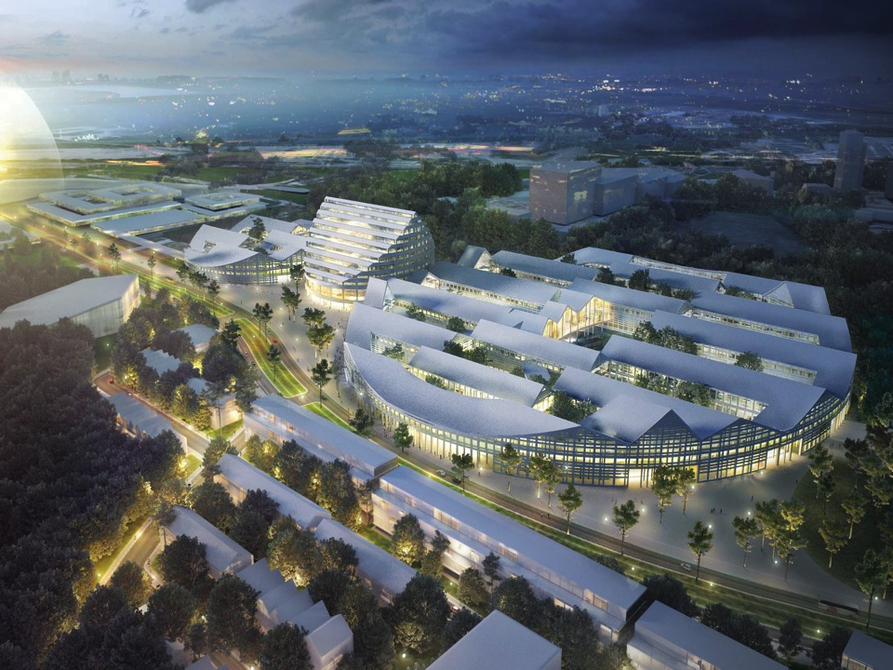
A NEW TYPE OF UNIVERSITY DESIGNED
TO ACCELERATE INNOVATION

Slide 3


Skoltech is a Partner in Developing the Skolkovo Innovation Ecosystem
City
Innovational
environment
Technology corporations
Students
Innovators
Infrastructure
Infrastructure
Infrastructure
International universities
Skoltech
Start-ups – professors,
students, graduates
Participants
Start ups
Technopark
Mature companies
Expertise
Graduates, students
Market feedback
Contracts for R&D
Business expertise
Professors
Spin-off’s
Financing
Financing
Industrial
Companies
Market feedback
Venture
Funds
Community
Market feedback
Partners

Slide 4
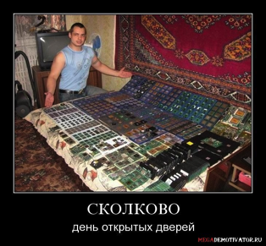
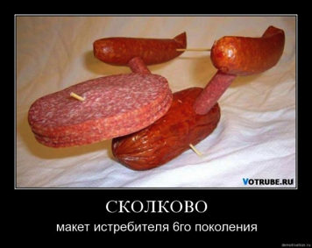

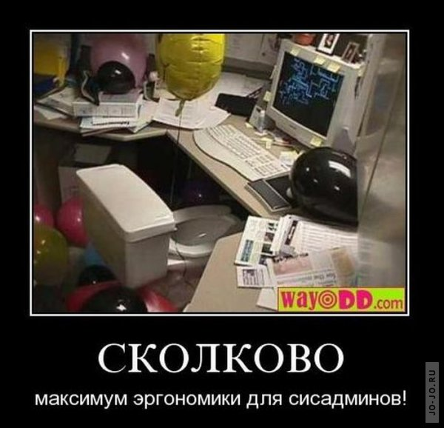
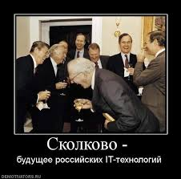


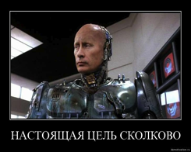
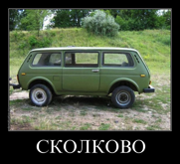


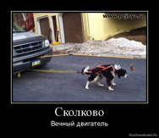

Slide 5
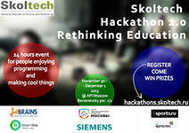
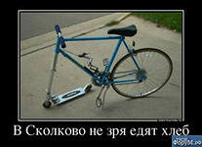
Designing Skoltech
Why build Skoltech?
How would you design a new type of university in Russia?

Slide 6







Russia Already Has Great Universities

Slide 7
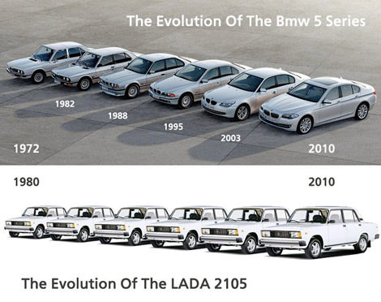
The Problem, in one picture

Slide 8
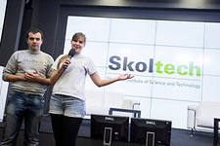

Skoltech at a Glance
A unique Russian institution in an international context
By 2020, Skoltech will have: 200 faculty, 300 post-docs, 1200 MSc and PhD
Integrates science, engineering, and technology
Addressing problems and issues in Information, Energy, Biomedicine, Space, and Nuclear
With strong programs in support of innovation and entrepreneurship
On a new campus, to be built in Skolkovo, near Moscow
Engine of the Skolkovo Innovation City
Special status in the Russian higher education landscape

Slide 9
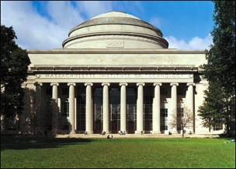
Start-Up Partner: MIT
Leadership of Skolkovo deeply impressed by MIT’s economic impact
MIT is involved in every aspect of launching Skoltech:
  Recruiting and selecting faculty
  Planning education
  Delivering innovation program
  Engaging in research centers
  Attracting & educating students
  Developing policies
  Planning campus
  Establishing university endowment

Slide 10

Start-up Organizational Goal
Make Skoltech comparable in scientific and engineering excellence to the best universities in the world
Make Skoltech the most economically impactful institute of science and technology in the world
Better
Economic Impact
Close
Scientific and engineering excellence
Skoltech is designed to be an engine of economic growth

Slide 11
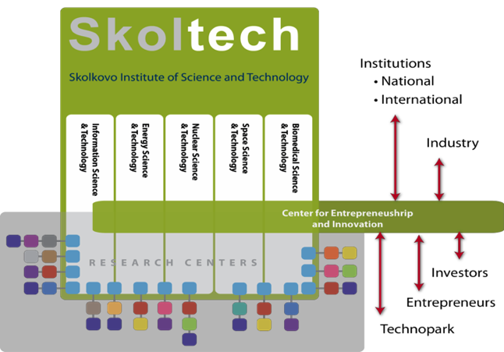
Start-Up Principle (A University Organized by Research & Innovation)

Slide 12
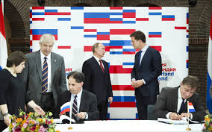
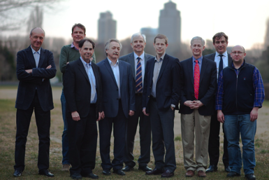
What is a Skoltech CREI?
Interdisciplinary or post-disciplinary center for research, education, and innovation
  Skoltech does not have “departments” (faculties, kafedras)
Each center is organized around a “problem” in need of solutions (in information, energy, life sciences/health, space technology, and nuclear technologies)
Each center is a COLLABORATION: Skoltech + 1 Russian partner university + 1 international university
10-15 faculty members, 30 postdocs, 40-50 Ph.D. students
$5-10 million annual budget

Slide 13
CREIs in 2013-2014 (& Ph.D. Studies!)
Bio: Stem Cell Center (Skoltech + U of Groningen + Vavilov Institute)
Materials: Advanced Structures, Processes, and Engineered Materials (Skoltech + Delft + TU Berlin + U Dayton + U South Carolina)
Energy: Electrochemical Storage (Skoltech + MSU + MIT)
Bio: Infectious Diseases and RNA Therapeutics (Skoltech + MSU + MIT)
Energy: Center for Modeling, Design, & Analysis of Energy Systems (Skoltech + NSU + MIT)
Energy: Center for Integrated Hydrocarbon Recovery (Skoltech + U of Texas + Texas A&M + U of Calgary + Bashkir State)
IT: Center for Data-Intensive Science and Engineering (Skoltech + U of Texas + MIPT)
IT/Nuclear: Center for Quantum Materials (Skoltech + MIPT + Stony Brook U)
IT: Center for Scalable Hardware for Big Data (Skoltech + MIT + many others)
Space: Center for Space Technology (Skoltech + many others)

Slide 14
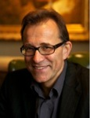
CREI Energy Systems
Janusz Bialek
Professor, Director-Designate of Energy Systems CREI (from July 2014)
Professor Janusz Bialek received his MEng and PhD degrees in Electrical Engineering from Warsaw University of Technology in 1977 and 1981, respectively. From 1981 to 1989 he was a lecturer at Warsaw University of Technology. In 1989 he moved to a lectureship in Durham University. From 2003 to 2009 he held Bert Whittington Chair of Electrical Engineering at the University of Edinburgh. He returned to Durham University in September 2009 to take up the Chair of Electrical Power and Control. From June to December 2012 he was seconded to Department of Energy and Climate Change (DECC) as DECC/EPSRC Science Policy Fellow. He was also a Visiting Professor at Swiss Federal Institute of Technology (EPFL) in 2000, and at Hong Kong University in 2008.

Slide 15
Research Priorities (CREIs)
Biomedicine:
  Computational and systems biology
  RNA-therapy/infectious diseases
  Biomedical visualization/imaging
  Regenerative medicine (Stem cells)
Energy:
  Hydrocarbon fuel production and transportation (Upstream)
  Materials and devices
  Electrical power systems generation and distribution (Grids)
  Electrical energy storage
Nuclear:
  Nuclear sciences
  Nuclear operations & safety
IT:
  Machine learning and AI
  Advanced computing systems
  Big Data
  Quantum physics/technology
Space:
  Supporting humans in long term space exploration
  Sensors, payloads, systems engineering
  Utilization of space data
Cross-cutting:
  Composite materials
  Computational and data-intensive science & engineering
  Human engineering and cognition
On the margins / excellence in targeted areas

