Slide 1
Austenitic stainless steel powders consolidated by explosive:
role of particle size in austenite content
A.R. Farinha¹, R. Mendes² and M. T. Vieira¹
¹CEMUC® Group of Nanomaterials and Micromanufacturing
²ADAI– Association for the Development of Industrial Aerodynamics
Mechanical Engineering Department - University of Coimbra – Portugal
XI International Symposium on Explosive Production of New Materials: Science, Technology,
Business and Innovations;
2-5 May 2012, Strasbourg, France

Slide 2
Content
Objective
Explosive compaction process
Explosive characteristics
Results
Conclusions
EPNM, 2012

Slide 3
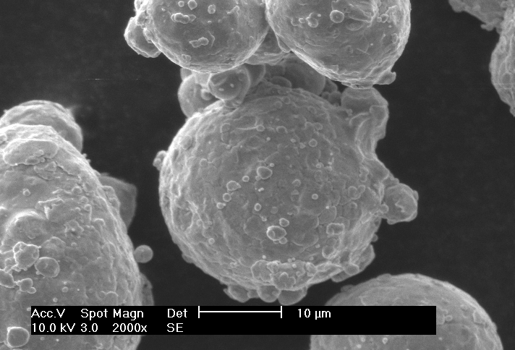
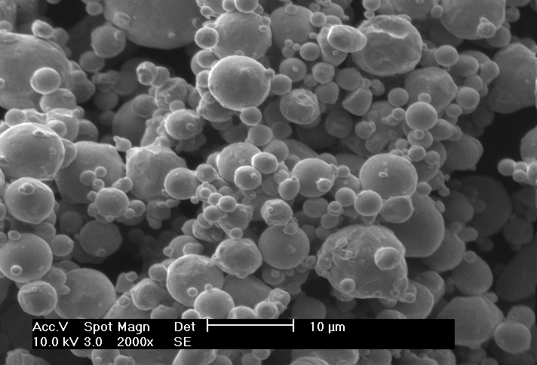
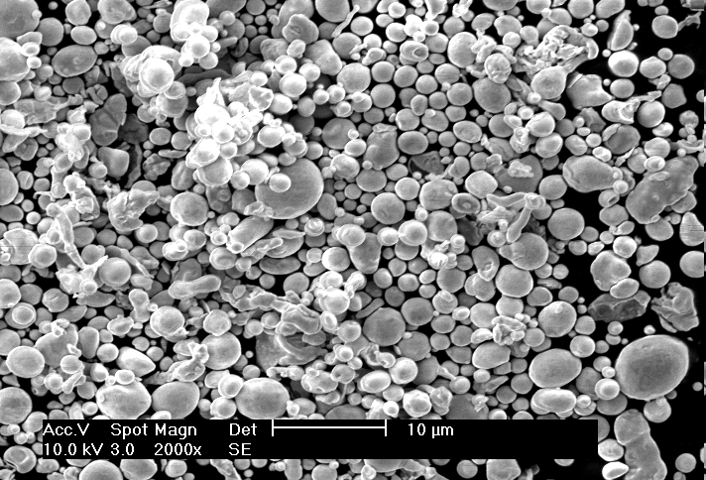
Objective
Spherical austenitic stainless steel 316L powder
Size
Structure
Si
ze
Ferrite
d₅₀=28 μm
d₅₀=9 μm
d₅₀=5 μm
Explosive consolidation behaviour
EPNM, 2012

Slide 4
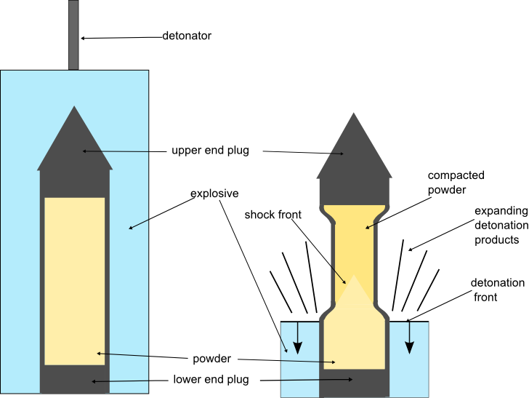
Explosive densification: Process
Cylindrical Configuration
EPNM, 2012

Slide 5
Explosive densification: Process
EPNM, 2012

Slide 6
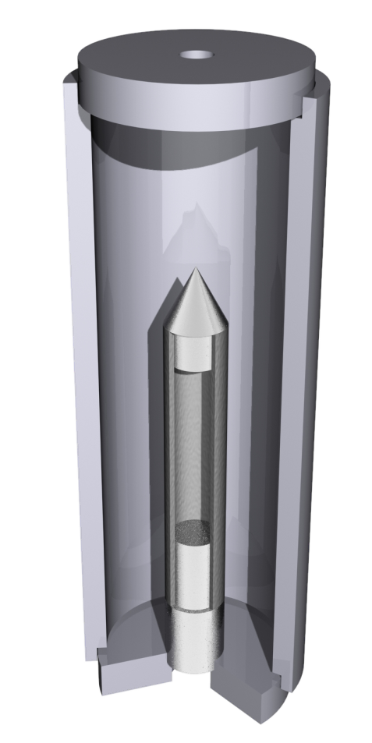
Explosive
Emulsion Explosive – Ammonium nitrate based water-in-oil emulsion
AN/water/wax, emulsifiers (84/10/6)
Hollow perlite micro spheres (15 -10 %(w/w))
Different detonation velocity (3.5 – 4.0 mm/μs)
EPNM, 2012

Slide 7
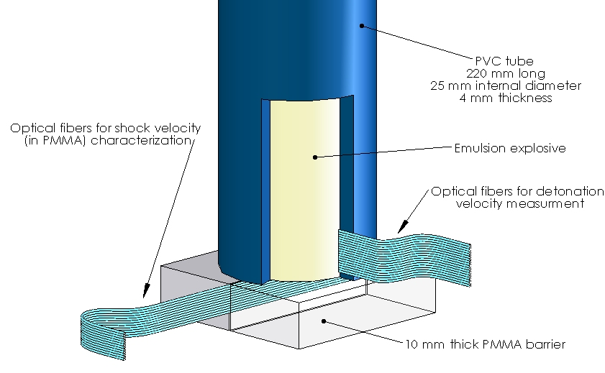
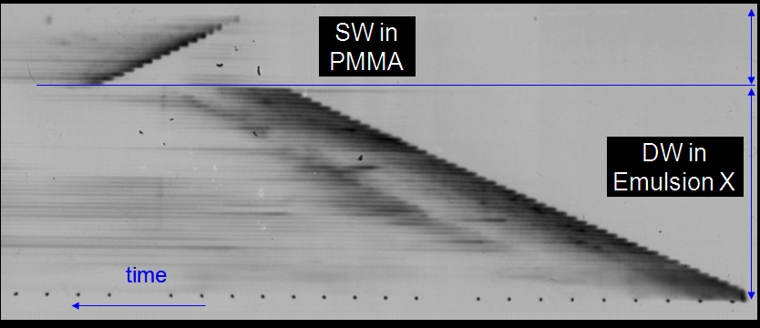
Explosive characterization
250 μm
EPNM, 2012

Slide 8
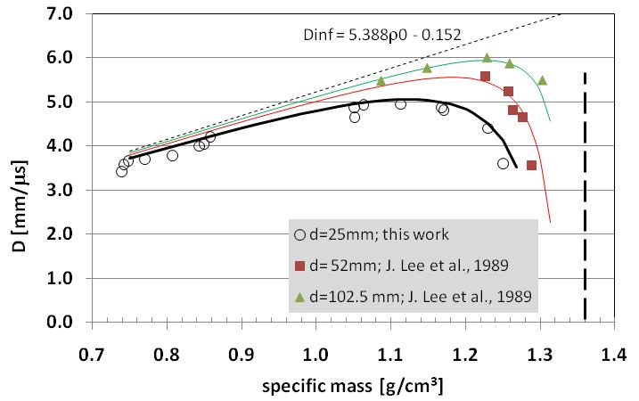
Explosive – Detonation velocity
- The non-ideal behaviour of EX detonation process, is well-defined in the low porosity zone.
- D(ρ₀) curves, Silvestrov model (2006)
EPNM, 2012

Slide 9
Effect of phase transition on compact features
Detonation velocity = 3.5 mm/μs; E/M= 1.1
Powder:
Austenite
No cracks
Powder:
Austenite
Ferrite
Cracks
Powder:
Ferrite
Austenite
some Cracks

Slide 10
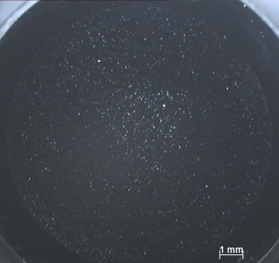
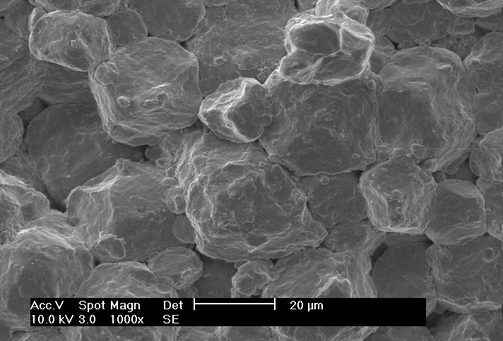
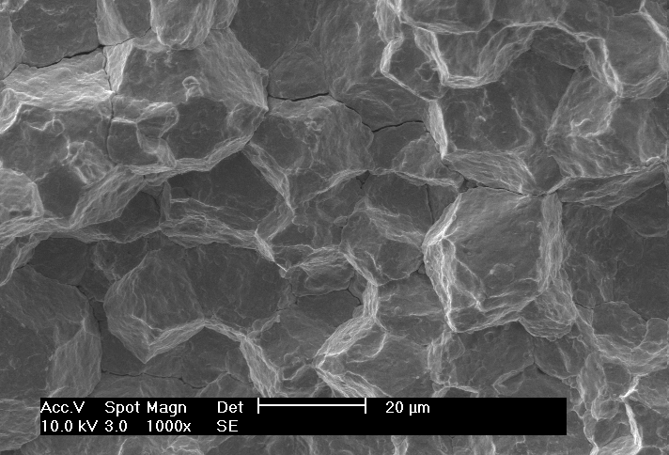
Effect of phase transition on compact features
Powder:
Austenite
No cracks
Compact:
Austenite
Ferrite
Detonation velocity = 3.5 mm/μs; E/M= 1.1
EPNM, 2012
Periphery Centre

Slide 11
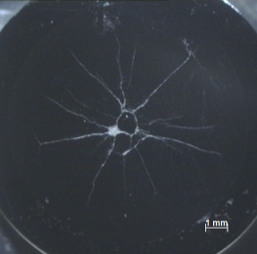
Effect of phase transition on compact features
Detonation velocity = 3.5 mm/μs; E/M= 1.1
Powder:
Austenite
Ferrite
Cracks
Compact periphery:
Austenite / Ferrite
Compact centre:
Austenite
Periphery Centre Periphery
EPNM, 2012

Slide 12
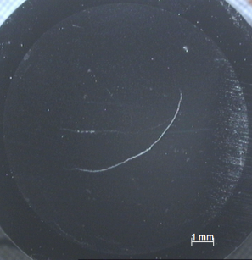
Effect of phase transition on compact features
Powder:
Ferrite
Austenite
Cracks
Compact:
Ferrite
Austenite
Detonation velocity = 3.5 mm/μs; E/M= 1.1
Periphery Centre
EPNM, 2012

Slide 13
Effect of phase transition on compact features
Detonation velocity = 4 mm/μs; E/M= 1.3
Powder:
Austenite
micro
Cracks
Powder:
Austenite
Ferrite
Cracks
Powder:
Ferrite
Austenite
Cracks

Slide 14
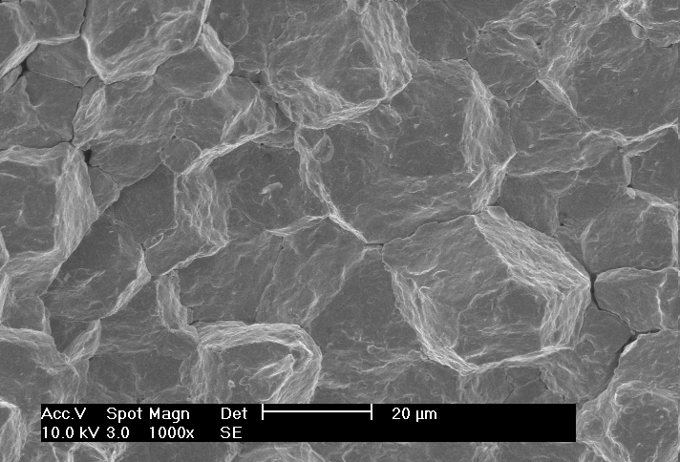
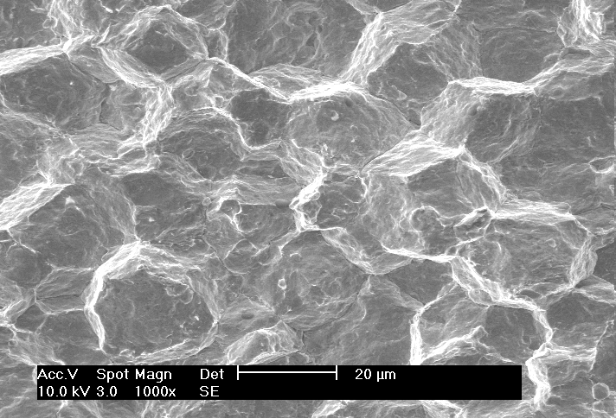
Effect of phase transition on compact features
Powder:
Austenite
Micro Cracks
Compact:
Austenite
Ferrite
Detonation velocity = 4 mm/μs; E/M= 1.3
Periphery Centre
EPNM, 2012

Slide 15
Effect of phase transition on compact features
Powder:
Austenite
Ferrite
Cracks
Compact periphery:
Austenite / Ferrite
Compact centre:
Austenite
Detonation velocity = 4 mm/μs; E/M= 1.3
Periphery Centre Periphery
EPNM, 2012

Slide 16
Effect of phase transition on compact features
Powder:
Ferrite
Austenite
Cracks
Compact periphery:
Ferrite / Austenite
Compact centre:
Austenite
Detonation velocity = 4 mm/μs; E/M= 1.3
Periphery Centre Periphery
EPNM, 2012

Slide 17
Conclusion
The very fine powders subjected to high cooling rates, during atomisation process, present a considerable amount of ferrite, which was not the case for the large powder size.
The ferrite fraction underwent a phase transition to austenite (compact centre) when subject to a explosive compaction. A circular and radial cracks are generated.
On the contrary, larger powders subjected to the explosive compaction, exhibit a small fraction of ferrite after compaction. A good compacts were obtained.
EPNM, 2012

Slide 18
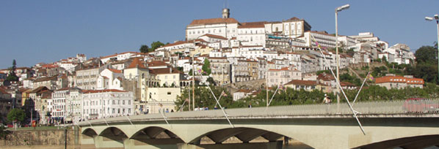
Thank you for your attention
Ricardo Mendes
ricardo.mendes@dem.uc.pt
rita.farinha@dem.uc.pt
Acknowledgments
The authors would like to thank the Portuguese Foundation for Science and Technology (FCT) through SFRH/BD/41214/2007 for financial support, and to LEDAP –Lab. Energetics and Detonics

