Slide 1
FABRICATION OF corrosion-resistanT multilayer materials by explosive welding
PENZA STATE UNUVERSITY
PENZA , RUSSIA

Slide 2
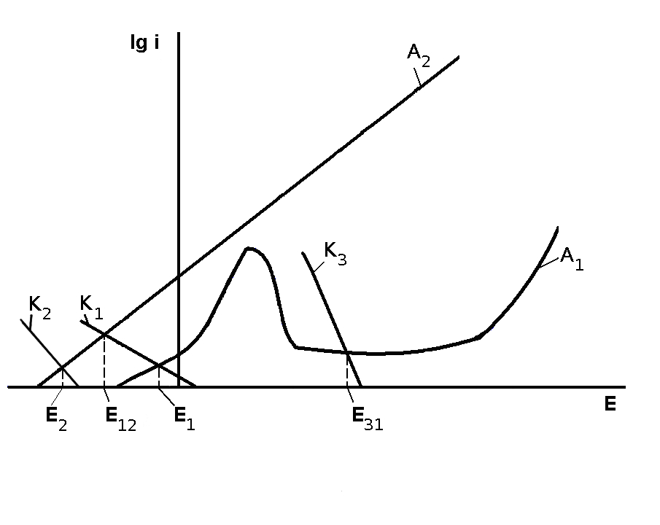
Anodic and cathodic polarization curves

Slide 3
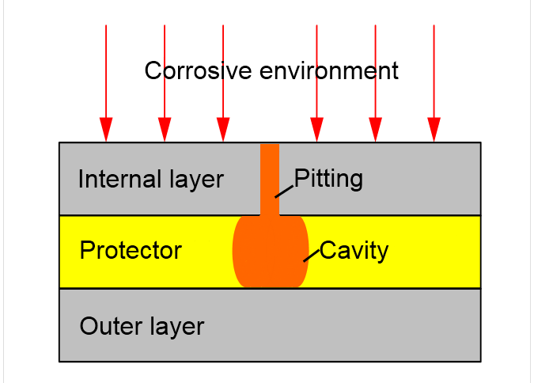
The corrosive influence on multilayer material

Slide 4
The international application РСТ WO2010/036139 A1«Multilayer material with enhanced corrosion-resistance (variants) and methods for preparing same»
USA, Japan, Korea, China, Ukraine
European Patent Office
Eurasian Patent Organization

Slide 5
Multilayer materials by explosive welding
stainless steel – carbon steel - stainless steel
12Х18Н10Т – 20 – 12Х18Н10Т
stainless steel – carbon steel - stainless steel - low-alloyed steel
12Х18Н10Т – 20 – 12Х18Н10Т – 09Г2С
stainless steel – copper - stainless steel
12Х18Н10Т – M1 – 12Х18Н10Т

Slide 6
The requirements of certification
Testing of corrosion resistant
Testing of stress-strain properties
Testing of technological properties

Slide 7
BASE STANDARTS
GOST 9.912 United system of corrosion and ageing protection. Corrosion resistant steels and alloys. Methods of accelerated tests for resistance to pitting corrosion
BS EN ISO 11463:2008 Corrosion of metals and alloys. Evaluation of pitting corrosion
ASTM G48 - 11 : Standard Test Methods for Pitting and Crevice Corrosion Resistance of Stainless Steels and Related Alloys by Use of Ferric Chloride Solution

Slide 8
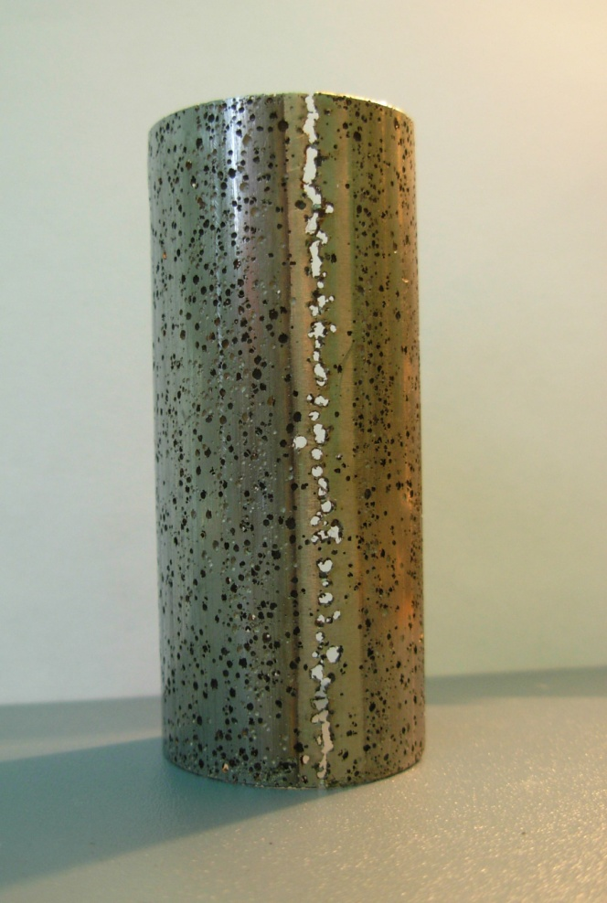
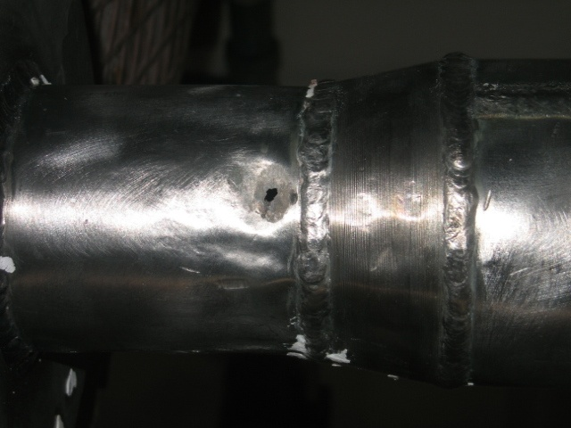
Pitting corrosion in stainless steel

Slide 9
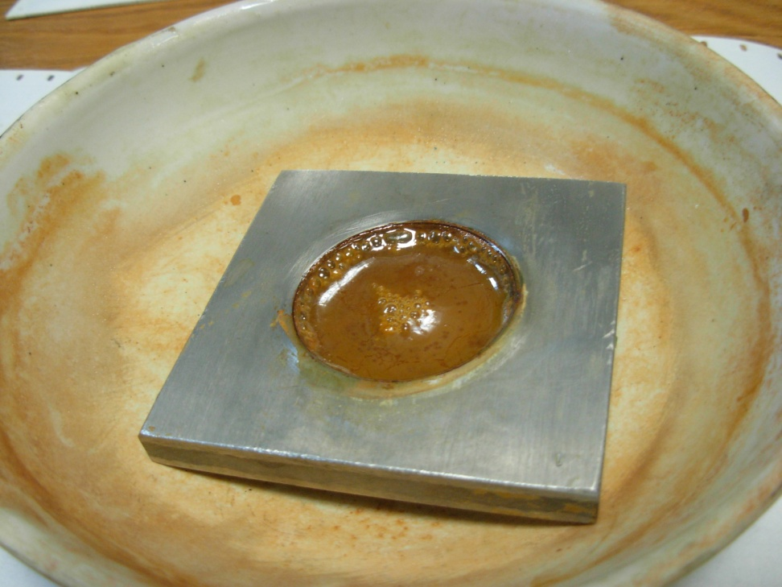
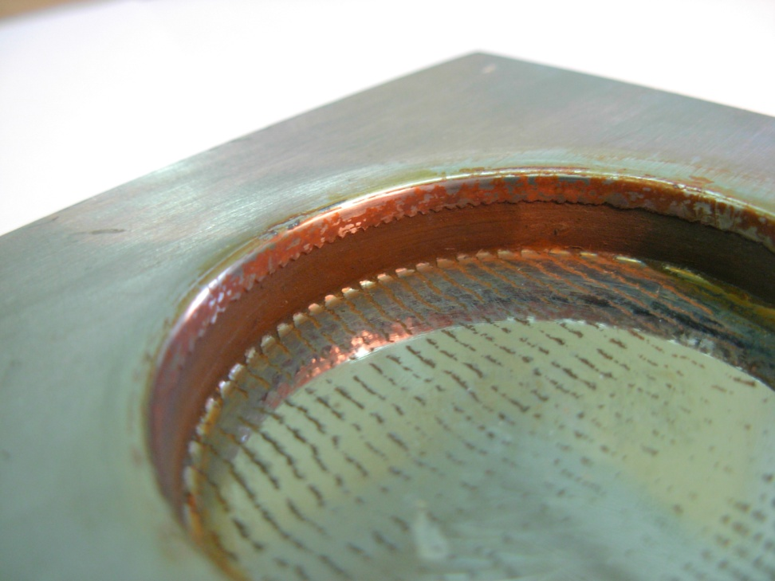
Calculation of pittings on protected surface

Slide 10
Anode solution reactions of protector
Аnode | Cathode
Fe⁰ → Fe⁺² + 2e | Fe⁺³+ 2e → Fe⁺² 2H⁺ + 2e → H₂

Slide 11
The quantitative measures
The number of holes on the unit of area
The depth of holes
The number of holes that was formed for long period

Slide 12
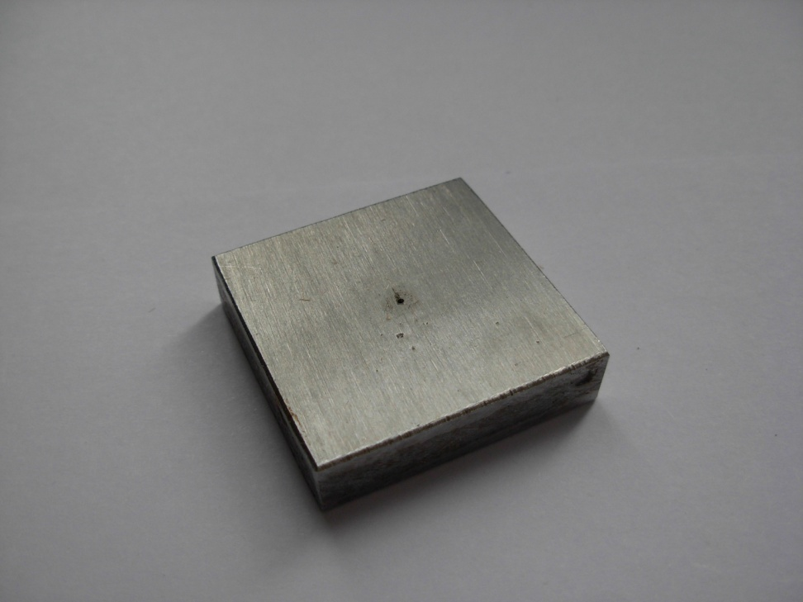
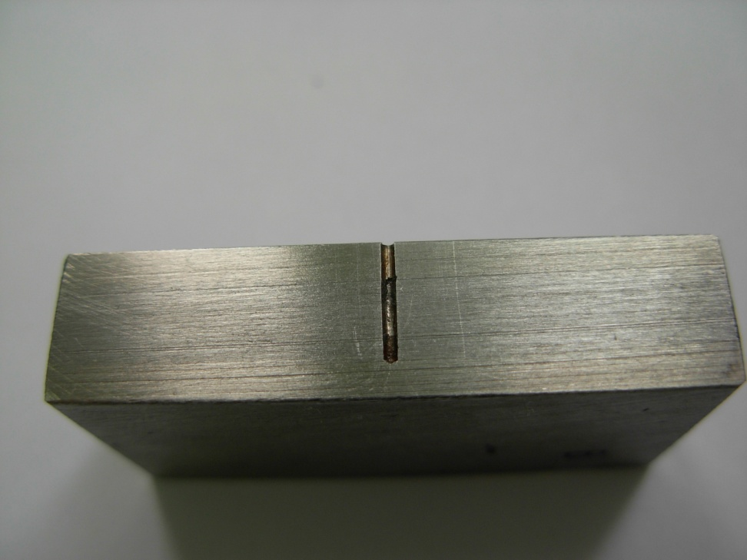
Specimen with synthetic pittings

Slide 13
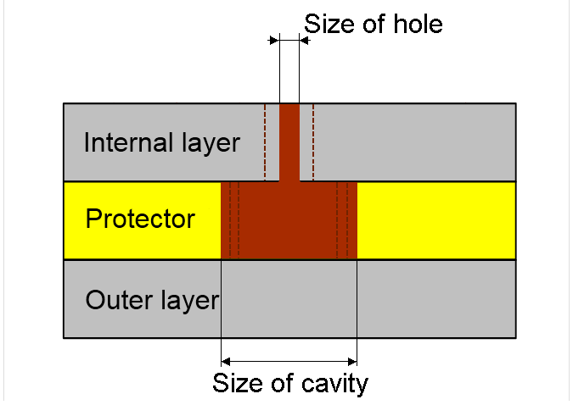
The quantitative measures
The growth rate of the cavity in different environments
The hole diameter impact on growth rate

Slide 14
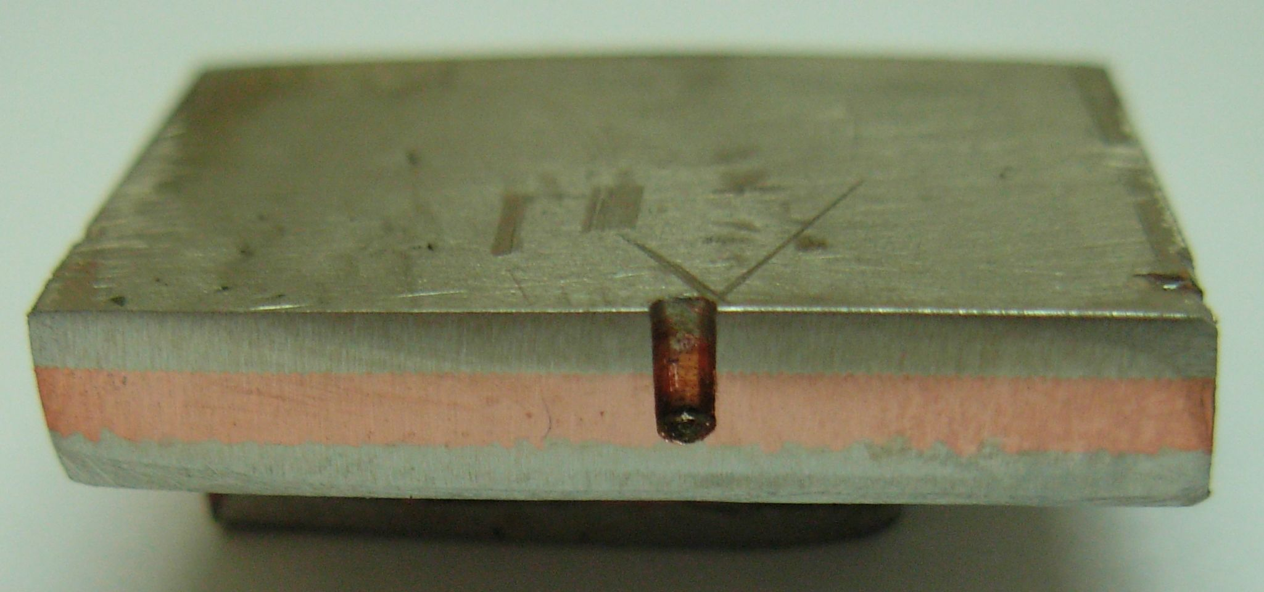
Stainless steel – copper - stainless steel
12Х18Н10Т – M1 – 12Х18Н10Т

Slide 15
The electrochemical test
The current test of short-circuited pair for different proportion between protector area and stainless steel area

Slide 16
Skolkovo Innovation Centre
Project «Multilayer corrosion-resistant and heat-resistant material development, its technology and metal product fabrication»
André Rozen

Slide 17
Skolkovo Innovation Centre
The benefits with regard to customs payments
The tax benefits
The access to the infrastructure of the Skolkovo Innovation Centre

Slide 18
PENZA STATE UNIVERSITY
metal@pnzgu.ru
THANK YOU ATTENTION

