Slide 1
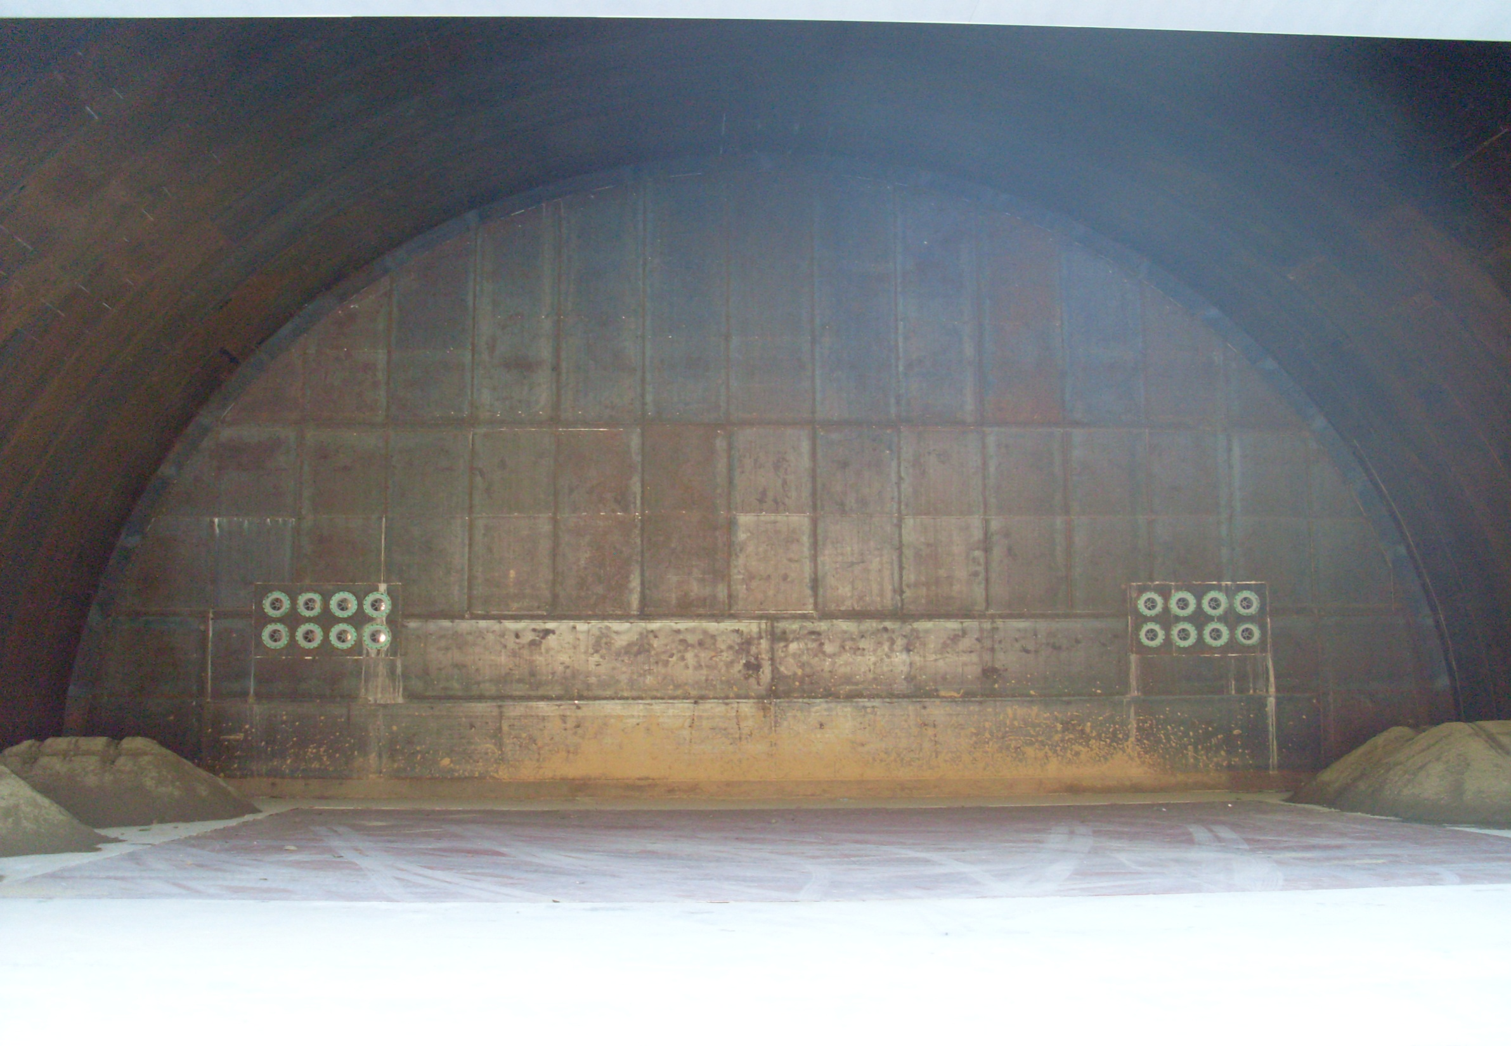
EPNM-2012
Attenuation of noise and vibration
in a giant explosion dome
Hyung-Tong MIN , Sung-Ho LEE
2012. 5. 5
Hanwha Corporation
South Korea

Slide 2
Lay-out
Blast loading characteristic
2. Design concept of Blast-proof structure
3. Blast loading simulation
4. Performance evaluation of structure
5. Blasting test with explosive cladding
6. Result of blasting test
7. Conclusions
Notes:
2

Slide 3
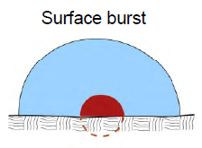
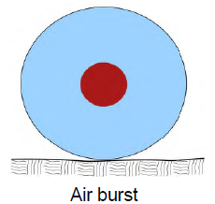
Blast loading characteristics
Blast loading categories
Blast loading categories
confinement ? | category | pressure loads
Unconfined Explosions | Free air burst Air burst Surface burst | Unreflected Reflected b. Reflected
Confined Explosions | 4. Fully vented | Internal shock Leakage
 | 5. Partially confined | Internal shock Internal gas d. Leakage
 | 6. Fully confined | Internal shock e. Internal gas
In case of explosion dome, pressure loads might be released to
internal shock, internal gas, and leakage.
Explosion dome is designed and built , considering the blast loading
characteristics at confined state.
Notes:
Partially confined explosion will be produced within a barrier type structure with limited size openings. The confinement of the detonation products,
which consist of the accumulation of high temperatures and gaseous products, is associated with a build-up of gas pressure.
This pressure has a long duration in comparison to that of the shock pressure.

Slide 4
Blast loading characteristics
Effect of blast loading at confined explosion
Noise Propagation
Internal Shock
Gas Pressure
Ground Shock
The confined explosion cause more damage than external free-air explosion,
and this damage depends on the geometrical parameters of the space
where the explosion occurs. (dimension, charge location, opening size, etc.)
Notes:
4

Slide 5
Design concept of blast-proof structure
Scope of Structural Design
1) Design of Blast-proof structure ; aspect of structural stability
Design for structure can withstand shock wave, impulse, gas pressure is caused by internal explosion
Shape and style of structure
Support structure
Design of reinforced concrete
Design of blast-proof for utilities
2) Design of Noise-proof ; aspect of civil complaint
Mitigative design within permissible level for noise which is propagated from internal explosion
Design of reinforced concrete (sound reduction index)
Design of opening
Design of silencer
3) Design of vibration-isolation ; aspect of structural stability & civil complaint
Mitigative design for transient vibration of adjacent structures induced by ground shocks
Design of base for vibration-isolation
Design of isolator specification
Notes:
5

Slide 6
Blast loading simulation
Analytical method and condition
1) Analytical method
Simulation using FSI (Fluid-Structure Interaction) analytical method of LS-DYNA code
Verification of blast-pressure measures which is generated by Explosion Cladding
Design Estimation of high-durable blast-proof facilities for Explosion Cladding
2) LS-DYNA code Option for blast loading simulation
EOS_JWL(charge) : detonation products of high explosives
MAT_HIGH_EXPLOSIVE_BURN(charge)
INITIAL_DETONATION
EOS_LINEAR POLYNOMIAL
EOS_GRUNEISEN
3) Maxium blasting conditions of internal structure
Charge weight : 570kgs of TNT equivalency
Explosion cladding size : 12m x 4m
Charge location : the center of inner structure
Explosive Modeling
Pressure for gas and materials
Notes:
EOS : equations of state parameters
EOS_JWL(charge) : detonation products of high explosives
EOS_LINEAR POLYNOMIAL : Define coefficients for linear polynomial EOS and initialize the initial thermodynamic state of the material
EOS_GRUNEISEN : Defines pressure for compressed material
MAT : Definition of constitutive constants for material models
MAT_HIGH_EXPLOSIVE_BURN(charge) : Modeling of the detonation of high explosive
INITIAL_DETONATION : Initiation of the location of high explosive detonation
INITIAL : Initial velocity and initial momentum for the structure

Slide 7
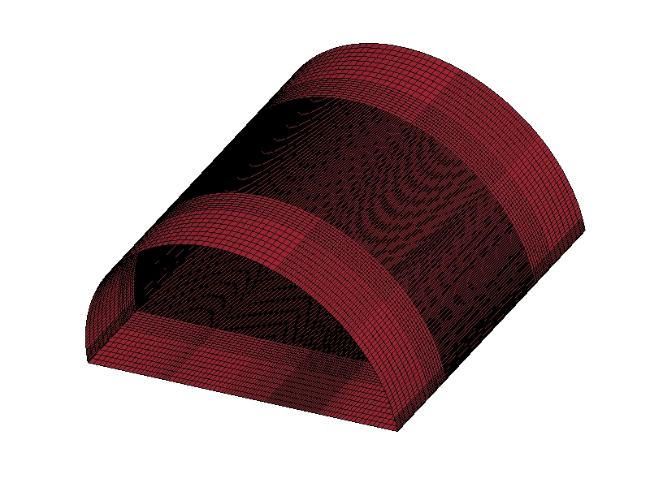
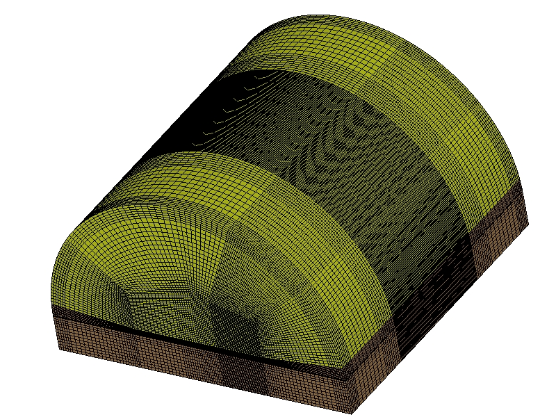
Blast loading simulation
1. Blast-proof analysis as Explosion cladding structure
1) Analytical model
External facing :
Reinforced Concrete THK 2,000mm
Interior finishing :
Steel Plate (SS400) THK 12mm
H m
h m
L m
W m

Slide 8
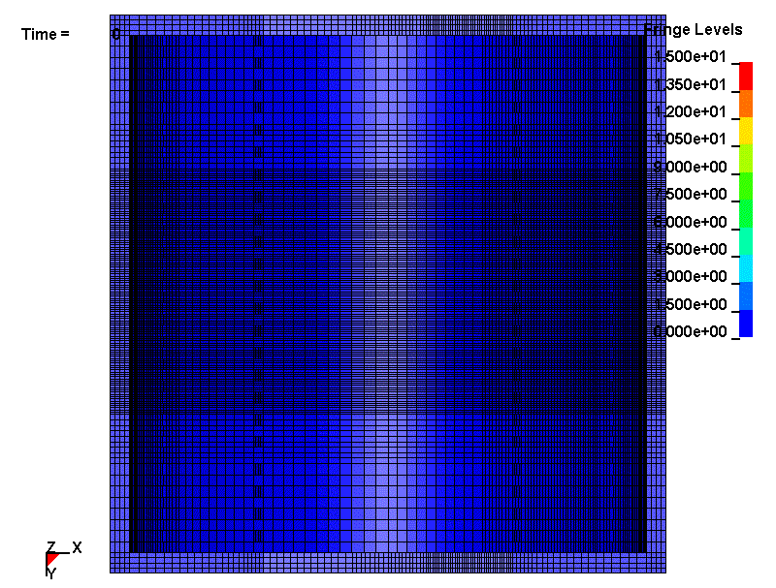
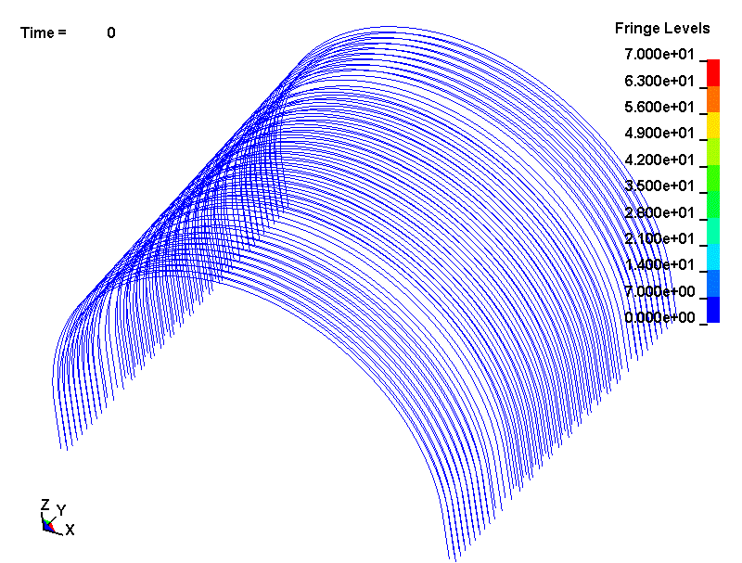
Blast loading simulation
2. Blast-proof analysis as Explosion cladding structure
Peak spot of deformation and stress response in the structure :
straight top on the blasting point
Stress response of concrete
Deformation response of reinforced bar

Slide 9
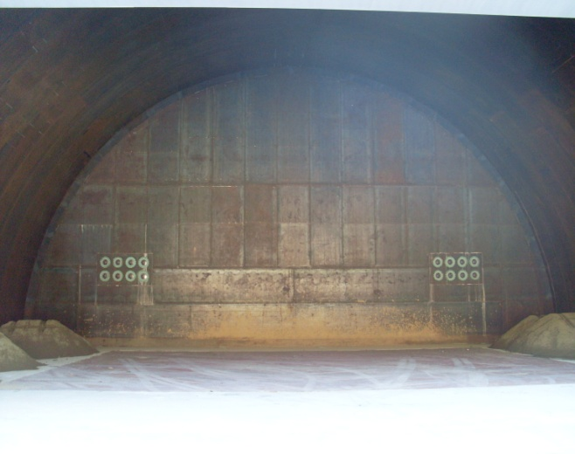
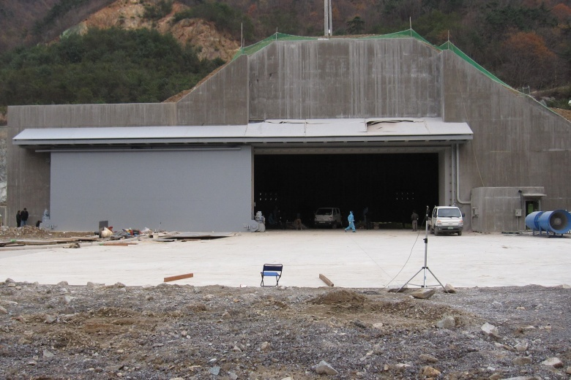
Performance Evaluation of structure
Introduction of measurement method
Purpose
Evaluation of DOME structure performance for blast-proof, noise-proof,
vibration-isolation after construction
Measurement points
Blast-pressure : 1 point of inner ceiling
Vibration : Each point of outer wall and inner bottom
Noise : fron t of structure and adjacent private house
Adjacent
Private house
Blast pressure
Vibration(horizontal)
Vibration(vertical)
Noise
Cladding Dome
<Noise measurement pt>
Notes:
9

Slide 10
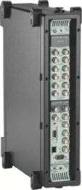
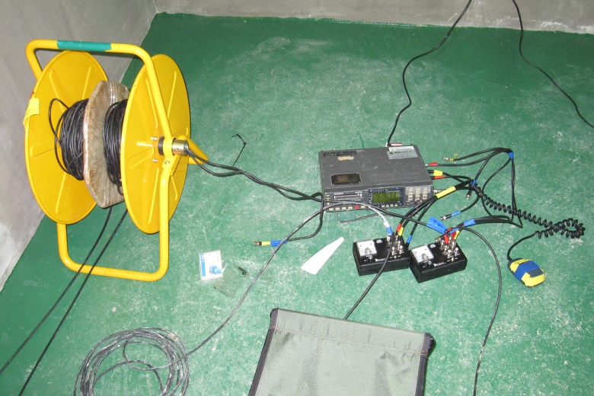
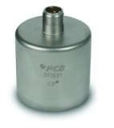
Performance Evaluation of structure
Measurement system Diagram
Field Work
Lab Work
Sensor Jig
Data Recorder
Analyzer H/W
Analyzer S/W
Explosion
Dynamic Pressure
Acceleration
Microphone
SONY PC208AX
B&k PULSE 3560C
B&k PULSE Labshop
Dynamic Pressure : PCB 106B
Acceleration : PCB 393B31
Microphone : GRAS 40AE or PCB
Analyzer S/W for Sound Level Meter
Sound Level Meter : Solo
(Standalone)
01dB dBFA
Notes:
10

Slide 11
Blasting test with explosive cladding
Explosive charge weight : 420 kgs
Notes:
11

Slide 12
Result of blast ing test
Result of blast-pressure, vibration, noise
Artificial Dome seems to be a structure integrity based on test result
as below.
All test values are satisfied with acceptance criteria.
Measurement items |  | Vibration |  |  |  |  |  | Blast-pressure | Noise(dBA)
 |  | Outer wall(horizontal) |  |  | Inner bottom(vertical) |  |  | Time Peak (psi) | Front Of structure | Adjacent Private house
Acceptance criteria |  | Max.40mm/s |  |  | 20~50mm/s |  |  | Max.303 | - | Max. 65dBA
Test Result | Charge weight | Peak |  | Overall | Peak |  | Overall
 |  | Freq. (Hz) | Value |  | Freq. (Hz) | Value
 | 123 kg | 18 | 7.9 | 27.9 | 38 | 1.3 | 4.6 | 87.6 | 100.2 | 58.0
 | 145 kg | 18 | 12.4 | 30.8 | 40 | 1.7 | 6.8 | - | 109.7 | -
 | 258 kg | 9 | 14.3 | 32.8 | 17 | 5.9 | 19.6 | 159 | 113.3 | 59.3
 | 336 kg | 10 | 16.5 | 36.5 | 29 | 6.9 | 24.3 | - | 115.6 | 53.6
 | 499 kg | 10 | 14.7 | 39.2 | 24 | 6.4 | 25.9 | 273 | 114.8 | 59.9
* Basis of acceptance criteria
Vibration : DIN 4150, Germany standard for short-teram vibration in sturucture
Noise : Korean local regulations for noise & vibration
Blast pressure : Permissible value estimated by UFC(US Unified facilities criteria)
Notes:
12

Slide 13
Conclusions
Explosion energy is a necessary evil for explosive cladding industry.
Explosion is an extremely rapid release of energy in the form of light,
heat, sound, shock wave, which are converted to vibration and noise
can be caused by a stream of civil complaints.
One of solution for these wicked problems is to block out an explosion
energy by artificial structure such as DOME.
Blast-proof performance of artificial DOME is generally satisfactory ,
because all test values of noise, vibration, blast-pressure are satisfied
with acceptance criteria of local regulation.
The internal core structure of Blast-proof door is an effective tool
to resist the blast wave propagation from explosion DOME.
Quality homogeneity of clad product has been much better due to
explosion DOME which can keep an uniform atmospheric condition.

Slide 14
6. 방음 설계

