Slide 1
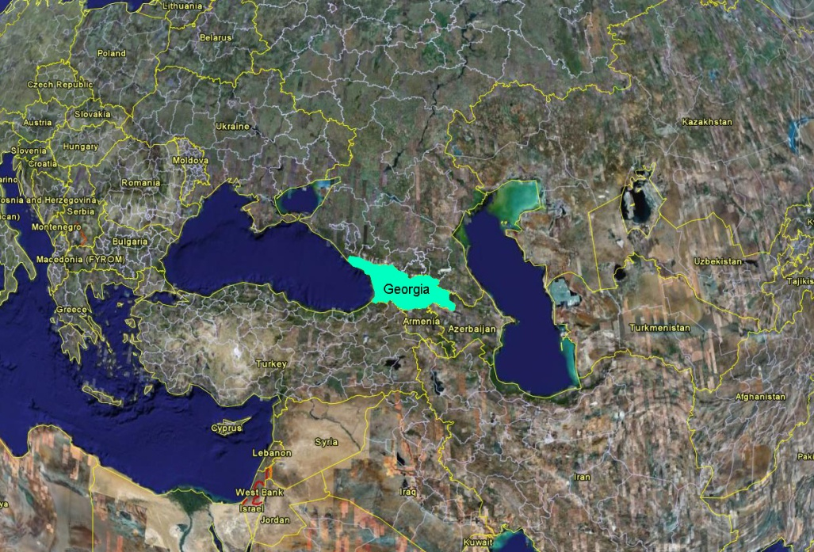
HOT SHOCK-WAVE FABRICATION OF
NANOSTRUCTURED Cu-W COMPOSITES
A.B.Peikrishvili, D.Lesuer, E.Sh.Chagelishvili, G.I.Mamniashvili, M.V.Tsiklauri and Bagrat Godibadze.*
G.Tsulukidze Mining Institute
Tbilisi 0186, Georgia. May 3, 2012
www.mining.org.ge Strasbourg, France.

Slide 2
Outline
*Nano Materials, Conventional Technologies, Properties and areas of application;
* Research Goals and Ways of Implementation;
* Explosive Compaction Technology;
* Experiment Techniques, Research methods;
* Conclusions;

Slide 3
Main Goals :
* Preparing experimental and measurement devices and predensification Cu-W nanostructural billets at room temperatures;
*Hot Explosive Consolidation (HEC) of nanostructural Cu-W composites;
* Determinate of optimal HEC temperature and parameters of compression providing obtaining High dense billets with correct geometry and perfect structure;
* HEC of nanostructural Cu-W precursors within different content of nanosized W phase (5-40%);
* Investigation structure/property relationship;
* Investigation of electronic properties (electric conductivity, susceptibility, mecanical properties) of HEC nanostructural Cu-W composites in dependence of phase content and parameters of fabrication;
* Determination of optimal parameters of fabrication (pressure, temperature, predensity) for best combination of electronic properties of HEC billets.

Slide 4
Powders Classification
Tungsten Powder (W) - With nominal grain size 99,9% 40÷60 nm. and 2÷6µm.
Copper Powder (Cu) - Nominal grain size 15-20mkm
Investigation of Cu-(5÷40)%W Composition were consolidated to near theoretical density between 800 -1000 °C. The shock wave loading intensity was under 10GPa; Investigation showed that application nanoscale W phase in Cu-W composition in contrast to conventional micron size compositions has big advantages and allows to obtain billets with improved electronic properties.

Slide 5
Explosives Materials for HEC experiments
Explosive Material ; Chemical content; | Density - 10³кg/m³ | Detonation rate, V, m /s | Heat of explosion Kkal/kg
Igdanit(ANFO) NH4NO3+5-6%Diesel fuel | 1.0-1.1 | 2200-2800
Granulate (AC-4) NH4NO3+4.2%Diesel fuel+4%Al | 1.1-1.3 | 2600-3200 | 1080

Slide 6
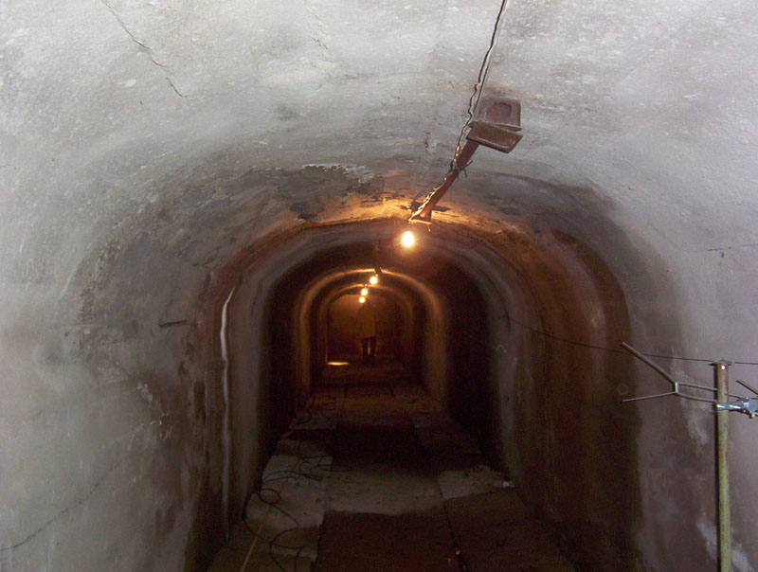
Infrastructure for EC experiments
* System of tunnels in the length 255 m;
* Observational station -600 m²;
* Explosive chamber in volume 1500 m³;
*Ventilating system, water-supply;
*Reserved explosive chamber;
*Equipment for explosive treatment of materials in at elevated temperatures (compaction,hardening,welding);

Slide 7
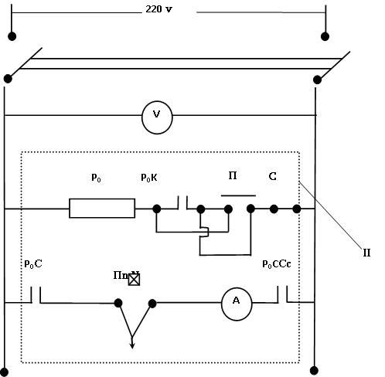
Hot Explosive Consolidation
_{PoC}
Electrical Scheme.
Basic part of the Heater equipment is a cylindrical form Stove, it can heat up the samples (dimensions: L = 300mm, D = 50mm), Process of warming up is carried out using of 220 Volts AC, 50 Hz.

Slide 8
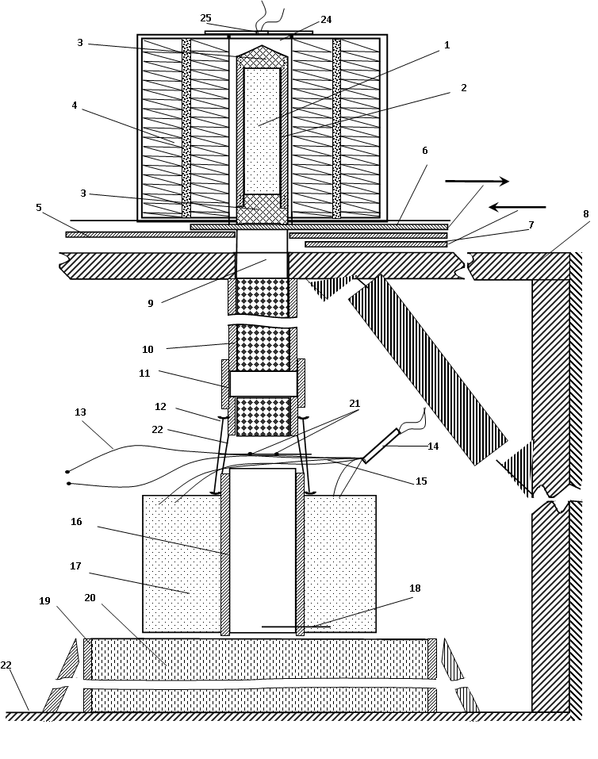
Mechanical Part
1 - precursor powders;
2 - The cylindrical steel tube container;
3 - Cork of the steel tube.
4 - Ni-Cr spiral of El. Scheme;
5 - LEADING (canal of the Stove of “open and
close”)
6 - Open shield of the stove;
7 - Close of shield of the stove;
8 - Basic constructive part of equipment;
9 - Pass canal of specimen;
10 -The leading tube for cylindrical container
(specimen);
11 - rubber and steel tubes connected with
endings;
12 - Accessory for fixing explosive charge;
13 - The circle of fixing of feeding of sample;
14 - electric detonator;
15 - Cord (string) for detonation.
16 - Compressing (flying) tube;
17 - Explosive material;
18 - The lowest level (limit) of feeding of
container (sample);
19 - The container of fixing delivered cylindrical
sample;
20 - Invert powder – sand.

Slide 9
Experimental set up for HEC of cylindrical billets explosive charge
1- The lowest level (limit) of feeding of container (sample)
2 and 4 - Cork of the steel tube;
3- The cylindrical steel
tube container;
5 - precursor powders;
6 - Compressing (flying) steel tube & Thermal insulator;
7 - Explosive material.

Slide 10
Experimental set up for HEC of cylindrical billets explosive charge
1-Lowest level of steel container;
2-The cylindrical carton tube container;
3-Explosive materials;
4-Flying steel tube for HEC & Thermal insulator;
5- Detonating cord;
6-Accessory for fixing explosive charge;

Slide 11
Compacted Samples at the Room Temperature

Slide 12
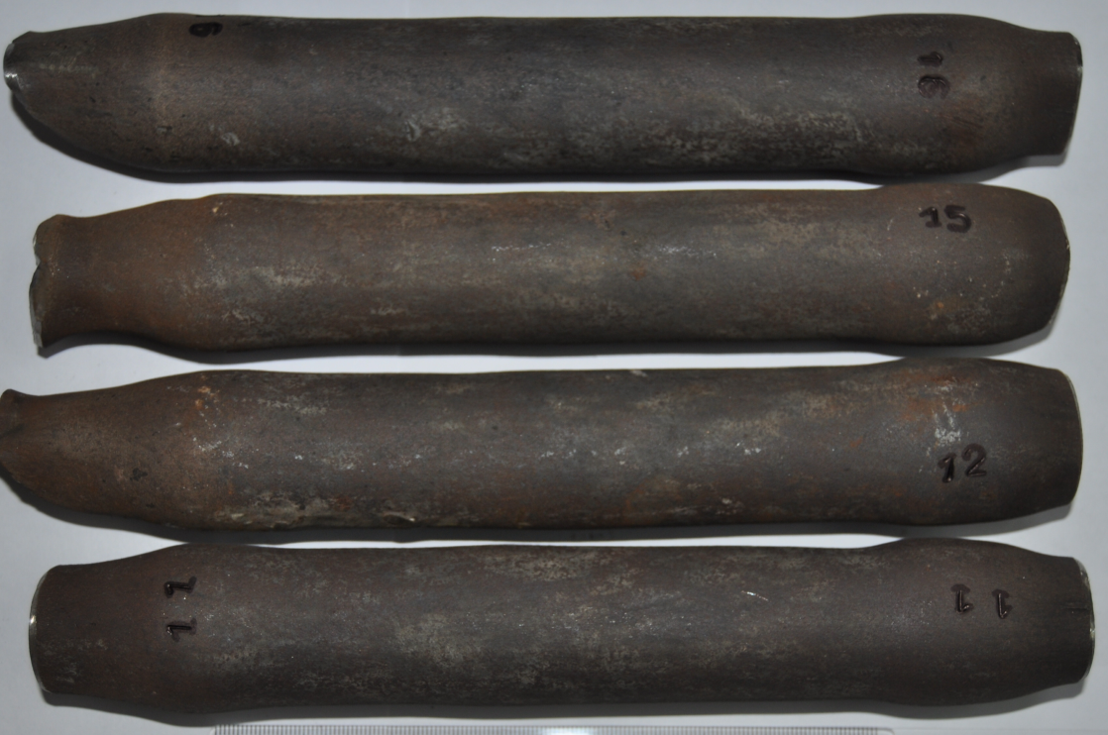
Compacted Samples by HEC

Slide 13
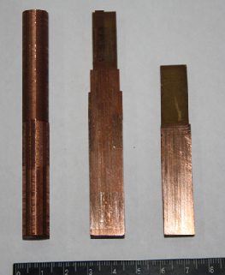
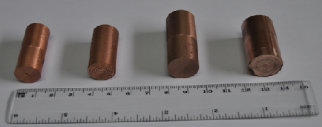
Compacted Cu-W composites After mechanical processing

Slide 14
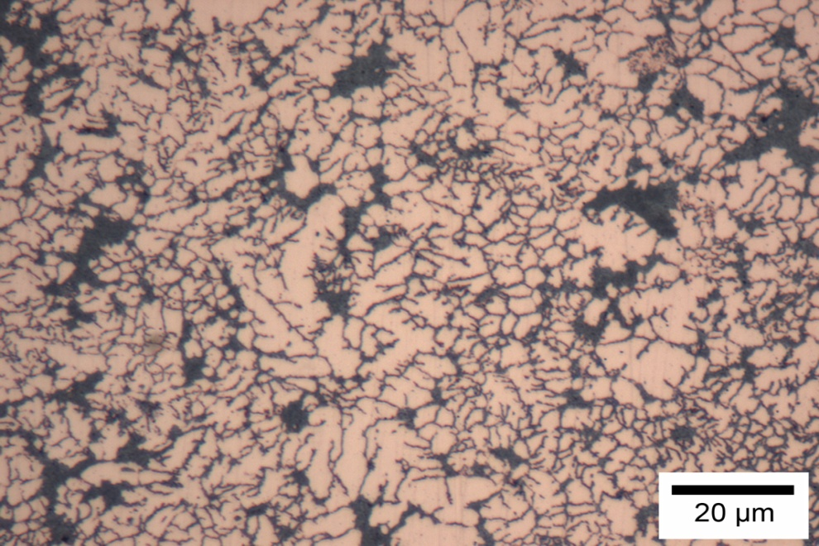
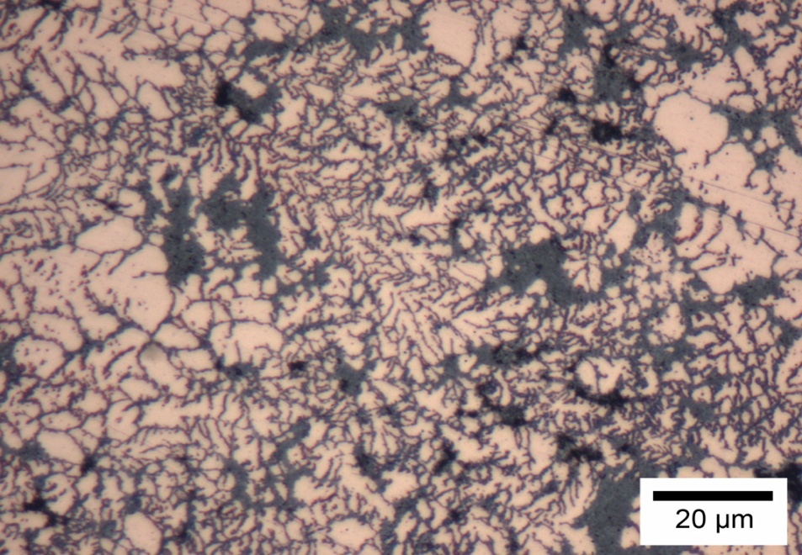
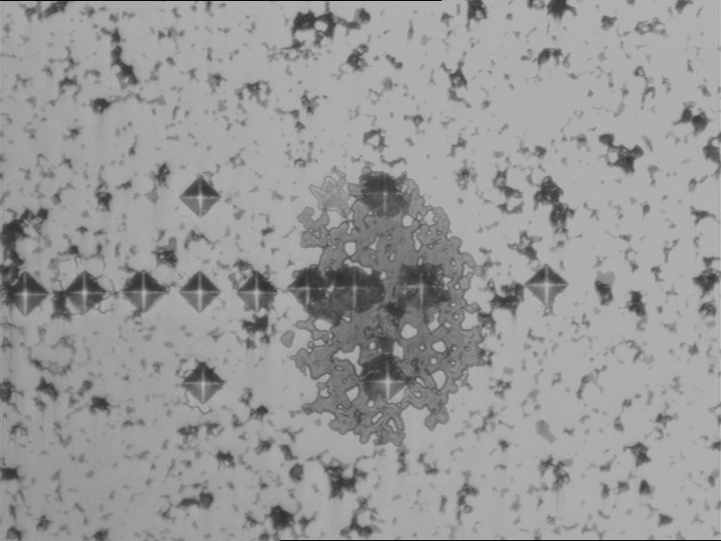
Structural and Micro-Hardness Investigations

Slide 15
Micro-hardness distribution of HEC composites Depending from the W content
№ | HEC Cu-W composition Consolidated at T=900 °C; P=5GPa; W=40÷60nm. | Micro hardness HV kg/mm² ; P=20gr.
1 | Cu - 5% W | 114
2 | Cu - 10% W | 107
3 | Cu - 15% W | 125
4 | Cu - 20% W | 114
5 | Cu - 25% W | 118
6 | Cu - 30% W | 120
7 | Cu - 35% W | 116
8 | Cu - 40% W | 126

Slide 16
Micro hardness distributions of the Cu -(20%)W composite samples The nanometer and micrometer sized W; □ - nanosized composite; O - micro sized composite;

Slide 17
Microstructural Investigations

Slide 18
Microstructural Investigations

Slide 19
Elastic properties and relaxation phenomena in W-Cu composites

Slide 20
Temperature dependences of internal friction (Q⁻¹) and Young modulus (Е) of W(5%)-Cu(95%) composite

Slide 21
Electronic properties study (electrical resistance) of pure and copper samples (thickness, correspondingly, 0.3 mm and 1 mm, Q⁻¹(T) and E(T) curves of pure Copper.

Slide 22
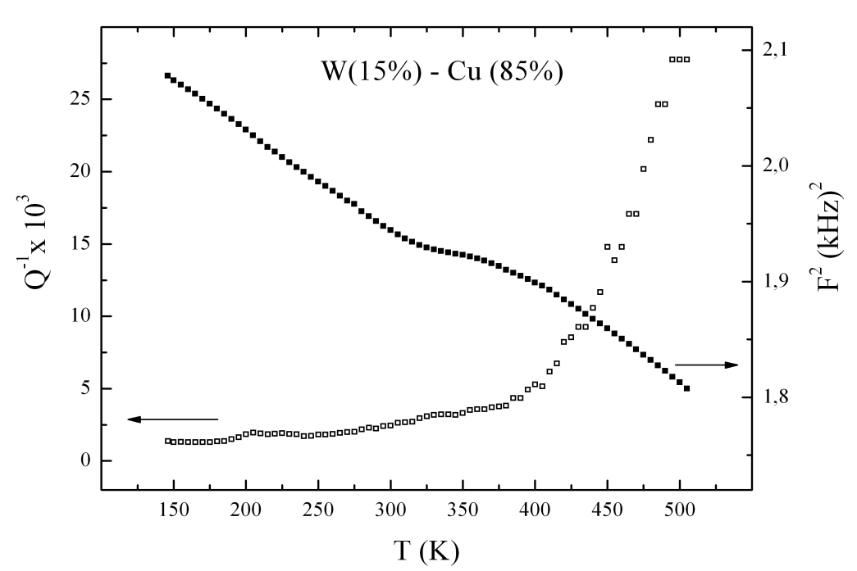
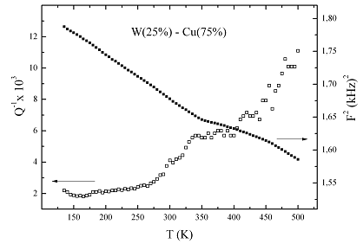
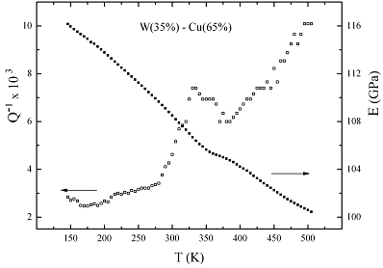
Similar dependences for Cu-10%W, Cu-15%W, Cu-25%W, Cu-35%W composites

Slide 23
Resistance measurements of Cu-W nanocomposites a) Specific electrical resistance of pure copper; 1- W10%, ; 2- pure copper, ; 3. Cu from literature data (A. Kikoin (ed.), Tables of Physical Quantities ; b) Specific electrical resistance copper foil.

Slide 24
CONCLUSIONS
On the basis of obtained results one could make following previous conclusions:
Composite porosity. The previous calculation of the composite porosity point to its lower value as compared with theoretical one. In the worst case porosity was not more then 2.6 %.
2. Influence of compaction temperature difference.
3. Dependence on tungsten nano powder concentration;
4. Influence of annealing mode;

Slide 25
Thank you for Your Attention
Questions

